Slide 1
GSNorCal Daisy Virtual Meeting Resource Packet

Slide 2
1. Virtual Troop Meeting FAQ, VTK, Zoom and other virtual resources 2. Girl Scout Traditions 3. Ice breakers 4. Virtual Activities 5. Scavenger Hunt 5. Girl Scout Songs 6. Letters to Daisies 7. Virtual Meeting templates and images
Table of Content
Slides 3-5 Slides 6-13 Slides 14-33 Slides 34-53 Slides 54-60 Slides 61-72 Slides 73-77 Slides 78-100
Notes:
(add welcome)

Slide 3
Virtual Troop Meeting FAQ, VTK, Zoom and other virtual resources

Slide 4
- General Virtual Troop Meeting Resources - General Daisy Resources - Friendly and Helpful Petal Resources
Click on ‘Notes’ in the lower ribbon below to learn more about:
Notes:
These links are listed in the Notes of the slides where they are applicable. They are compiled here if you need to find all of them in one place.
Virtual Troop Leading Resources:
Here is a "Wheel of Names" tool that you can edit and use to assign Kapers or pick a girl at random for any reason—maybe to share first for an activity, or pick a song for the group to sing, etc. https://wheelofnames.com/?fbclid=IwAR3B_y1iUK-VdEV0EMO6bpU653xTivfnrcvKS1o_y5eb98lqlqib6cwiG4E
Link to virtual Ice Breakers: (Pre-made icebreaker slides at end of this presentation) https://www.girlscouts.org/en/girl-scouts-at-home/troop-leaders/digital-icebreakers-games.html
Girl Scout Internet Safety Pledge: https://www.gsnorcal.org/content/dam/girlscouts-gsnorcal/documents/volunteer_resources/risk/internet-safety-pledge.pdf
General Daisy Resources:
Link to Your Daisy Petals and Leaves (Badges) in GS Volunteer Toolkit PDF:
http://vtkdemo.girlscouts.org/content/dam/girlscouts-vtk/meeting-aids/Daisy-Petals.pdf
All Daisy Badges and Journeys (except brand new ones) PDF:
https://www.girlscouts.org/content/dam/girlscouts-gsusa/forms-and-documents/our-program/Badges/GSUSA_DaisyBadgesAwardsAndPins2019_Guide.pdf
Badge Explorer (with badge requirements, interactive): https://www.girlscouts.org/en/our-program/badges/badge_explorer.html
Link to Daisy Promise and Law worksheet in GS Volunteer Toolkit PDF:
http://vtkdemo.girlscouts.org/content/dam/girlscouts-vtk/meeting-aids/Daisy-Promise-and-Law.pdf
Girl Scout Law Song video made by older Girl Scouts. Challenge the girls to watch the video at home and practice the song.
https://www.youtube.com/watch?v=6dF8dUi37x8&t=1s (start the video 30 seconds in, after they finish singing the song once, stop the video)
Daisy Intro Meeting in Volunteer Toolkit: http://vtkdemo.girlscouts.org/content/girlscouts-vtk/en/vtk.details.html?elem=189320400000
Friendly and Helpful Petal (Sunny) Resources:
Sunny's Story in PDF form:
https://my.girlscouts.org/content/dam/girlscouts-vtk/local/aid/meetings/D14DP04/Sunnys-Story.pdf
(You can make the PDF full screen and then "share screen" over zoom so girls can see the pages as you read the story to them)
Sunny’s Story (read aloud) YouTube link:
https://www.youtube.com/watch?v=Y2uopZwglBw&feature=youtu.be
GSUSA Sunny story and petal activities (mural and discussing) 8 minutes:
https://www.girlscouts.org/en/girl-scouts-at-home/activities-for-girls/daisies/daisy-sunny-petal-badge-activity.html
Video made by GS Virgina Skyline on making a mural for Sunny’s story—can use as part of your meeting or for inspiration (17 minutes):
https://www.youtube.com/watch?v=Ls5InHewAoQ&list=PLPrEwDw9DOl-mS2AI7pawC4EsL7eaEQeF&index=2

Slide 5
Zoom and VTK Tips
Volunteer Toolkit (VTK) includes:
Content to plan any badge!
Video Tutorials on adding badges to year plan and more
Link to Badge Explorer to check requirements for each badge
Zoom How to:
Make sure to disable annotations when you share your screen
Share a video
Create a poll
*Click ‘Notes’ in the lower bar to access Zoom and VTK ‘How to’
Notes:
Volunteer Toolkit (for leaders and parents):
General Volunteer Toolkit Link: https://www.gsnorcal.org/en/for-volunteers/volunteer-toolkit.html
Video tutorials (quick and easy!):
How to Set Up Your Year Plan https://www.youtube.com/watch?v=n0nrh4NJBFk&list=PLZaWZO965rJ2_OmlsOCwnzUe0xkhTBhrG&index=1
Meeting Plan Overview https://www.youtube.com/watch?v=AHw9W6YyOPU&list=PLZaWZO965rJ2_OmlsOCwnzUe0xkhTBhrG&index=2
Setting Meeting Dates and Locations https://www.youtube.com/watch?v=R_nGzg4Ux3w&list=PLZaWZO965rJ2_OmlsOCwnzUe0xkhTBhrG&index=3
Customizing Your Year Plan https://www.youtube.com/watch?v=uTdSFjJcFu0&list=PLZaWZO965rJ2_OmlsOCwnzUe0xkhTBhrG&index=4
Badge Explorer (with badge requirements): https://www.girlscouts.org/en/our-program/badges/badge_explorer.html
Zoom:
General: It can be easier/smoother to use two computer monitors if you have access.
How to disable annotations: This can only be done while the host is sharing their screen. To set it up beforehand, open a zoom meeting and select share screen. Once sharing right click on the three dots/More on the right side of the menu bar. Click "disable participants annotation" When you start the next meeting, this setting should remain saved, but it's good to check when you start sharing your screen during the meeting. If your girls know not to annotate inappropriately, then there is no need to disable this feature and you may choose to use it as part of your meeting—maybe your troop can create a picture together on the screen.
How to share a video: Only a host or co-host can share a screen. Select "Share Screen" and click on the window with the video. Make sure to check the boxes in the bottom left corner that say "Share Computer Sound" and "Optimize for Video Sharing" and then click "share." Make sure there are no "zoom" boxes over the video screen such as the chat, participants list, or control panel. This will appear to participants as a gray box blocking the screen. If you are experienced with Zoom, some of these settings can be changed in Zoom settings: https://zoom.us/
How to see girls' videos while you are screen sharing: While screen sharing, go to the menu bar and click on the three dots/More on the right hand side. Select "View Participant Videos"
How to Poll: When you start the meeting, click Polls on the menu bar. This will take you to a browser window where you can give the Poll a title, question, and possible answers. When you are done you can click the Polls button on the menu again and your poll will show up. You can click Launch Poll to start polling the girls. You can end polling and relaunch at anytime. You can also add additional poll questions. (If you don't see the Polls menu, try making your Zoom window full screen or by clicking the More tab on the menu bar)

Slide 6
Girl Scout Traditions

Slide 7
Kaper Chart
Katara Waterbender
Supply
Checker
Junie B. Jones
Song Leader
Kaper
Chart
Ramona Quimby
Promise Leader
Matilda Wormwood
Hermione Granger
Clean up Captain
Katniss Everdeen
Lucy Pevensie
Friendship
Squeeze Starter
Joke
Teller
Dora Explora
Reporter
Dorothy Gale
Annie Warbucks
Notes:
Here is a "Wheel of Names" tool that you can edit and use to assign Kapers or pick a girl at random for any reason—maybe to share first for an activity, or pick a song for the group to sing, etc.
https://wheelofnames.com/?fbclid=IwAR3B_y1iUK-VdEV0EMO6bpU653xTivfnrcvKS1o_y5eb98lqlqib6cwiG4E
Please edit this slide with the girls’ names in your troop. There are extra name boxes beside the slide. You may not want to have all of these roles. To delete a role, click on the box where the job is listed and delete the text. Or you can drag text boxes off the slide and they will not be visible while presenting.
Possible jobs with descriptions:
Promise Leader: Leads the group is saying the GS Promise. The girl starts the Promise "On my honor.." and the rest of the girls join in.
Reporter: Reports back to the group a summary of what we did at the previous meeting.
Clean up Captain: After snack or craft, leads the group and encourages them to clean up their surroundings. "A Girl Scout always leaves a place cleaner than she found it"
Supply Checker: Reminds other scouts of the supplies needed for that meeting in the beginning. Check to make sure everyone has everything they need and helps to come up with alternatives if missing supplies.
Song Leader: Starts the song for the group or leads the song in repeat after me.
Joke Teller: Brings 1 or 2 jokes to the meeting to share with the troop
Friendship Squeeze Starter: Once girls are crossing their arms, she tells the girls to close their eyes and make a wish and squeeze once.
For next week, you can copy this slide and drag it down to near the beginning of next meeting. Right click, select “Duplicate Slide”, then click and hold the new slide to drag it.

Slide 8
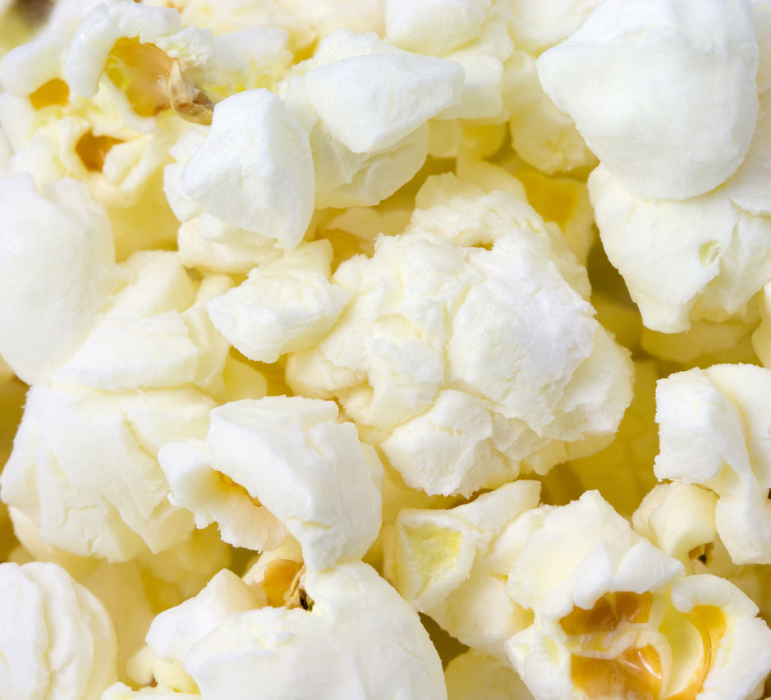
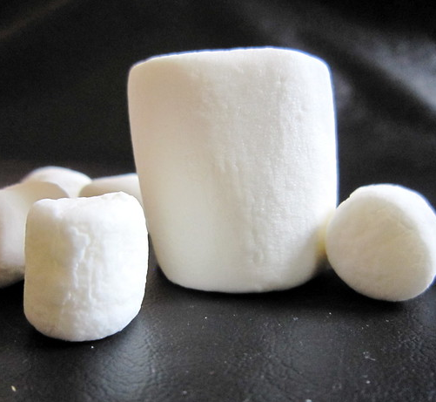
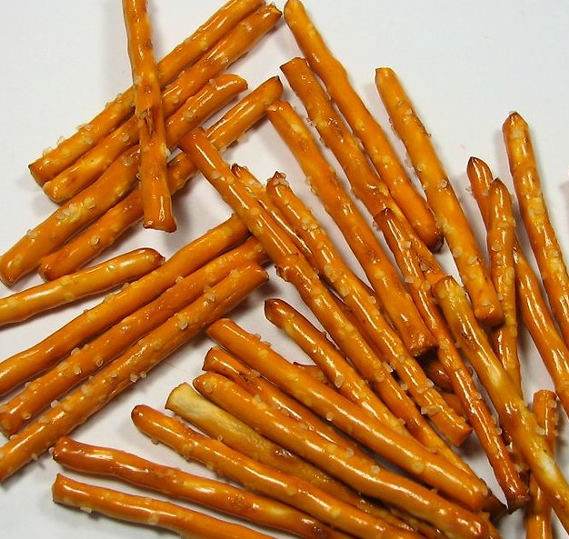
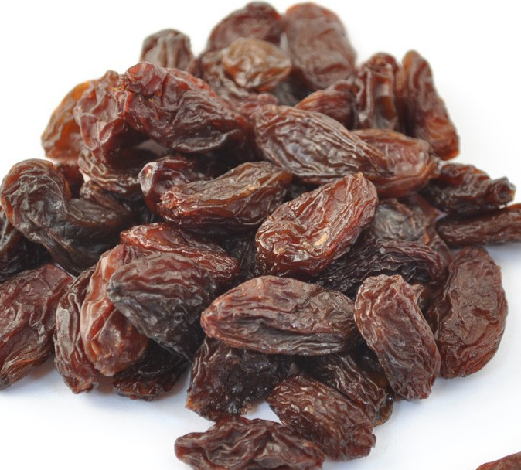
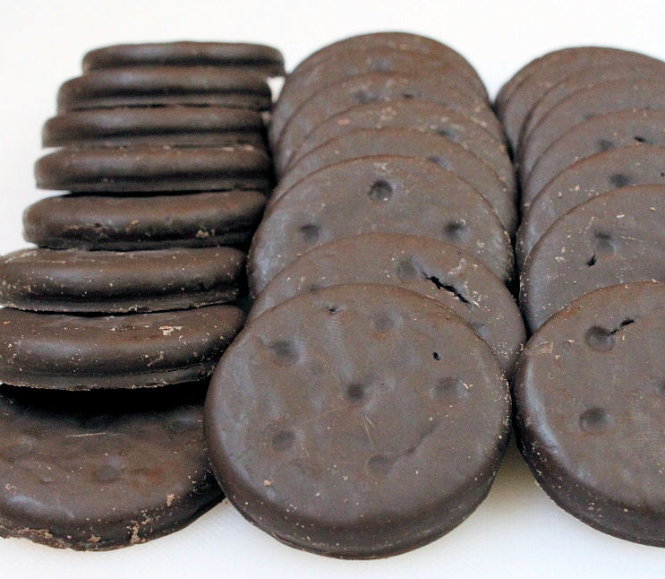
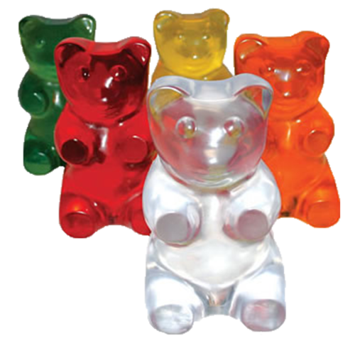
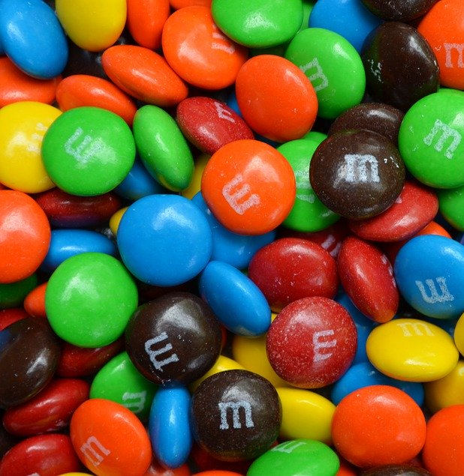
Rededication Scavenger Hunt!!
Get a bowl
And then add as many of these food items as you can find!!
CHEX CEREAL
POPCORN
MARSHMALLOWS
CHEERIOS
PRETZEL STICKS
RAISINS
THIN MINTS
GOLDFISH
GUMMI BEARS
M&M's
Notes:
Leader: Today we are going to do a Rededication Ceremony.” That is a fancy way of saying we are going to reflect on why we are in Girl Scouts. This ceremony is an important Girl Scout tradition as it is also when we all commit to being a Girl Scout again.
Today, for our ceremony, we will use the items you found during our scavenger hunt to build a snack to nourish our bodies to symbolize how Girl Scouting nourishes our spirits. Each ingredient of our snack represents one of the “ingredients” of the Girl Scout Law. We pledge to uphold this law because we know it will make us better people and help us make the world a better place.
When I read each statement, I want you to hold up that ingredient to the screen so that we can see it. If you don’t have that ingredient, that’s ok because we’re all at our homes and we have different ingredients in our kitchens. If you have the ingredient I call out, put a small bit of it into your bowl.
CHEX MIX SQUARE - “honest and fair” is the first part of the Girl Scout Law. Let’s remember to be fair and square by adding CHEX to our snack.
POPCORN - “friendly and helpful” We “pop” with enthusiasm when we lend a helping hand. So, let’s add POPCORN to show that we are “friendly and helpful.”
MARSHMALLOWS – “considerate and caring” Sometimes, we show that we are “considerate and caring” by giving a squishy-squeezy hug to a friend when they are sad or just to say “hi.” Let’s add MARSHMALLOWS to represent hugs for our friends.
CHEERIOS- “courageous and strong” As a troop, we have a strong circle of friendship that we can count to help all of us be “courageous and strong.” Let’s add CHEERIOS to represent that strong circle.
PRETZELS- “responsible for what I say and do” this pretzel looks like a capital “I”, and represent that “I” am responsible for doing what’s right. Let’s add pretzels to represent “responsible for what I say and do.”
RAISINS - “respect myself and others” I can respect myself be eating foods that are health good for me. RAISINS are a good source of iron, potassium, and other nutrients; so let’s add raisins as a reminder to take care of our bodies.
THIN MINT COOKIES – “respect authority” By selling Girl Scout cookies, we are helping support the Girl Scouts raise money to support girls over the whole nation. By adding THIN MINTS to our mix, we “respect authority” by supporting our organization in raising funds and following Product Sale rules.
GOLDFISH- “use resources wisely” We should always remember to “use resources wisely” in order to take care of our planet and all living things. We will add GOLDFISH to remind us to take care of the earth and use resources wisely.
GUMMI BEARS “make the world a better place” Look at these cute bears!! To represent the community service and conservation projects that we do, let’s add GUMMI BEARS to the mix to represent the endangered animals that we want to help.
M&M’s “be a sister to every Girl Scout” Girl Scouts come from all over the world. No matter what she looks like on the outside or what language she speaks or where she lives, she is our sister, we are all the same on the inside, just like M&M’s.
Now, we have a big mix all these yummy treats, and just like each ingredient on its own is wonderful, mixed together it is AMAZING, just like how your next year in Girl Scouts will be!

Slide 9
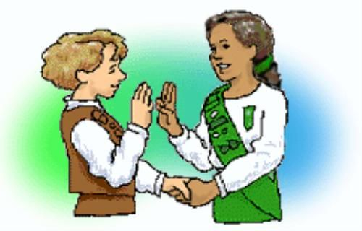
Girl Scout Handshake
Notes:
Greeting: Girl Scouts can greet one another with the Girl Scout handshake, used by Girl Scouts and Girl Guides all over the world. The handshake is made by shaking hands with the left hand and making the Girl Scout sign with the right. The left hand is nearest to the heart and signifies friendship.

Slide 10
Do you know the Girl Scout slogan?
"Do a good turn daily“
The Girl Scout slogan, which has been used since 1912, is "Do a good turn daily." The slogan is a reminder of the many ways girls can contribute positively to the lives of others.
Notes:
Slogan:

Slide 11
Do you know the Girl Scout Motto?
Be prepared
The Girl Scout motto is "Be prepared." In the 1947 Girl Scout Handbook, the motto was explained this way: "A Girl Scout is ready to help out wherever she is needed. Willingness to serve is not enough; you must know how to do the job well, even in an emergency." The same holds true today.
Notes:
Motto:

Slide 12
Juliette Gordon Low's Birthday Party
Juliette Gordon Low's Birthday/Girl Scout Founder's Day - October 31
Ways to Celebrate Juliette Low's birthday:
https://trailhead.gsnorcal.org/ways-to-celebrate-juliette-gordon-lows-birthday/

Slide 13
Girl Scout Traditions: SWAPS
Girl Scouts often make small tokens of friendship to exchange with the Girl Scouts they meet while traveling. These little gifts are called ”SWAPS,” which stands for “Special Whatchamacallits Affectionately Pinned Somewhere.”
More about SWAPS:
https://www.girlscoutsp2p.org/content/dam/girlscouts-girlscoutsp2p/documents/SWAPS.pdf

Slide 14
Ice breakers
The following slides have Ice Breakers you can use with your troop. Duplicate the slide you want and drag it up to where you want to use it.

Slide 15
Ice Breaker: The Wind Blows
For someone whose name starts with letter ‘N’
For someone who has long hair
For someone who had ice-cream for lunch
For someone who went for a walk this week
For someone who is celebrating her birthday this month
For someone who is wearing a Daisy vest/ sash

Slide 16
Ice Breaker
Show and Tell
Ask the girls to share something of theirs with the troop. Consider giving them a theme or a question. For example, “Show us something you’ve had since you were a baby” or “Show us something you can’t go a day without.”

Slide 17
Ice Breaker
Where Are You?
Ask girls to give you a brief virtual tour of their space. What’s one thing they love about the room they are in? What’s one thing they wish they could change?

Slide 18
Ice Breaker
Virtual I-Spy
Ask the girls to pick one spot and stay in that spot for the entire icebreaker. Then, have the girls take turns looking at the screens and seeing what they can find in each other's backgrounds!
Notes:
Virtual ‘I Spy’

Slide 19
Ice Breaker
Two truths and a fib
Give this well-known icebreaker a virtual spin! Ask the girls a specific question (“What are some places you have visited?” Or “What don’t we already know about you?”) and ask them to pick three answers—two that are true and one that’s not. But, when it’s not true, they have to make a subtle gesture or change in their tone of voice. Then, see if the other girls can guess which answers are true.
Notes:
Two Truths and a Fib

Slide 20
Ice Breaker
If I could, then I would
Ask girls to complete each part of the sentence “If only I could____, then I would _____.” Remind them that it can be something true or just something silly. It is completely up to them!
Notes:
If Only I Could… Then I Would...

Slide 21
Ice Breaker
Question of the day
Pick a different question for each meeting and ask the girls to answer it in just one or two sentences. The question can tie into something going on in their lives, badge activities you will complete during the meeting, or just something silly!
Notes:
Question of The Day

Slide 22
Ice Breaker
What’s your emoji today?
Instead of asking the girls how they’re feeling, ask them to take turns making the emoji face that matches how they are feeling. Then, give the rest of the troop a few minutes to guess the emotion before asking the girl to share how she is feeling. This icebreaker is a great way to check in on everyone while turning it into a game for the girls.
Notes:
What's Your Emoji Today?

Slide 23
Ice Breaker
Big questions:
• Do you want to stay the same age forever? If yes, what age would that be?
• What is your favorite possession?
• If you could have one superpower, which one would you choose?
• Are you a morning bird or a night owl?
• Which season is your favorite? Why?
• What item or gadget are you currently dreaming of buying?
• Would you prefer to go to the mountains or the beach?
• If you could live anywhere on this planet, where would you live?
• What is the most memorable vacation you have ever taken?
• What is your favorite food?
• Which historical figure would you want to meet?
• Who has been the most influential person in your life?
• Where do you see yourself in 10 years?
• Juliette Gordon Low left Girl Scouts a wonderful legacy. What do you want your legacy to be?
• What is one of your biggest goals in life?

Slide 24
Ice Breaker
What is unique about me?
This ice-breaker will take a little coordinating with parents of girls before the meeting. Ask each parent to share one unique thing about their daughter. This could be anything from their hobbies to favorite toys. Then, set up a quiz. In the meeting, you can describe one of the girls and everyone has to try to guess who that girl is. This is a great time to talk about how everyone is unique and how important it is to respect each other.

Slide 25
Ice Breaker
What is your favorite song?
This ice-breaker will take a little coordination before the meeting. Have every girl send you their favorite song. Find the music video that goes with each song. During the meeting, play part of the video. Pause it and ask girls to guess whose favorite song it is. Continue this through the year as you go through all the girls in the troop. Or, do this activity, if you can, every time you meet.
Notes:
What is Your Favorite Song?

Slide 26
Ice Breaker
Write a meme (for Brownies+)
Have the girls send you a funny picture of themselves, of their pet, of something in house, etc. before the meeting. At the meeting, bring up one of the pictures. Everyone will write in chat a funny meme that should go with the picture. You can show a few examples of what a Meme is. After everyone comes up with a meme, have them vote for the funniest. Save the winner and if you can, add a title to the meme. You could add captions to the meme and show the girls the finished Memes next time.
Notes:
Write a Meme (for Brownies and up)

Slide 27
Ice Breaker
Would you rather
This is more for laughs and conversation. Don’t waste time coming up with them yourself. This website has 100s to choose from.
Notes:
Would you rather questions

Slide 28
Ice Breaker
Pictionary
If you are meeting with Zoom, use the whiteboard feature:
How to play: Put everyone on call into two teams. To play, divide your group into teams. Choose the team to go first and either have one girl on team come up with a word for her team to guess or use this easy to use Pictionary word generator. Then, give the drawer one minute to draw that word for their team to guess. If the team guesses the card correctly, they get a point. Choose how long you will play or to what point level to find a winner.

Slide 29
Ice Breaker
Freeze dance
Most girls love dancing. Add one of these active YouTube videos to your next virtual meeting. It might be a great way to end the meeting or even break it up in middle of meeting.
The Dance Freeze Song
Tooty Ta

Slide 30
Icebreaker – The wind blows
For someone whose name starts with letter ‘N’
For someone who has long hair
For someone who had ice-cream for lunch
For someone who went for a walk this week
For someone who is celebrating her birthday in June
For someone who is wearing a Daisy vest/ sash

Slide 31
Ice Breaker
What did you do this week? Show it in action and let your friends guess.
Notes:
Let the girls take turns sharing answers the these questions.
About 3-4 minutes.

Slide 32
Ice Breaker
Get the wiggles out
Do yoga or have a dance party together.
Notes:
Get the wiggles out:

Slide 33
Ice Breaker
More Ince-breaker links:
https://www.girlscouts.org/en/girl-scouts-at-home/troop-leaders/digital-icebreakers-games.html

Slide 34
Virtual Activities

Slide 35
Virtual Activity
Virtual trip to the zoo
You may not be able to go to the zoo but many zoos offer live footage of their zoo animals. Take your girls on a zoo trip virtually. Here are a few to get you started. If you have a local zoo be sure to check in locally as well.
Baboons at San Diego Zoo
Elephant at Houston Zoo

Slide 36
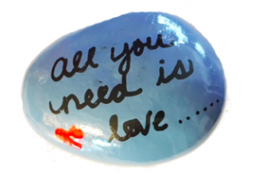
Virtual Activity
Paint a kindness rock
Girls will enjoy painting a rock and leaving somewhere on their next work for someone else to find. I shared my experience with the Kindness Rock Project a few years ago. This is the perfect time to keep these gestures going.

Slide 37
Virtual Activity
Making masks for people in your community.
One thing many people need right now is masks, there are many making them and selling but you could also make them and donate to people in your community. Sew and No Sew Instructions for mask.

Slide 38
Virtual Activity
Make a ‘thinking of you’ card
Make for people in nursing homes, senior residences, and assisted living. The card can be anything the girls want to put on them. Learn how to make a Kite “Thinking of You” card.

Slide 39
Virtual Activity
Kitchen Science
Slides 40-46

Slide 40
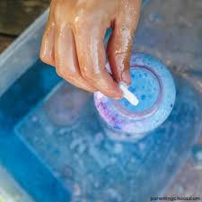
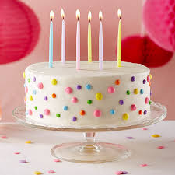
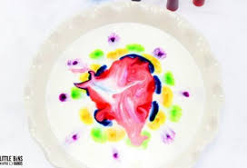
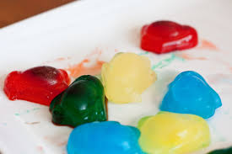
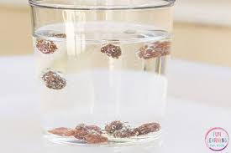
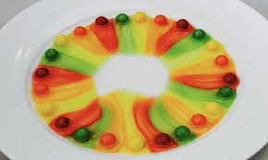
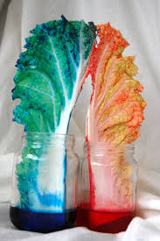
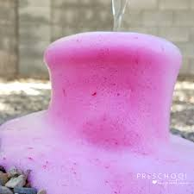
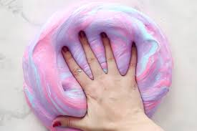
KITCHEN SCIENCE
Program Activity
Notes:
Did you know that there is a boatload of science right in your own kitchen?
There are so many great science experiments that use simple kitchen ingredients. Most of which you already have in your cupboards. Why not bring your science learning right into the kitchen. Remember Learning happens everywhere!
Please make sure you have an adult nearby to help you with this experiment.

Slide 41
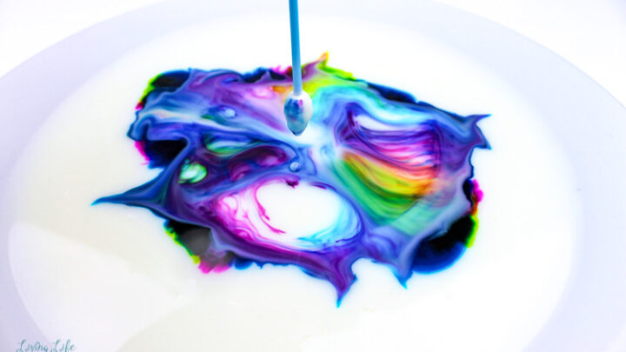
MAGIC MILK
This Photo by Unknown Author is licen
Notes:
Making a cake is science! All of the different ingredients that you mix into a cake and once it gets heated up they all react to each other and make something new and delicious
Please just watch first, then you will go into a breakout room to do your experiment

Slide 42
What you will need:
a bowl
Whole milk or Nut milk
dish detergent (dawn works best)
food coloring (Not the gel kind)
Q-tip
Notes:
I'm going to have you watch me first, then you will go into break out rooms to do your experiments

Slide 43
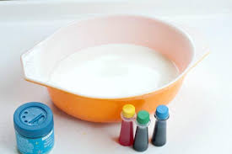
Step 1: Pour milk into bowl Step 2: Choose three colors Step 3: Squeeze 4 to 6 drops of each color, kind of close together, into the milk
Instructions
Notes:
Just watch for now and then you will do your experiment in a break out room

Slide 44
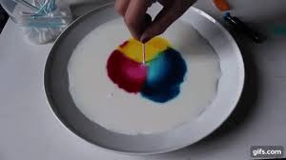
Instructions
Step 4: Dip Q-tip in the dish soap
Step 5: Touch the dipped end of the Q-tip to the center of your colors.
Step 6: Wait for the explosion of color which will be followed with Ooohs and Awwws

Slide 45
If you have Zoom and enough adult support, use breakout rooms for smaller groups to work on the experiment. If not, ask the girls to pay attention to what you do and follow along. Once you add dish detergent to milk, the reaction will happen fast. Ask girls to focus on the milk and the reaction. * More leading questions in ‘Notes’.
Notes:
Did you see what happened?
The secret of the bursting colors is the chemistry of that tiny drop of soap. Milk contains fat and protein which like to be together. Dish Soap sticks to the fat in the milk and pushes away the protein.
This is where the fun begins!
The bits of fat bend, roll, twist, in all directions as the soap races around to join up with the fat.
During all these gymnastics the food coloring is bumped and shoved everywhere which gives you an easy way to see the invisible activity. As the soap becomes evenly mixed with the milk, the action slows down and eventually stops.

Slide 46
Virtual Activity: Leaf Man
* Activity information in ‘Notes’.
Notes:
Leaf-man Video:
https://www.youtube.com/watch?v=YvAK2hxNFrY
Breakout Room to do activity:
Assign the girls into breakout room to do the art & craft activity. Each room need to have an adult leader or staff
Girls will create their own Leaf-man using the leaves that they collected and glue
Girls share their art project

Slide 47
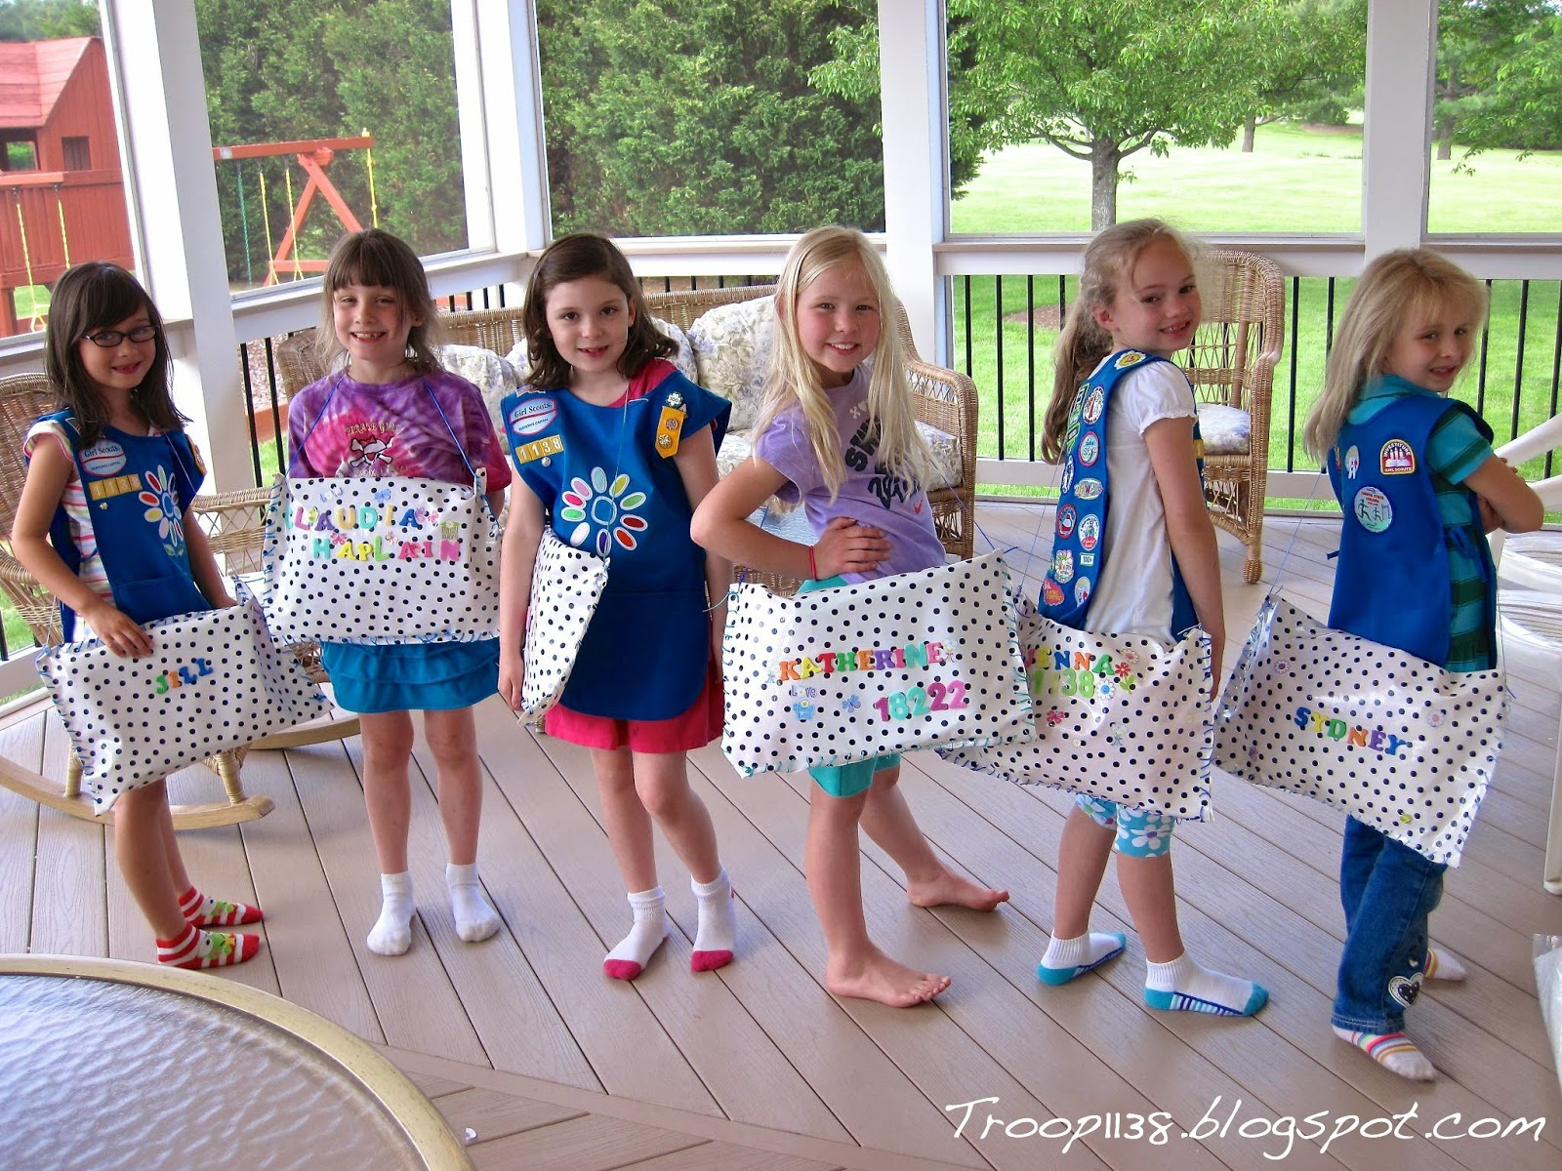
Virtual Activity: Make Sit-upons
Info on Sit-upons from Girl Scouts of Utah:
https://www.gsutah.org/content/dam/girlscouts-gsutah/documents/Sit_Upons_Short_and_Snappy.pdf
Instructions and supplies for Sit-upons:
http://troop1138.blogspot.com/2014/05/sit-upons.html

Slide 48
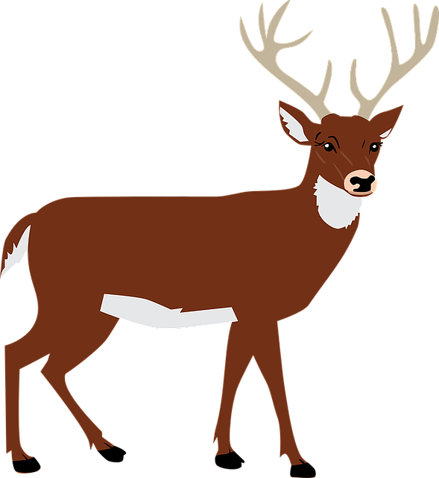
Great Job!
This Photo by Unknown Author is licensed under CC BY-NC
Notes:
Virtual Activity: Virtual Hike
Ask "what kinds of things do we see on a hike?"
Click through to show them the answers.
*keep muted* Thumbs up and thumbs down , do hiking motions. Explain leave no trace on trash portion.

Slide 49
Virtual Activity
Origami
The best way to learn how to do origami is watch someone else walk through the steps of making it. My favorite Youtube Channel that gives great step by step instructions is PPO pick one and have the girls have paper ready you can pause after each step to make sure everyone has that step done.
Notes:
Origami Creation

Slide 50
Virtual Activity
Create a comic
Using Pixton website, girls can make their own avatar and create their very own comic strips.
Notes:
Create comics

Slide 51
Virtual Activity
Digital Escape Room
If you are looking for fun and easy digital escape rooms, but don’t want to pay for one, there are a number of free ones all over the web. Kids Activities website has compiled a pretty extensive list of ones to choose from.
Notes:
Digital Escape Room

Slide 52
Virtual Activity
Yoga party
Here are some ideas for a yoga party, there are ideas for fun patches, how to make the yoga event have a theme. If you don’t want to lead the yoga search YouTube for a short yoga session and play it during meeting.

Slide 53
Virtual Activity
Morse code with flashlights
This could be focus of whole meeting. First share the history of Morse Code how it started this is a great video kid friendly explanation. Give Morse Code a try using flashlights. Maybe do their name or another short word for others to guess. Here is a Morse Code chart for letters and numbers. Here is a morse code translator site so you could watch Morse Code in action when you type words in.

Slide 54
Virtual Activity
How to make slime
This is a great activity you could do together as group. Make sure everyone has the supplies needed to make before hand. Or, ask each girl to find a recipe for slime online and make it before meeting. Then, each girl could take turns sharing how they made it, and the science behind the slime. Here is an article to get you started. There are so many recipes for slime the girls will have a blast learning about a new one.

Slide 55
Scavenger Hunt

Slide 56
Scavenger Hunt!
Find something…
Brown
Blue
Green
Notes:
SAY:
It's time to play a game. We are doing a 2 minute scavenger hunt! When I say go, you will have 2 minutes to find: a hat or headband, something round, something blue, a stuffed animal or pet, and a snack! Any questions?
Your two minutes starts in 3...2....1...go!
Give the girls updates on how much time they have left ("1 minute and 10 seconds to go!") and when the return, have them share one of the things they found.
Explain that Blue is the color of Daisies, Brown is the color of Brownies, and Green is the color of Juniors but also the Girl Scout color!
SAY: (optional)
What are some other things that are green, brown, or blue that relates to Girl Scouts?
Answers could be: green for nature, brown for dirt, earth, and trees, blue for sky. Related to GS because Girl Scouts like to be outside and interacting with nature.
Scavenger hunt: 5 minutes

Slide 57
Time for a Scavenger Hunt!
You have 2 minutes!
How many can
you find….
Something clear
Something you take to camp
Something you use at night
Something made of plastic
Something square
Something blue

Slide 58
Time for a Scavenger Hunt!
You have 2 minutes!
How many can
you find….
Starting that makes you happy
Something you use during the day
Something you use for class
Something that doesn’t make noise
Something round
Something soft
Notes:
Additional Scavenger Hunt if you have extra time or think the girls need to get some energy out.

Slide 59
Time for a Scavenger Hunt!
You have 2 minutes!
How many can
you find….
Headband or Hat
Something ROUND
Something Yellow
Stuffed Animal
Or Your Pet
A Napkin
Notes:
If the girls voted last meeting for Show and Tell, then take down the slideshow and allow girls to share what they brought. You may need more than 5 minutes.
If they voted for scavenger hunt:
SAY:
It's time to play a game. We are doing a 2 minute scavenger hunt! When I say go, you will have 2 minutes to find: a hat or headband, something round, something blue, a stuffed animal or pet, and a snack! Any questions?
Your two minutes starts in 3...2....1...go!
Give the girls updates on how much time they have left ("1 minute and 10 seconds to go!") and when the return, have them share one of the things they found.
Scavenger hunt: 5 minutes

Slide 60
Time for a Scavenger Hunt!
Something purple
Something clean
Something found in nature
Something with lots of colors
You have 2 minutes!
How many can
you find….
Something that starts with 'D'
Something that has a letter 'B'

Slide 61
Time for a Scavenger Hunt!
You have 2 minutes!
How many can
you find….
Notes:
Add items to the list for girls to find.

Slide 62
Girl Scout Songs

Slide 63
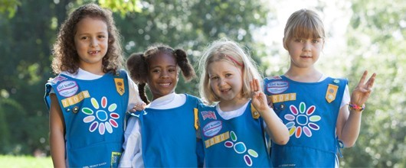
Closing Song
Make new friends
But keep the old
One is silver and the other's gold
A circle is round
It has no end
That's how long I want to be your friend

Slide 64
Closing Song
I'm a little Daisy dressed in blue I am a Girl Scout you are too When I go to meetings I sing and shout I love being a Daisy Girl Scout
Notes:
Omit this song if you already did the "Super California Surfer" song at this meeting.
Have the girls stand up (and do the hand motions). Go through the lyrics line by line and teach the motions. Have the girls unmute themselves and sing the song in "repeat after me" style once or twice and then all together once.
Song lyrics and motions (tune of "I'm a little teapot")
I'm a little Daisy (fingers spread, at side of face, head tilted) Dressed in blue (hands pick at chest of uniform smock) I am a Girl Scout (make 3 fingered sign) You are too (point to neighbor) When I go to meetings (hands out, palms up) I sing and shout (hands cup around mouth) I love being a Daisy Girl Scout (make a heart with hands or clap hands together)

Slide 65
Super California Surfer
Because I was afraid to surf When I was just a lass, My father took my board away And told me I was bad. But when I learned the word That every surfer knows, The longest word you ever heard, And this is how it goes... Super California surfer, expert of the ocean. Even though the most of them Do not use suntan lotion. When they hit the waves too hard They always cause a motion.
Super California surfer, expert of the ocean! Um didle iddle iddle um diddle lie, Um didle iddle iddle um diddle lie!
Notes:
Optional song you can add in.
To the tune of super-cali-fragilistic-expialidocious (from Mary Poppins, for reference: https://www.youtube.com/watch?v=rihNRTTcztQ )

Slide 66
Princess Pat
Click The princess pat, (the princess pat) Lived in a tree, (lived in a tree) She sailed across, (she sailed across) The seven Seas, (the seven seas) She sailed across, (she sailed across) The channel two, (the channel two) And she took with her, (and she took with her) A rick-a-bamboo, (a rick-a-bamboo) A rick-a-bamboo, (a rick-a-bamboo) Now what is that? (now what is that?) Its something made, (it's something made) By the princess pat, (by the princess pat) Its red and gold, (its red and gold) And purple too, (and purple too) That's why it's called, (that's why it's called) A rick-a-bamboo, (a rick-a-bamboo) A rick-a-bamboo, (a rick-a-bamboo)
Now Captain Jack, (now captain Jack) Had a mighty fine crew (had a mighty fine crew) He sailed across, (he sailed across) The channel two, (the channel two) But his ship sank, (but his ship sank) And yours will too, (and yours will too) If you don't take, (if you don't take) A rick-a-bamboo (a rick-a-bamboo) A rick-a-bamboo, (a rick-a-bamboo) Now what is that? (now what is that?) Its something made, (it's something made) By the princess pat, (by the princess pat) Its red and gold, (its red and gold) And purple too, (and purple too) That's why it's called, (that's why it's called) A rick-a-bamboo, (a rick-a-bamboo) A rick-a-bamboo, (a rick-a-bamboo)to add text

Slide 67
The Moose Song
There was a great big moose!
He liked to drink a lot of juice.
There was a great big moose!
He liked to drink a lot of juice.
Singin’ oh way oh
Way oh way oh way oh way oh
Way oh way oh
Way oh way oh way oh way oh
The moose’s name was Fred.
He liked to drink his juice in bed.
The moose’s name was Fred.
He liked to drink his juice in bed.
Singin’ oh way oh
Way oh way oh way oh way oh
Way oh way oh
Way oh way oh way oh way oh
He drank his juice with care,
but he spilled some in his hair.
He drank his juice with care,
but he spilled some in his hair.
He drank his juice with care,
but he spilled some in his hair.
Singin’ oh way oh
Way oh way oh way oh way oh
Way oh way oh
Way oh way oh way oh way oh
Now he’s a sticky moose
Because he’s all covered in juice!
Singin’ oh way oh
Way oh way oh way oh way oh
Way oh way oh
Way oh way oh way oh way oh

Slide 68
Kookaburra
Kookaburra sits on the old gum tree, Merry merry king of the bush is he. Laugh, Kookaburra, laugh, Kookaburra, Gay your life must be!
Kookaburra sits in the old gum tree Eating all the gumdrops he can see Stop, Kookaburra, Stop, Kookaburra Leave some there for me.
Kookaburra sits in the old gum tree, Counting all the monkeys he can see Stop, Kookaburra, Stop, Kookaburra, That's no monkey, that's me.

Slide 69
The Little Green Frog
MmmAck went the little green frog one day, MmmAck went the little green frog. Mmmack went the little green frog one day, And his eyes went MmmAck MmmAck MmmAck MmmAckAck All the other frogs go Fo de o de o de o de o Fo de o de o de o, Fo de o de o de o All the other frogs go Fo de o de o de o de o But the little green frog goes Mmmack Mmmack Mmmackack

Slide 70
Boom Chika Boom
I said A Boom Chicka Boom (repeat)
I said A Boom Chicka Boom (repeat)
I said Boom A Chicka Rocka Chicka Rocka Chicka Boom (repeat) Uh Huh! (repeat)
Oh Yeah! (repeat)
One more time (repeat)
1) Baby Style
2) Under water style
3) Really fast

Slide 71
Way Up in the Sky
Way up in the sky, the big birdies fly
While down in the nest, the little ones rest
With a wing on the left *tweet*, and a wing on the right *tweet*
The baby birds sleep all through the night
SHHHH you mustn't wake the baby birdies!
The bright sun comes up, the dew falls away
Good morning! good morning! the little birds say

Slide 72
Other Girl Scout Songs
Notes:
Click link in the slide to access the Song Book PDF.

Slide 73
Closing Song
Notes:
Template for Closing Song for troop meetings, copy lyrics intro purple box if girls can read

Slide 74
Letters to Daisies
Notes:
The following "Dead Daisies..." Slides have prewritten emails that you can alter to send as follow up emails after your meetings.

Slide 75
Dear Daisies...
Notes:
Send Follow-up Email within 24 hours of the meeting: (edit underlined text accordingly)
Dear Daisies,
You did a great job at your first Daisy Meeting! We earned our Promise Center (our very first badge!) and played some fun games to learn more about Girl Scouts and our founder, Juliette Gordon Low. We voted for a fun activity for next meeting to be (a Scavenger Hunt or Show and Tell). (if Show and Tell: So remember to bring something to the next meeting to show all our Daisy friends and tell us why it's special to you!) Remember, until next meeting, your challenge is to think about ways you are friendly and helpful to those around you.
Supplies to bring to next meeting are:
Colored markers or crayons or colored pencils
Colored or white paper
Scissors
Glue or tape
I can't wait to see you again, Daisies! We will meet again at (Date and Time) and use this link: (Zoom link).
Send a reminder email the day before the meeting—send the same email but add this at the beginning:
Hi Daisies! This is a reminder that we are meeting with our Troop friends tomorrow at (time). Please let me know if you can't come to the meeting.
See you soon!

Slide 76
Dear Daisies...
Notes:
Send Follow-up Email within 24 hours of the meeting: (edit underlined text accordingly)
Dear Daisies,
You did a great job at our Daisy Meeting! Today, we worked on earning our Friendly and Helpful Petal by listening to Sunny's story and creating a mural. We also learned a fun song to sing called Make New Friends.
Supplies to bring to next meeting are:
Colored markers or crayons or colored pencils
Paper
Also, do you remember what your Kaper (job) is for our next meeting? Be ready at the next meeting to do your Kaper! Below is a list of who is doing which Kaper at the next meeting and what that job means:
(girl's name): (kaper)
(girl's name): (kaper)
(girl's name): (kaper)
(girl's name): (kaper)
(girl's name): (kaper)
(girl's name): (kaper)
Kaper Descriptions: (delete ones you are not using)
Promise Leader: Leads the group in saying the GS Promise. The girl starts the Promise "On my honor.." and the rest of the girls join in.
Reporter: Reports back to the group a summary of what we did at the previous meeting.
Clean up Captain: After snack or craft, leads the group and encourages them to clean up their surroundings. "A Girl Scout always leaves a place cleaner than she found it."
Supply Checker: Reminds other Girl Scouts of the supplies needed for that meeting in the beginning. Check to make sure everyone has everything they need and helps to come up with alternatives if missing supplies.
Song Leader: Starts the song for the group or leads the song in repeat after me.
Joke Teller: Brings 1 or 2 jokes to the meeting to share with the troop
Friendship Squeeze Starter: When girls are crossing their arms, she tells the girls to close their eyes and make a wish and squeeze once.
I can't wait to see you again, Daisies! We will meet again at (Date and Time) and use this link: (Zoom link).
Send a reminder email the day before the meeting—send the same email but add this at the beginning:
Hi Daisies! This is a reminder that we are meeting with our Troop friends tomorrow at (time). Please let me know if you can't come to the meeting.
See you soon!

Slide 77
Dear Daisies...
Notes:
Send Follow-up Email within 24 hours of the meeting: (edit underlined text accordingly)
Dear Daisies,
You did a great job at our Daisy Meeting! Today, we worked on earning our Friendly and Helpful Petal by playing a fun game with body motions. We also voted this week to do a Daisy Pledge together to practice being friendly and helpful by (write what the girls voted on for their pledge). Remember, before next meeting, your challenge is to write a card or draw a picture to thank someone who helps you!
Supplies to bring to next meeting are:
Colored markers or crayons or colored pencils
Paper
Daisy Uniform Coloring Sheet (attached to email or link here)
Also, do you remember what your Kaper (job) is for our next meeting? Be ready at the next meeting to do your Kaper! Below is a list of who is doing which Kaper at the next meeting and what that job means:
(girl's name): (kaper)
(girl's name): (kaper)
(girl's name): (kaper)
(girl's name): (kaper)
(girl's name): (kaper)
(girl's name): (kaper)
Kaper Descriptions: (delete ones you are not using)
Promise Leader: Leads the group is saying the GS Promise. The girl starts the Promise "On my honor.." and the rest of the girls join in.
Reporter: Reports back to the group a summary of what we did at the previous meeting.
Clean up Captain: After snack or craft, leads the group and encourages them to clean up their surroundings. "A Girl Scout always leaves a place cleaner than she found it."
Supply Checker: Reminds other scouts of the supplies needed for that meeting in the beginning. Check to make sure everyone has everything they need and helps to come up with alternatives if missing supplies.
Song Leader: Starts the song for the group or leads the song in repeat after me.
Joke Teller: Brings 1 or 2 jokes to the meeting to share with the troop
Friendship Squeeze Starter: Once girls cross their arms, she tells the girls to close their eyes and make a wish and squeeze once.
I can't wait to see you again, Daisies! We will meet again at (Date and Time) and use this link: (Zoom link).
Send a reminder email the day before the meeting—send the same email but add this at the beginning:
Hi Daisies! This is a reminder that we are meeting with our Troop friends tomorrow at (time). Please let me know if you can't come to the meeting.
See you soon!

Slide 78
Dear Daisies...
Notes:
Send Follow-up Email within 24 hours of the meeting: (edit underlined text accordingly)
Dear Daisies,
You did a great job at our Daisy Meeting! Today, we finished our Friendly and Helpful Petal. We also made a paper uniform to see what badges we've earned so far! To earn the Promise Center and the Friendly and Helpful Petal, you:
- learned the Girl Scout Promise
- worked on your mural about Sunny's story
- drew a card for a friend/ family/ neighbor/first responder
- decided on a 'Friendly' pledge
You girls should be so proud. You did such an amazing job!
Also, do you remember what your Kaper (job) is for our next meeting? Be ready next meeting to do your Kaper! Below is a list of who is doing which Kaper next meeting and what that job means:
(girl's name): (kaper)
(girl's name): (kaper)
(girl's name): (kaper)
(girl's name): (kaper)
(girl's name): (kaper)
(girl's name): (kaper)
Kaper Descriptions: (delete ones you are not using)
Promise Leader: Leads the group is saying the GS Promise. The girl starts the Promise "On my honor.." and the rest of the girls join in.
Reporter: Reports back to the group a summary of what we did at the previous meeting.
Clean up Captain: After snack or craft, leads the group and encourages them to clean up their surroundings. "A Girl Scout always leaves a place cleaner than she found it."
Supply Checker: Reminds other scouts of the supplies needed for that meeting in the beginning. Check to make sure everyone has everything they need and helps to come up with alternatives if missing supplies.
Song Leader: Starts the song for the group or leads the song in repeat after me.
Joke Teller: Brings 1 or 2 jokes to the meeting to share with the troop
Friendship Squeeze Starter: Once girls are crossing their arms, she tells the girls to close their eyes and make a wish and squeeze once.
I can't wait to see you again Daisies! We will meet again at (Date and Time) and use this link: (Zoom link).
Send a reminder email the day before the meeting—send the same email but add this at the beginning:
Hi Daisies! This is a reminder that we are meeting with our Daisy friends tomorrow at (time). Please let me know if you can't come to the meeting.
See you soon!

Slide 79
Virtual Meeting Templates and Images

Slide 80
Daisy Meeting Theme or Badge Title Meeting __
TEMPLATE:
Notes:
Overview:
__ minutes
Welcome: coloring and chatting - 5 minutes
Icebreaker Meeting Rules - 5 minutes
Opening: Pledge of Allegiance, GS Promise, GS Law – 5 minutes (optional: Girl Scout Law song video)
Kaper chart: 2-5 minutes
Game: Scavenger Hunt (and sharing) - 5 minutes
Main badge activity - 20 minutes
Prep for Next Meeting (Challenge), Daisy Song, Friendship Circle – 10 minutes
BADGE REQUIREMENTS:
Supplies Needed:

Slide 81
Ice Breaker

Slide 82
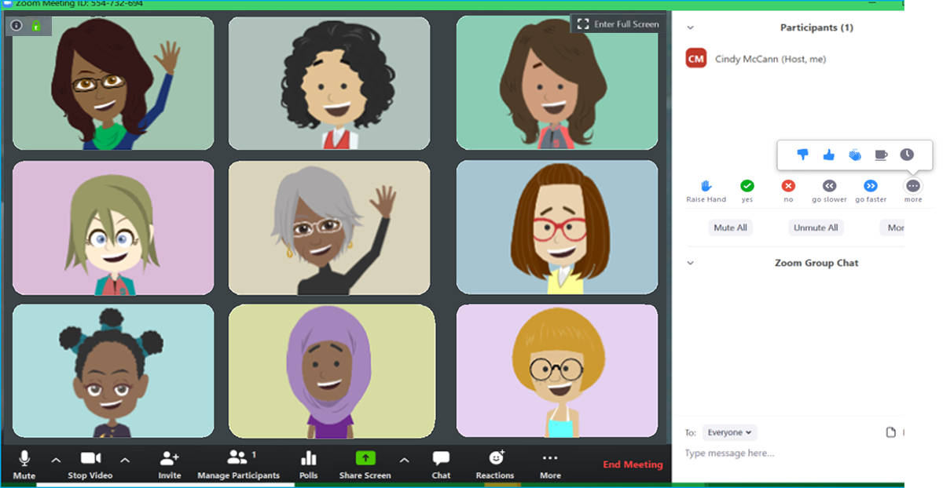
Daisy Zoom Meeting Tips
TURN SOUND &
CAMERA ON & OFF
WRITE A QUESTION OR ADD YOUR IDEAS

Slide 83
Meeting Rules
If we ask a Yes/ No question, answer with a thumbs up or thumbs down
Mute yourself until it is time to talk
Notes:
Please customize this slide to rules you have established for your meetings.

Slide 84
Kaper Chart
Katara Waterbender
Supply
Checker
Junie B. Jones
Song Leader
Kaper
Chart
Ramona Quimby
Promise Leader
Matilda Wormwood
Hermione Granger
Clean up Captain
Katniss Everdeen
Lucy Pevensie
Friendship
Squeeze Starter
Joke
Teller
Dora Explora
Reporter
Dorothy Gale
Annie Warbucks
Notes:
Kaper Chart 1:
SAY:
Kapers are another important part of our meetings. Kaper is another word for job. The jobs when we meet in person might be getting the room ready for the meeting, passing out supplies or snacks, or cleaning the room before leaving. While we are doing virtual meetings, we will have jobs like Promise Leader and Clean up Captain. We use this Kaper Chart to hand out these jobs and make sure we all have something to do. When everyone pitches in to help with chores, the work is lighter for all.
Here is a "Wheel of Names" tool that you can edit and use to assign Kapers or pick a girl at random for any reason—maybe to share first for an activity, or pick a song for the group to sing, etc.
https://wheelofnames.com/?fbclid=IwAR3B_y1iUK-VdEV0EMO6bpU653xTivfnrcvKS1o_y5eb98lqlqib6cwiG4E
Please edit this slide with the girls names in your troop. There are extra name boxes beside the slide. You may not want to have all of these roles, to delete a role just click on the box where the job is listed and delete the text. Or you can drag text boxes off the slide and they will not be visible while presenting.
Possible jobs with descriptions:
Promise Leader: Leads the group is saying the GS Promise. The girl starts the Promise "On my honor.." and the rest of the girls join in.
Reporter: Reports back to the group a summary of what we did at the previous meeting.
Clean up Captain: After snack or craft, leads the group and encourages them to clean up their surroundings. "A Girl Scout always leaves a place cleaner than she found it"
Supply Checker: Reminds other scouts of the supplies needed for that meeting in the beginning. Check to make sure everyone has everything they need and helps to come up with alternatives if missing supplies.
Song Leader: Starts the song for the group or leads the song in repeat after me.
Joke Teller: Brings 1 or 2 jokes to the meeting to share with the troop
Friendship Squeeze Starter: Once girls are crossing their arms, she tells the girls to close their eyes and make a wish and squeeze once.
For next week, you can copy this slide and drag it down to near the beginning of next meeting. (Right click, select “Duplicate Slide”, then click and hold the new slide to drag it)

Slide 86
* Members may substitute for the word God in accordance with their own spiritual beliefs.
Notes:
Officially begin the meeting with an Opening Ceremony. This consists of the Girl Scout Promise and the option of adding the pledge of allegiance and/or Girl Scout Law.
Have girls unmute for the Girl Scout Promise. Can do "repeat after me" style if they don't know the Promise yet.
Your troop can have a girl lead the Promise as a job (kaper).
SAY:
Now everyone sit up tall and make the Girl Scout sign, we are going to say the Girl Scout Promise.
Depending how well your girls know the promise you may choose to do "repeat after me" or all together.
Optional: You can take down the slideshow so the girls can all see each other better.
Link to Daisy Promise and Law worksheet in GS Volunteer Toolkit:
http://vtkdemo.girlscouts.org/content/dam/girlscouts-vtk/meeting-aids/Daisy-Promise-and-Law.pdf
Opening Ceremony: 2 minutes or less.

Slide 88
Time for a Scavenger Hunt!
You have 2 minutes!
How many can
you find….
Notes:
Add items to the list for girls to find.

Slide 89
Main Badge Activity

Slide 90
Be Prepared for Next Meeting:
1. Challenge! Daisy Challenge is to...
2. Be ready for your Kaper!
3. Supplies:
Notes:
(add prep for your next meeting here)
You can add the date and time of your next meeting to this slide.

Slide 91
Closing Song
Lyrics here

Slide 92
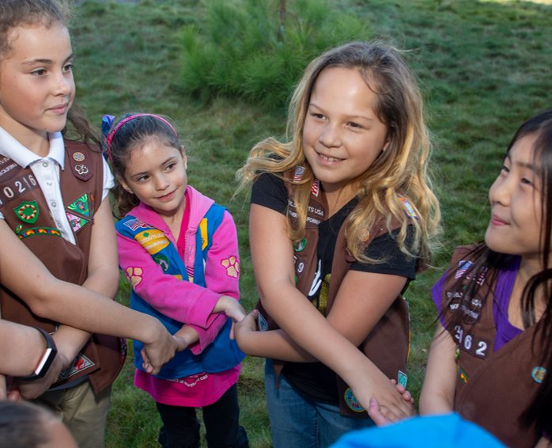
Friendship Circle and Goodbye
Notes:
Don't forget to send a follow up email!

Slide 93
I know the Girl Scout Promise!
I'm a good neighbor!
I'm friendly and helpful!
Notes:
Change the quotes to reflect which petals or badges your girls earned

Slide 94
Clipart of Petals for Customizing Slides
Promise Center
Fiendly and Helpful Petal
Be a Sister to Every Girl Scout Petal
Respect Authority Petal
Courageous and Strong Petal
Responsible For What I Say and Do Petal
Make the World a Better Place Petal
Honest and Fair Petal
Considerate and Caring Petal
Respect Myself and Others Petal
Use Resources Wisely Petal

Slide 95
Journeys and Leaves
Journey: Welcome to the Daisy Flower Garden
Journey: Between Earth and Sky
Journey: 5 Flowers, 4 Stories, 3 Cheers for Animals

Slide 96
Daisy Badge Clipart
Outdoor Art Maker
Democracy for Daisies
Good Neighbor
Buddy Camper
Toy Business Designer
Eco Learner

Slide 97
Daisy Badge Clipart
Cybersecurity 1: Basics
Cybersecurity 2: Safeguards
Cybersecurity 3: Investigator
Space Science Explorer
Coding for Good 1: Coding Basics
Coding for Good 2: Digital Game Design
Coding for Good 3: App Development

Slide 98
Daisy Badge Clipart
*Not pictured: Robotics badges (1, 2, 3)
Automotive 2: Engineering
Automotive 3: Manufacturing
Automotive 1: Design
Mechanical Engineering: Model Car
Mechanical Engineering: Roller Coaster
Mechanical Engineering: Board Game

Slide 99
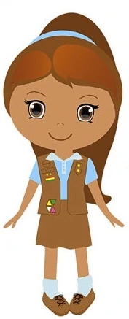
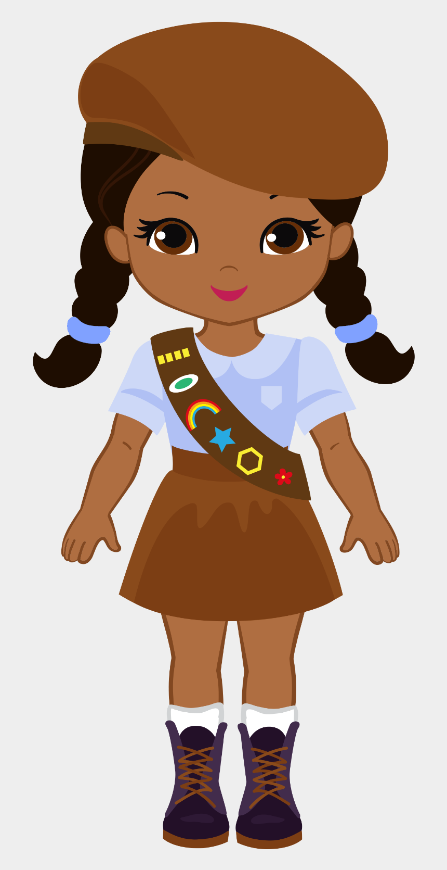
Girl Scout Clipart

Slide 100
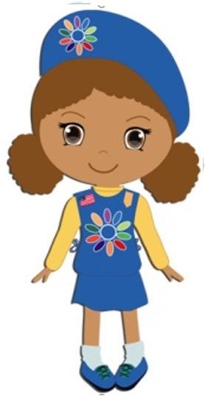
Girl Scout Clipart

