Slide 1
Brownie Virtual
Sisterhood Series
Notes:
Meeting 1 summary:
Opening, scavenger hunt, play Action Name Game, learn about Making New Friends badge, hear about talent show, discussion about what brownies do, closing.
Meeting 1:
Brownie Intro Meeting: about 30 minutes
Welcome: chatting - 2 minutes
Welcome: Opening Question – 3 minutes
Zoom and Meeting Rules – 2-3 minutes
Opening: Pledge of Allegiance, GS Promise, GS Law – 2 minutes
Game: Scavenger Hunt (and sharing) - 5 minutes
Introductions: Action Name Game – 5 minutes
Badge activity: explain badges and Making Friends Badge – 3-5 minutes
Explain Talent Show, Prep for Next Meeting and Friendship Circle – 5 minutes
Badge Requirements:
Making Friends
Step 1 Make a Friendly Introduction (game)
Step 2 Show Friends You Care (craft)
Step 3 Share a Favorite Activity.
Step 4 Learn How to Disagree.
Step 5 Practice Friendship (pledge)

Slide 2
Brownie Sisterhood Series TOC
Brownie Leader Instructions
Meeting 1
Meeting 2
Meeting 3
Meeting 4
Meeting 5
Meeting 6
Slides 3-7
Slides 8-25
Slides 26-41
Slides 42-62
Slides 63-79
Slides 80-96
Slides 97-114

Slide 3
Virtual Troop Meeting FAQ, VTK, Zoom and other virtual resources
Notes:
Meeting 1 summary:
Opening, scavenger hunt, play Action Name Game, learn about Making New Friends badge, hear about talent show, discussion about what brownies do, closing.
Meeting 1:
Brownie Intro Meeting: about 30 minutes
Welcome: chatting - 2 minutes
Welcome: Opening Question – 3 minutes
Zoom and Meeting Rules – 2-3 minutes
Opening: Pledge of Allegiance, GS Promise, GS Law – 2 minutes
Game: Scavenger Hunt (and sharing) - 5 minutes
Introductions: Action Name Game – 5 minutes
Badge activity: explain badges and Making Friends Badge – 3-5 minutes
Explain Talent Show, Prep for Next Meeting and Friendship Circle – 5 minutes
Badge Requirements:
Making Friends
Step 1 Make a Friendly Introduction (game)
Step 2 Show Friends You Care (craft)
Step 3 Share a Favorite Activity.
Step 4 Learn How to Disagree.
Step 5 Practice Friendship (pledge)

Slide 4
Packet Instructions
Packet includes Brownie Making Friends Badge in 6 meetings, roughly 25-30 minutes each.
Meetings are designed to be held on Zoom.
"Dear Brownies..." slides contain reminder emails to parents.
For Opening: Pledge of allegiance and GS Law are optional
Scavenger hunts and other Ice-breakers can be added or omitted based on timing. See more Ice-breakers in Resources slideshow.
To "hide" slides, right click on slide and select "Hide Slide" this will make it skip when you are presenting.
You are encouraged to customize the slides, so they fit with how you typically run your troop meetings.
There are links in the slide notes to the online Volunteer Toolkit which has badge requirements and activity plans. The next slide explains how to access and utilize the Volunteer Toolkit and tips for using Zoom.
See "Notes" below (bottom right corner) on every slide to see descriptions of activities, material lists, links, and script.
If you have questions, contact Lauren Fialkow: lfialkow@gsnorcal.org
Notes:
Great! You found the notes section! This is where we have more details on activities, badge requirements, links to resources, a script you can follow, and more!
The first slide for each meeting will have the overview of the whole meeting.
Once you have completed this badge with your troop, please fill out our feedback survey so we can keep providing everything you need to run a successful, meaningful, and easy Girl Scout meetings! (Link)
Please do not feel as though you need to follow the script, it's more authentic for the girls if you speak from the heart. The script is there if you need some guidance.
Overview:
6 Meetings, Badges earned: Making Friends
Meeting 1 summary:
Opening, scavenger hunt, play action name game, learn about Making New Friends badge, hear about talent show, discussion about what brownies do, closing.
Meeting 2 summary:
Opening, scavenger hunt, learn about kapers, snack and story, learn brownie song, closing.
Meeting 3 summary:
Opening, Kapers, scavenger hunt, Internet safety pledge, making origami hearts, Brownie Song, closing.
Meeting 4 summary:
Kaper review, opening, scavenger hunt, badge activity: learn to disagree, closing.
Meeting 5 summary:
Opening, traffic light game, learn Girl Scout handshake, talent show, closing.
Meeting 6 summary:
Opening, scavenger hunt, making a friendship pledge together, writing an acrostic poem, Brownie song, closing.

Slide 5
Zoom and VTK Tips
Volunteer Toolkit (VTK) includes:
Content to plan any badge!
Video Tutorials on adding badges to year plan and more
Link to Badge Explorer to check requirements for each badge
Zoom How to:
Make sure to disable annotations when you share your screen
Share a video
Create a poll
*Click ‘Notes’ in the lower bar to access Zoom and VTK ‘How to’
Notes:
Volunteer Toolkit (for leaders and parents):
General Volunteer Toolkit Link: https://www.gsnorcal.org/en/for-volunteers/volunteer-toolkit.html
Video tutorials (quick and easy!):
How to Set Up Your Year Plan https://www.youtube.com/watch?v=n0nrh4NJBFk&list=PLZaWZO965rJ2_OmlsOCwnzUe0xkhTBhrG&index=1
Meeting Plan Overview https://www.youtube.com/watch?v=AHw9W6YyOPU&list=PLZaWZO965rJ2_OmlsOCwnzUe0xkhTBhrG&index=2
Setting Meeting Dates and Locations https://www.youtube.com/watch?v=R_nGzg4Ux3w&list=PLZaWZO965rJ2_OmlsOCwnzUe0xkhTBhrG&index=3
Customizing Your Year Plan https://www.youtube.com/watch?v=uTdSFjJcFu0&list=PLZaWZO965rJ2_OmlsOCwnzUe0xkhTBhrG&index=4
Badge Explorer (with badge requirements): https://www.girlscouts.org/en/our-program/badges/badge_explorer.html
Zoom:
General: It can be easier/smoother to use two computer monitors if you have access.
How to disable annotations: This can only be done while the host is sharing their screen. To set it up beforehand, open a zoom meeting and select share screen. Once sharing right click on the three dots/More on the right side of the menu bar. Click "disable participants annotation" When you start the next meeting, this setting should remain saved, but it's good to check when you start sharing your screen during the meeting. If your girls know not to annotate inappropriately, then there is no need to disable this feature and you may choose to use it as part of your meeting—maybe your troop can create a picture together on the screen.
How to share a video: Only a host or co-host can share a screen. Select "Share Screen" and click on the window with the video. Make sure to check the boxes in the bottom left corner that say "Share Computer Sound" and "Optimize for Video Sharing" and then click "share." Make sure there are no "zoom" boxes over the video screen such as the chat, participants list, or control panel. This will appear to participants as a gray box blocking the screen. If you are experienced with Zoom, some of these settings can be changed in Zoom settings: https://zoom.us/
How to see girls' videos while you are screen sharing: While screen sharing, go to the menu bar and click on the three dots/More on the right hand side. Select "View Participant Videos"
How to Poll: When you start the meeting, click Polls on the menu bar. This will take you to a browser window where you can give the Poll a title, question, and possible answers. When you are done you can click the Polls button on the menu again and your poll will show up. You can click Launch Poll to start polling the girls. You can end polling and relaunch at anytime. You can also add additional poll questions. (If you don't see the Polls menu, try making your Zoom window full screen or by clicking the More tab on the menu bar)

Slide 6
- General Virtual Troop Meeting Resources - General Brownie Resources
Click on ‘Notes’ in the lower bar below to learn more about:
*Click ‘Notes’ in the lower bar for ‘How to’
Notes:
These links are listed in the Notes of the slides where they are applicable. They are compiled here if you need to find all of them in one place.
Virtual Troop Leading Resources:
Here is a "Wheel of Names" tool that you can edit and use to assign Kapers or pick a girl at random for any reason—maybe to share first for an activity, or pick a song for the group to sing, etc. https://wheelofnames.com/?fbclid=IwAR3B_y1iUK-VdEV0EMO6bpU653xTivfnrcvKS1o_y5eb98lqlqib6cwiG4E
Link to virtual Ice Breakers: (Pre-made icebreaker slides at end of this presentation) https://www.girlscouts.org/en/girl-scouts-at-home/troop-leaders/digital-icebreakers-games.html
Girl Scout Internet Safety Pledge: https://www.gsnorcal.org/content/dam/girlscouts-gsnorcal/documents/volunteer_resources/risk/internet-safety-pledge.pdf
General Resources:
Badge Explorer (with badge requirements, interactive): https://www.girlscouts.org/en/our-program/badges/badge_explorer.html
Badges and other awards: https://www.girlscouts.org/content/dam/girlscouts-gsusa/forms-and-documents/our-program/Badges/GSUSA_BrownieBadgesAwardsAndPins2019_Guide.pdf
Girl Scout Law Song video made by older Girl Scouts. Challenge the girls to watch the video at home and practice the song.
https://www.youtube.com/watch?v=6dF8dUi37x8&t=1s (start the video 30 seconds in, after they finish singing the song once, stop the video)

Slide 7
VTK Resources in ‘Notes’ below!
Notes:
Volunteer Toolkit Curriculum: Brownie Intro Meeting
Activity 2: Trefoil Name Tag
Materials
Girl Scout Trefoil Name Tag template
Girl Scout Promise template
Yarn pre-cut in 2-4 foot sections
Scissors, hole-punch, glue-stick, markers/crayons/colored pencils, stickers.
Steps
Have the Trefoil name tag supplies ready so girls can start making them as they wait for others to arrive.
INSTRUCTIONS:
Give each girl a copy of the Girl Scout Trefoil Name Tag template.
Have girls cut out the trefoil and punch holes where noted.
Have girls write their names on the trefoil and decorate it.
Have girls glue the Girl Scout Promise template to the back.
Tie each end of a piece of yarn through the holes on the trefoil.
Have girls wear the name tags during the meeting so they can start to know each others' names.
Activity 3: Action Name Introduction Game
Materials
None
Steps
SAY:
Welcome! Are you looking forward to being Brownies this year? Are you ready to start our Brownie adventures together?
This is our Brownie circle. It's a special place where we will come together to share thoughts and ideas and make decisions and plans for our troop. In the Brownie Ring, everyone gets a chance to talk, and everyone listens to what others have to say.
During this meeting, we are going to learn a little about Girl Scouts and spend some time getting to know each other better. Let's do that now.
Each person is going to say their name along with an action-word to go with their name (such as "Swimming Samantha or Jumping Jennifer"), and then you will show the action to the group. So if my name was Samantha, I would say Swimming Samantha and then pretend to swim. Got it?
Let's try! Everyone stand up -we might need some space for this.
Start the game by saying your action name and then perform the action.
Have girls repeat your action name and do the action.
Now ask the girl to your left to say her action name and perform her action. Her action name should start with the same letter as her first name.
Great! Now let's all try to remember from the beginning.
Everyone says her action name and performs the action, then the next girl's name and performs the action, and then the third girl will introduce her action name and perform her action. The group will then repeat all the action names and perform the actions of all girls before her, and so on, until all girls have been introduced.
Keep It Girl-Led Tip
Let girls choose their own action word for their name. Don't decide for them, or let other girls decide for them. If a girl is struggling to come up with a word, ask if she would like the group's help before giving her hints.
After the game, introduce yourself by telling a little about you, including whether you're related to any girls in the troop.
SAY:
I will be guiding you this year as we have our troop meetings, do activities, earn badges and awards, sell cookies, and so much more. The most important thing that I want you to know is that this is YOUR Brownie troop and you get to make the plans and decisions.
How does that sound?
I will help to guide you and make sure we always stay safe.
Cadettes or members of your Friends and Family Network should also introduce themselves.
Activity 4: Girl Scout Traditions
Materials
Optional: Poster with the Girl Scout Promise and Law written on it, hung where girls can easily read it.
Steps
(Note: The Opening Ceremony is usually done at the very beginning of the troop meeting. It's a way for you to officially get the meeting started. We didn't do it right away at this meeting, because you needed time to get to know the other girls. The opening ceremony will be the way you start meetings in the future.)
You can either do one of the pre-planned ceremonies in your meeting plan or substitute your own. For example, girls may recite the Pledge of Allegiance or the Girl Scout Promise and Law. They may hold a Flag Ceremony, recite a poem, or sing a song.
Keep It Girl-Led Tip
Let girls decide how they'd like to open their meeting. You can give them choices until they start coming up with their own ideas.
SAY:
Are you ready to learn about Brownie Girl Scout traditions?
Let's start by learning the Girl Scout Sign. Girl Scouts make the Girl Scout Sign when they recite the Girl Scout Promise and the Girl Scout Law.
Hold up your right hand with the three middle fingers up and hold your thumb and pinky finger together.
Now let's recite the Girl Scout Promise. Repeat after me as I say each line one at a time.
On my honor,
I will try,
to serve God and my country,
to help people at all times,
And to live by the Girl Scout Law.
Great job! Did you notice that when we say the Promise, we are holding up three fingers and there are three parts to the Girl Scout Promise? What were the three parts?
Serve God and my country
Help people at all times
Live by the Girl Scout Law
The three fingers that we hold up remind us that we are making these three important promises. These three parts of our Girl Scout Promise are also represented by the three clover shapes on your name tag. That shape is called a trefoil and it is the symbol for Girl Scouts.
Flip your name tag over; what is on the back?
That's right! It's the Girl Scout Promise. Now you can practice it at home.
IF TIME, ASK:
What does it mean to make a promise?
Why is it important to keep our promises?
What happens if we forget a promise?
What do the words I will try mean?
Do you think these three parts of the Promise are good things to live by?
Variation: For troops who already know the Girl Scout Promise, use this opportunity to refresh girls' memory and then ask girls to share a time when they had a chance to put the Girl Scout Promise into action.
SAY:
Did you notice in the last line of the Girl Scout Promise that we are promising to live by the Girl Scout Law? Are you wondering what you just promised to live by? Let's find out by reciting the Girl Scout Law.
Let's all do the Girl Scout Sign together
Now let's recite the Girl Scout Promise.
I will say a line and then repeat after me.
Recite the Girl Scout Law:
I will do my best to be
honest and fair,
friendly and helpful,
considerate and caring,
courageous and strong,
and responsible for what I say and do,
and to
respect myself and others,
respect authority,
use resources wisely,
make the world a better place,
and be a sister to every Girl Scout.
Variation: Show the YouTube video of girls reciting the Girl Scout Promise and Law and then have them repeat the Girl Scout Law after you.
For girls who already know the Girl Scout Law, ask them which line of the Girl Scout Law they value the most and why.
SAY:
We usually do an opening ceremony at every Brownie meeting. We'll start by saying the Girl Scout Promise and Law.
Next let's learn two more Girl Scout Traditions: the Girl Scout Quiet Sign and the Girl Scout Handshake.
Girl Scouts all over the world use the Quiet Sign as a way to get everyone's attention. Let's give it a try. Here's how you make the Quiet Sign:
Raise your right hand with all fingers extended straight up.
Got it? Great! Now, everybody make the Quiet Sign.
The Quiet Sign is a way to let everyone know it is time to be quiet and pay attention without raising your voice.
When you see someone raise their right hand (the Quiet Sign), then you raise your right hand and stop talking. When other people see you with your hand up, they'll stop talking and raise their hands, too. You'd be surprised how fast you can make a room go quiet! In fact, let's make this into a game!
Everyone stand up and wiggle, jump in place, make any kind of animal noise you can think of. When you see me do the Quiet Sign, then stop what you are doing, raise your right hand and be quiet. Ready to try? Let's see how quickly you can do it.
GO!
Let girls make a bunch of noise and then raise your right hand in the Quiet Sign. Do not say anything, just stand in place quietly with your right hand raised and all fingers extended. Wait for all girls to stop what they are doing, raise their right hand, and quiet down. Do not start talking until all girls' hands are raised and they are all quiet. You might need to try this a few times until girls get it. This is a great tool to use throughout the year when you need to get girl's attention.
SAY:
Now let's try the Girl Scout Handshake.
This is a way for Girl Scouts to greet each other.
Find a partner and face each other.
Raise your right hand and make the Girl Scout Sign.
Now shake left hands with your partner.
This is a special way to remind us that we are all sisters because we belong to Girl Scouts.
Find two new friends to practice the Girl Scout sign with.
Variation: For girls who already know these traditions, use this chance to talk about them. Did any girls go to a Girl Scout Camp or other Girl Scout activity over the summer where they used the Quiet Sign, said the Girl Scout Promise, or where they learned any other Girl Scout traditions? Use this time to ask questions and let them share. Keep in mind, they may have forgotten these traditions over the summer and may need time to refresh their memory.
Activity 5: Girl Scout Law Keepsake
Materials
12 Popsicle sticks (regular size, not jumbo) for EACH girl (plus some extra just in case)
Girl Scout Law Template
Scissors
Masking tape
Ribbon or yarn
Markers or crayons
Prepare Ahead:
In the interest of time, pre-cut the Girl Scout Law from the Girl Scout Law Template.
Steps
Instructions for Girl Scout Law Keepsake:
Girls will line up their 12 Popsicle sticks, one on top of each other, horizontally. When all 12 are lined up, they will use pieces of masking tape to connect the sticks together.
Girls will then turn the Popsicle stick over so that no masking tape is showing.
Girls will then tape the Girl Scout Law to the front (non-tape side) of the Popsicle sticks.
Finish by taping a piece of ribbon or yarn to the back so girls can hang their keepsake at home.
Have them write their name on the back in marker.
SAY:
So now you have both the Girl Scout Promise on your nametag and the Girl Scout Law keepsake that you can take home and hang someplace where you can see them. That will remind you of how Girl Scouts act and how important it is to be Girl Scout!
Activity 6: Story and Snack
Materials
Healthy snack such as fruit, granola, veggies with dip, etc.
A Note about Snacks:
Girls may need a small snack during their 1½ hour meeting to tide them over. Feel free to schedule snack time when girls need it.
Talk to the girls' families before the first meeting about any food allergies.
The first few meetings you may want to bring snacks. You may want to create a sign-up sheet so that family members can share the task.
Steps
Ask a couple girls to volunteer to pass out snacks.
SAY:
Have you been wondering at all why Girl Scouts in second- and third-grade are called Brownies? While you're eating your snacks, I'll read The Brownie Story. It's a traditional story that has been told to Brownies for years and years - and it tells how Brownies got their name.
READ: The Brownie Story while the girls are eating snack.
Tip: Short on time? Feel free to skip through the story or just tell it in your own words. Use different voices or add sound effects if you want to amp up the fun factor!
SAY:
Who were the Brownies?
What did they do?
How do you think you could be like the Brownies in the story?
That's right! We can clean up after ourselves at all our Girl Scout Brownie activities. Girl Scouts always leave a place cleaner than they found it!
We should start now! Are you ready, Brownies? How could we leave this room cleaner than we found it?
Let girls suggest ways to tidy the room (throw away trash, push in chairs, sweep, put away supplies, etc.). Give them time to clean up and then ask them to come back to the Brownie Ring for the closing ceremony.
OPTIONAL:
Sing the Brownie Clean-up song while girls are tidying up. Cleaning up is much more fun if you sing while you work.
Brownie Clean-up song (tune is London Bridge)
Weave the magic in and out, in and out in and out,
Weave the magic in and out, for we are Brownies.
We have tidied everything, everything, everything,
We have tidied everything, for we are Brownies.
Activity 7: Closing Ceremony: Friendship Circle
Reminder: If you are doing the combined Parent/Caregiver and Daisy Intro Meeting, both come together for the closing.
Materials
None
Steps
Gather girls in their Brownie Ring. Use the Quiet Sign to get their attention.
SAY:
When we get together for Brownie meetings, it's important that everyone does their part so everybody will have a happy time together.
Our meetings will be very similar to today's meeting. We'll usually open with our Girl Scout Promise and Law, so you may want to practice at home.
We'll use the Quiet Sign to get everyone's attention
And we'll always have lots of fun together
At our next meeting, you'll start planning what you want to do this year, so get ready! That will be exciting!
Another important thing we will do at our meetings are Kapers. Kapers are another word for jobs. Just like the Brownies in the story that we heard at snack time, when everyone pitches in to help with chores, the work is lighter for all. The jobs might be getting the room ready for the meeting, passing out supplies for an activity, passing out snacks, or cleaning the room before leaving. Girl Scout Brownies like to be helpful and should always leave a place cleaner than they found it.
It's time to do our closing ceremony to end our meeting
For this closing ceremony, we're going to do a traditional Girl Scout Friendship Circle and sing the Make New Friends song
Let's start by getting in our Friendship Circle
Stand shoulder-to-shoulder in a circle
Now cross your right arm over your left arm
You might want to take a quick minute to make sure all the right arms are crossed over the left. Girls will keep arms crossed in the Friendship Circle to sing Make New Friends and for the Friendship Squeeze
Now hold hands with the girl on each side of you.
This is our Friendship Circle. The Friendship Circle stands for an unbroken chain of friendship with Girl Scouts and Girl Guides around the world.
Now let's learn the Make New Friends song, an all-time favorite song that Girl Scouts like to sing.
Does anybody know this song?
Will you help me sing it once, and then we will try it again.
Sing Make New Friends
Make new friends, but keep the old.
One is silver and the other's gold.
A circle's round, it has no end.
That's how long I want to be your friend.
Sing twice so that girls catch on.
SAY:
Now let's close our meeting with the Friendship Squeeze
Who would like to start the Friendship Squeeze?
Choose a volunteer to start the Squeeze. Have girls quiet down.
Think of a silent wish that you would like to pass along.
Once you get the wish and the squeeze passed to you, then you'll use your right hand to squeeze the hand of the friend next to you and it will travel all around the circle.
The last person to have her hand squeezed will say, Goodbye, Brownie Girl Scouts.
Ready?
Ask girl who volunteered to start the Friendship Squeeze. After the squeeze has gone all the way around the circle, girl who began the squeeze says, Goodbye, Brownie Girl Scouts.
Now everyone raise your joined hands and twist clockwise out of the circle so that everyone is untwisted and facing away from the circle.
Remember to keep your Girl Scout promise and Girl Scout Law where you can see them and practice at home.
The next meeting is________________________
See you next time, Brownies!

Slide 8
Extra interactive tools, videos, and links in ‘Notes’
Notes:
Links in this packet:
Girl Scout Law Song: https://www.youtube.com/watch?v=6dF8dUi37x8&t=1s
Brownie Smile Song on YouTube: https://www.youtube.com/watch?time_continue=3&v=KQLo5VuKwyE&feature=emb_logo
Girl Scout singing Brownie Smile Song with hand motions: https://www.youtube.com/watch?v=S-E_Og1fPxc
Girl Scout Internet Safety Pledge: https://www.gsnorcal.org/content/dam/girlscouts-gsnorcal/documents/volunteer_resources/risk/internet-safety-pledge.pdf
Badge Explorer (with badge requirements): https://www.girlscouts.org/en/our-program/badges/badge_explorer.html
Badges and other awards: https://www.girlscouts.org/content/dam/girlscouts-gsusa/forms-and-documents/our-program/Badges/GSUSA_BrownieBadgesAwardsAndPins2019_Guide.pdf

Slide 9
Brownie Meeting
Meeting 1
Notes:
Meeting 1 summary:
Opening, scavenger hunt, play Action Name Game, learn about Making New Friends badge, hear about talent show, discussion about what brownies do, closing.
Meeting 1:
Brownie Intro Meeting: about 30 minutes
Welcome: chatting - 2 minutes
Welcome: Opening Question – 3 minutes
Zoom and Meeting Rules – 2-3 minutes
Opening: Pledge of Allegiance, GS Promise, GS Law – 2 minutes
Game: Scavenger Hunt (and sharing) - 5 minutes
Introductions: Action Name Game – 5 minutes
Badge activity: explain badges and Making Friends Badge – 3-5 minutes
Explain Talent Show, Prep for Next Meeting and Friendship Circle – 5 minutes
Badge Requirements:
Making Friends
Step 1 Make a Friendly Introduction (game)
Step 2 Show Friends You Care (craft)
Step 3 Share a Favorite Activity.
Step 4 Learn How to Disagree.
Step 5 Practice Friendship (pledge)

Slide 10
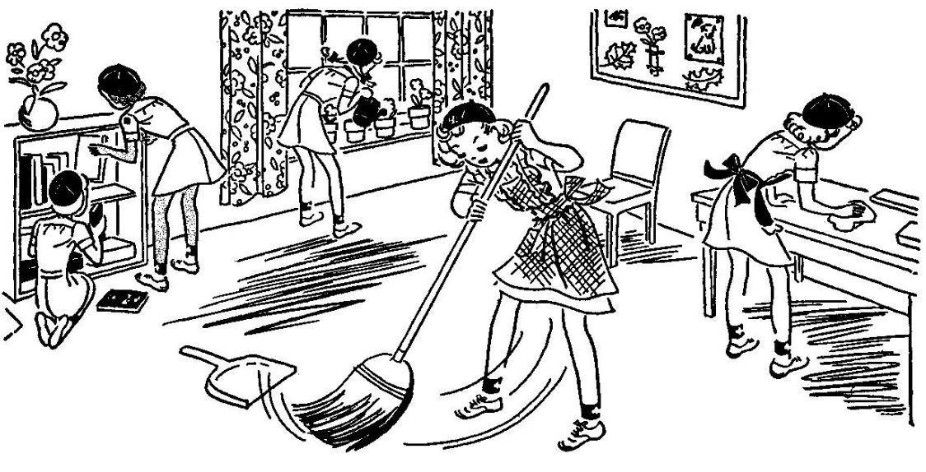
Opening Question
I helped at home with...
No supplies today!
Notes:
SAY:
Welcome! Are you looking forward to being Brownies this year? Are you ready to start our Brownie adventures together?
This is our Brownie circle. It's a special place where we will come together to share thoughts and ideas and make decisions and plans for our troop. In the Brownie Ring, everyone gets a chance to talk, and everyone listens to what others have to say.
During this meeting, we are going to learn a little about Girl Scouts and spend some time getting to know each other better.

Slide 11
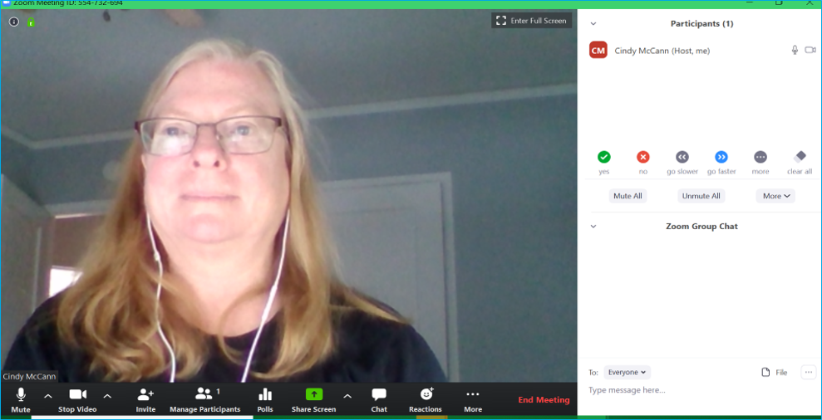
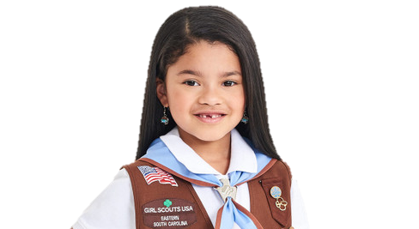
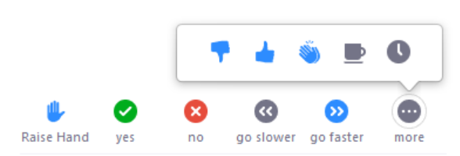
Brownie Zoom Meeting Rules
TURN AUDIO
CAMERA ON & OFF
WRITE A QUESTION OR ADD YOUR IDEAS
Notes:
Show girls how to use Zoom if they don't already know.
Show them how to mute/unmute themselves and where the chat is. You can also show them how to use the hand raise function if you wish to use that feature.

Slide 12
Meeting Rules
Be respectful in the chat
Remember to share with others and allow others to share too
*Click ‘Notes’ in the lower bar for ‘How to’
Notes:
Go over meeting rules with the girls.
Please customize this slide to rules you prefer for your meetings. Some suggestions are:
- Be respectful in Chat and do not type the same thing over and over
- Listen to others when they are talking.
In a later meeting, we will go over the Girl Scout Internet Safety Pledge which will likely reiterate some of these rules.

Slide 13
Notes:
Optional pledge of allegiance

Slide 14
* You may replace 'God' with what you believe in. For e.g. 'family'
Notes:
Officially begin the meeting with an Opening Ceremony. This consists of the Girl Scout Promise and the option of adding the pledge of allegiance and/or Girl Scout Law.
Have girls unmute for the Girl Scout Promise. Can do "repeat after me" style for Girl Scout Law.
Your troop can have a girl lead the Opening Ceremony as a job (or kaper).
SAY:
Now everyone stand/sit up tall and make the Girl Scout sign, we are going to say the Girl Scout Promise.
Depending how well your girls know the promise, you may choose to do "repeat after me" or all together.
Optional: You can take down the slideshow so the girls can all see each other better.
If time permits, ask:
What does it mean to make a promise?
Why is it important to keep our promises?
What happens if we forget a promise?
What do the words I will try mean?
Do you think these three parts of the Promise are good things to live by?

Slide 15
Notes:
SAY:
Did you notice in the last line of the Girl Scout Promise that we are promising to live by the Girl Scout Law? Are you wondering what you just promised to live by? Let's find out by reciting the Girl Scout Law.
Let's all do the Girl Scout Sign together
Now let's recite the Girl Scout Promise.
I will say a line and then repeat after me.
Optional: Show girls the Girl Scout Law Song video made by older Girl Scouts. Challenge the girls to watch the video at home and practice the song.
https://www.youtube.com/watch?v=6dF8dUi37x8&t=1s (start the video 30 seconds in, after they finish singing the song once, stop the video) See tips on Slide #2 for sharing videos on Zoom.

Slide 16
Time for a Scavenger Hunt!
Stuffed animal
Something for cleaning
Sunglasses or gloves
a coin
Something that's silly
Something that makes music
Notes:
SAY:
It's time to play a game. We are doing a 2 minute scavenger hunt! When I say go, you will have 2 minutes to find (read options on the screen). Can you wear of hold them all at once?
Your two minutes starts in 3...2....1...go!
Give the girls updates on how much time they have left ("1 minute and 10 seconds to go!") and when the return, have them share one of the things they found.

Slide 17
Action Name Game!
*Click ‘Notes’ in the lower bar for ‘How to’
Notes:
Activity 3: Action Name Introduction Game
Materials
None
Steps
During this meeting, we are going to learn a little about Girl Scouts and spend some time getting to know each other better. Let's do that now.
Each person is going to say their name along with an action-word to go with their name (such as "Swimming Samantha or Jumping Jennifer"), and then you will show the action to the group. So if my name was Samantha, I would say Swimming Samantha and then pretend to swim. Got it?
Let's try! Everyone stand up -we might need some space for this.
Start the game by saying your action name and then, perform the action.
Have girls repeat your action name and do the action.
Now, pick one girl to say her action name and perform her action. Her action name should start with the same letter as her first name.
Great! Now let's all try to remember from the beginning.
Everyone says her action name and performs the action. Keep going until all girls have been introduced.
Keep It Girl-Led Tip
Let girls choose their own action word for their name. Don't decide for them, or let other girls decide for them. If a girl is struggling to come up with a word, ask if she would like the group's help before giving her hints.
After the game, introduce yourself by telling a little about you, including whether you're related to any girls in the troop.
SAY:
I will be guiding you this year as we have our troop meetings, do activities, earn badges and awards, sell cookies, and so much more. The most important thing that I want you to know is that this is YOUR Brownie troop and you get to make the plans and decisions.
How does that sound?
I will help to guide you and make sure we always stay safe.

Slide 18
We will be working on Making Friends Badge
Step 1 Make a Friendly Introduction (game)
Step 2 Show Friends You Care (craft)
Step 3 Share a Favorite Activity
Step 4 Learn How to Disagree
Step 5 Practice Friendship! (pledge)
The badge you will earn!
Notes:
SAY:
Today we are going to start to earn our first badge! We will be earning this badge here and it is called "Making Friends". Every Brownie badge has 5 steps that we will need to complete to earn it.
Here are the steps for this badge:
Step 1 Make a Friendly Introduction
Step 2 Show Friends You Care (craft)
Step 3 Share a Favorite Activity.
Step 4 Learn How to Disagree.
Step 5 Practice Friendship

Slide 19
Making Friends Badge
You are here
Step 1 Make a Friendly Introduction (game)
Step 2 Show Friends You Care (craft)
Step 3 Share a Favorite Activity
Step 4 Learn How to Disagree
Step 5 Practice Friendship! (pledge)
The badge you will earn!
Notes:
SAY:
When we played our Action Name Game, we all completed the first step of the badge: Make A Friendly Introduction! 1 down and 4 to go until we've earned our badge.
Badge steps
Step 1 Make a Friendly Introduction (game) ...
Step 2 Show Friends You Care (craft) –origami heart
Step 3 Share a Favorite Activity. ...
Step 4 Learn How to Disagree.
Step 5 Practice Friendship (game)

Slide 20
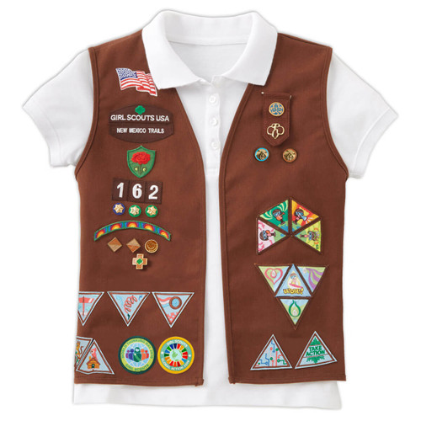
Notes:
SAY:
As a brownie Girl Scout your uniform will look like this! This is where you can put all the badges you earn while you’re a brownie.
If you click the Making Friends will fly onto the vest.

Slide 21
Upcoming: Talent Show!
Notes:
SAY:
In a few meetings, each one of you will share something with us that you love to do! You can teach us an activity or a song or share something you know a lot about. I'm telling you now so you can start thinking about what you might want to share. You will have a few minutes only to share. You can share something with your family or by yourself. You can also share a slide show of your talent if you know how. Does anyone have any questions? Does that sound good?
Talent Show requirements:
Groups are allowed to enter. Groups must be from the same household (siblings or family members living together)
Live Virtual Show will be on Date and Time. (5th meeting)
Your piece should be under 5 minutes -
You can choose to share your favorite activity: a dance, song, a skit.
OR do a show and tell (it could be about your pet, your hobby) - You can create a slide show or do a live presentation.
Practice, practice, practice - we want this to be our best Brownie show!
Invite all your family members (who live in the same household) to watch the show!

Slide 22
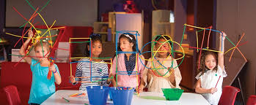
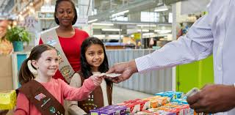
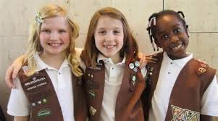
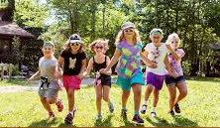
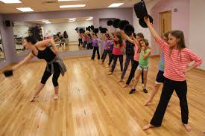
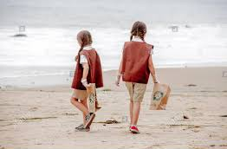
What fun things do brownies do?
*Click ‘Notes’ in the lower bar for ‘How to’
Notes:
Optional activity/discussion:
Ask the girl what they are excited to do in Brownies. If they don't know what Brownies do, ask them which of these pictures looks the most fun and why. You can also talk about what's happening in each picture:
From left to right starting at top:
picture 1—selling Girl Scout cookies at a cookie booth
picture 2—girls creating unique structures, fun crafts
picture 3—making new friends
picture 4—playing field games
picture 5—taking a dance class together
picture 6—cleaning up a beach

Slide 23
Be prepared for next week:
1. Supplies: a healthy snack
2. Brownie Challenge! Think about 2 things you really like to do at home, with friends, or in a club

Slide 24
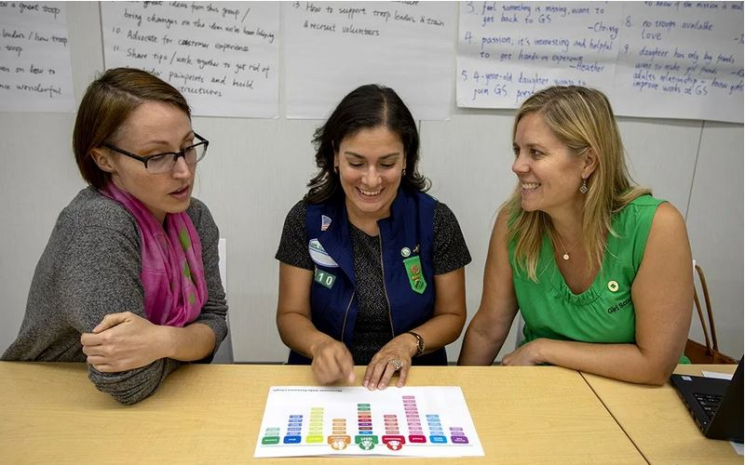
Parent chat!
*Click ‘Notes’ in the lower bar for ‘How to’
Notes:
At the end of every meeting, bring the adults over and clue them in and get them involved:
"I'll send you the follow up email. Who can help me at the next meeting and be present so that we have enough adults?"
Suggestions of what you can ask them to help specifically with an activity:
"Next week, we are working on a mural, can anyone help out with that?"
"Next week, we are going to read a story for a petal. Whose name can I put down for helping with the story?"
"Who can help out when the girls do a craft?"
"Who is good at singing and would like to lead a song?"
Plan out the help you will need for the four meetings. Use Sign-up Genius to get parents to sign up for specific duties.
Suggestions of what you can discuss with parents:
Make sure everyone has your phone and email, knows the troop number, and has all the information about the next troop meting (date, time, location and any supplies the girls will need to bring).
Make Her Experience Memorable (a resource for parents on how they can help): https://my.girlscouts.org/content/dam-resources2/girlscouts-vtkcontent/Parent-Hub/02_MV_VTKMake%20HerExperienceMemorable_flyer_8.5x11.pdf
More Parent Meeting Resources:
See Brownie Intro Meeting in Volunteer Toolkit for more guidance : https://my.girlscouts.org/content/girlscouts-vtk/en/vtk.details.html?elem=190616400000
Another great resource: "Getting Adults to Help" training in our volunteer eLearning portal: https://training.gsnorcal.org/login/index.php To find it, under Troop Leaders, click on Daisy Leader (Grades K-1). Then click "New troop Leader Course (Part 1 & Part 2). Then scroll to Part 1: Troop Basics and select "Getting Adults to Help (Avg. 20 Min.) or scroll down further to "Meeting with Parents (Avg. 5 Min.)"

Slide 25
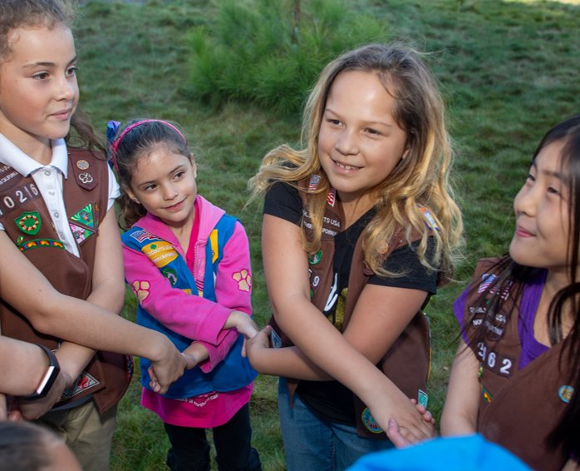
Friendship Circle and Goodbye
*Click ‘Notes’ in the lower bar for ‘How to’
Notes:
Have girls cross arms right over left. They can hold hands with another person in their house if available. Tell girls to close their eyes and make a wish. Show girls how to "spin out" of the circle.
If Friendship Squeeze starter is a Kaper, let the girl know how she will lead the squeeze next time.
Don't forget to send a follow up email!

Slide 26
Dear Brownies...
*Click ‘Notes’ in the lower bar for ‘How to’
Notes:
Send Follow-up Email within 24 hours of the meeting: (edit underlined text accordingly)
Follow-up Email for 1st Brownie Sisterhood meeting
Dear Brownies,
It was wonderful to meet with you and your parents. Do you remember what we did at our meeting? I led you through the Girl Scout Promise. We played a scavenger hunt that you all seemed to enjoy a lot. And even more fun was the ‘get to know you’ game. Wasn’t it cool to come up with an action/ sound/ adjective/ animal that starts with your first name initial?
And without even realizing that you were working on a badge, guess what you were able to earn?
First step of the ‘Making Friends’ badge (Make a friendly introduction with a game)!
Now, it is time to get ready for your next meeting. Do you remember your challenges?
You have to think of two things you like doing the most – with your Troop/ family/ class/ friends/ on your own.
Bring two square pieces of paper to work on Origami – we will make paper craft and work on Step 2 of the badge, Show your friends you care.
I will see you again on (date) at (time). I will send you a reminder again on (Friday morning) with the Zoom link. Until then, have a good rest of the week, read a lot, remember to go out and get some fresh air and exercise.
See you then!
Your Leader,
(leader's name)

Slide 27
Brownie Meeting
Meeting 2
Notes:
Meeting 2 summary:
Opening, scavenger hunt, learn about kapers, snack and story, learn brownie song, closing.
Meeting 2:
Brownie "Making Friends" Meeting 2: about 30 minutes
Welcome: Opening Question / Attendance – 3 minutes
Zoom and Meeting Rules – 1 minute
Opening: GS Promise, GS Law – 2 minutes
Game: Scavenger Hunt (and sharing) - 5 minutes
Kaper Chart Introduction – 5 minutes
Snack and Brownie Story – 5-7 minutes
Brownie Song - 5 minutes
Prep for Next Meeting, Friendship Circle – 3 minutes
Badge Requirements:
Making Friends
Step 1 Make a Friendly Introduction (game)
Step 2 Show Friends You Care (craft)
Step 3 Share a Favorite Activity.
Step 4 Learn How to Disagree.
Step 5 Practice Friendship (game)

Slide 28
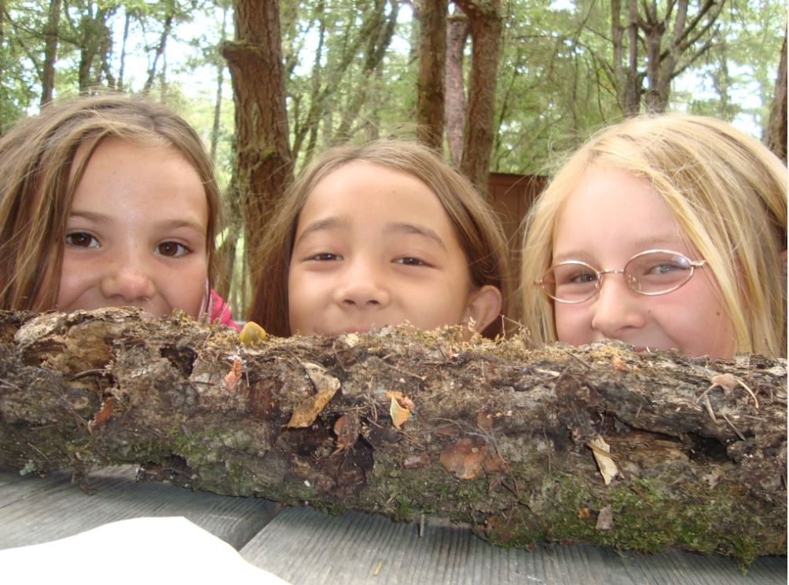
Opening Question
How do you say hello to someone new?
Today's Supplies:
Paper
Markers or crayons
*Click ‘Notes’ in the lower bar for ‘How to’
Notes:
SAY:
Welcome! Are you looking forward to being Brownies this year? Are you ready to start our Brownie adventures together?
This is our Brownie circle. It's a special place where we will come together to share thoughts and ideas and make decisions and plans for our troop. In the Brownie Ring, everyone gets a chance to talk, and everyone listens to what others have to say.
During this meeting, we are going to learn a little about Girl Scouts and spend some time getting to know each other better.

Slide 29
Attendance
*Click ‘Notes’ in the lower bar for ‘How to’
Notes:
Take attendance and ask girls about the 2 things they are interested in. Make a note of their interests.
You can use this information to pick some badge options for the girls for later in the year.
Badges and requirements can be found here: Badge Explorer-- https://www.girlscouts.org/en/our-program/badges/badge_explorer.html
Badges and other awards: https://www.girlscouts.org/content/dam/girlscouts-gsusa/forms-and-documents/our-program/Badges/GSUSA_BrownieBadgesAwardsAndPins2019_Guide.pdf

Slide 30
Brownie Zoom Meeting Rules
TURN AUDIO
CAMERA ON & OFF
WRITE A QUESTION OR ADD YOUR IDEAS
Notes:
Show girls how to use Zoom if they don't already know.
Show them how to mute/unmute themselves and where the chat is. You can also show them how to use the hand raise function if you wish to use that feature.

Slide 31
Meeting Rules
Be respectful in the chat
Remember to share with others and allow others to share too
*Click ‘Notes’ in the lower bar for ‘How to’
Notes:
Go over meeting rules with the girls.
Please customize this slide to rules you prefer for your meetings. Some suggestions are:
- Be respectful in Chat and do not type the same thing over and over
- Listen to others when they are talking.
In a later meeting, we will go over the Girl Scout Internet Safety Pledge which will likely reiterate some of these rules.

Slide 32
Notes:
Optional pledge of allegiance

Slide 33
* You may replace 'God' with what you believe in. For e.g. 'family'

Slide 35
Time for a Scavenger Hunt!
Something orange
Something soft
Something with spots
Something with eyes
Something that makes you happy
Something that starts with the same letter as your name
Notes:
SAY:
It's time to play a game. We are doing a 2 minute scavenger hunt! When I say go, you will have 2 minutes to find (read options on the screen). Can you wear of hold them all at once?
Your two minutes starts in 3...2....1...go!
Give the girls updates on how much time they have left ("1 minute and 10 seconds to go!") and when the return, have them share one of the things they found.

Slide 36
Kaper Chart
Sally May Jones
Sally May Jones
Sally May Jones
Sally May Jones
Reporter
Sally May Jones
Sally May Jones
Attendance Taker
Sally May Jones
Supplies Checker
Clean up Captain
Sally May Jones
Chat Monitor
Law Leader
Sally May Jones
Joke Teller
Sally May Jones
Friendship Squeeze Starter
Song Leader
Promise Leader
Sally May Jones
Sally May Jones
Sally May Jones
*Click ‘Notes’ in the lower bar for ‘How to’
Notes:
Learn about Kapers:
SAY:
Kapers are another important part of our meetings. Kaper is another word for job. The jobs when we meet in person might be getting the room ready for the meeting, passing out supplies or snacks, or cleaning the room before leaving. While we are doing virtual meetings, we will have jobs like Promise Leader and Clean up Captain. We use this Kaper Chart to hand out these jobs and make sure we all have something to do. When everyone pitches in to help with chores, the work is lighter for all.
Here is a "Wheel of Names" tool that you can edit and use to assign Kapers or pick a girl at random for any reason—maybe to share first for an activity, or pick a song for the group to sing, etc.
https://wheelofnames.com/?fbclid=IwAR3B_y1iUK-VdEV0EMO6bpU653xTivfnrcvKS1o_y5eb98lqlqib6cwiG4E
Please edit this slide with the girls’ names in your troop. There are extra name boxes beside the slide. You may not want to have all of these roles. To delete a role, click on the box where the job is listed and delete the text. Or you can drag text boxes off the slide and they will not be visible while presenting.
Possible jobs with descriptions:
Promise Leader: Leads the group is saying the GS Promise. The girl starts the Promise "On my honor.." and the rest of the girls join in.
Reporter: Reports back to the group a summary of what we did at the previous meeting.
Clean up Captain: After snack or craft, leads the group and encourages them to clean up their surroundings. "A Girl Scout always leaves a place cleaner than she found it"
Supply Checker: Reminds other scouts of the supplies needed for that meeting in the beginning. Check to make sure everyone has everything they need and helps to come up with alternatives if missing supplies.
Song Leader: Starts the song for the group or leads the song in repeat after me.
Joke Teller: Brings 1 or 2 jokes to the meeting to share with the troop
Friendship Squeeze Starter: Once girls are crossing their arms, she tells the girls to close their eyes and make a wish and squeeze once.
You can set up a Kaper at the end of each meeting + send reminder to girls to be ready.
Once you fill out this slide for next week’s jobs, you can copy the slide and drag it down to near the beginning of next meeting. Right click, select “Duplicate Slide”, then click and hold the new slide to drag it.

Slide 37
Snack and Story
In what ways, during snack and mealtime, can we show others that we care?
Healthy snack and reading of Brownie elf story!
Brownie Story PDF
Notes:
Activity 6: Story and Snack
Materials
Healthy snack such as fruit, granola, veggies with dip, etc.
A Note about this activity:
Girls may need extra small breaks during their hour long meeting to tide them over. Feel free to include some activities involving movement in between.
Steps
Ask girls to get out their snacks.
SAY:
Have you been wondering at all why Girl Scouts in second- and third-grade are called Brownies? While you're eating your snacks, I'll read The Brownie Story. It's a traditional story that has been told to Brownies for years and years - and it tells how Brownies got their name.
READ: The Brownie Story while the girls are eating snack.
Tip: Short on time? Feel free to skip through the story or just tell it in your own words. Use different voices or add sound effects if you want to amp up the fun factor!
SAY:
Who were the Brownies?
What did they do?
How do you think you could be like the Brownies in the story?
That's right! We can clean up after ourselves at all our Girl Scout Brownie activities. Girl Scouts always leave a place cleaner than they found it!
We should start now! Are you ready, Brownies? How could we leave our meeting place cleaner than we found it?
Let girls suggest ways to tidy the room (throw away trash, push in chairs, sweep, put away supplies, etc.). Give them time to clean up and then ask them to come back to the Brownie Ring for the closing ceremony.
OPTIONAL:
Sing the Brownie Clean-up song while girls are tidying up. Cleaning up is much more fun if you sing while you work.
Brownie Clean-up song (tune is London Bridge)
Weave the magic in and out, in and out in and out,
Weave the magic in and out, for we are Brownies.
We have tidied everything, everything, everything,
We have tidied everything, for we are Brownies.

Slide 38
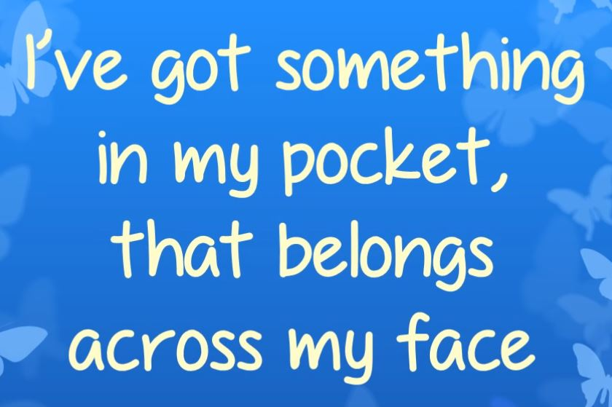
Brownie Song
YouTube Link
*Click ‘Notes’ in the lower bar for ‘How to’
Notes:
Teach all the words to the Brownie song except the last 2 words, ask the girls to guess what is in the pocket. Afterwards, practice the song with repeat after me and learn hand motions.
Lyrics: (and hand motions)
I've got something in my pocket (reach in imaginary chest pocket or pants pocket)
That belongs across my face (point to face)
I keep it very close to me (pull both hands into chest like your hugging something close)
In a most convenient place (pull both hands into chest like your hugging something close)
I'm sure you couldn't guess it (wave finger back and forth)
If you guessed a long long while (wave finger back and forth)
So I'll take it out and put it on (take it out of your pocket)
It's a great big... brownie smile. (smile and put fingers on cheeks)
Brownie Smile Song on YouTube: https://www.youtube.com/watch?time_continue=3&v=KQLo5VuKwyE&feature=emb_logo
Girl Scout singing Brownie Smile Song with hand motions: https://www.youtube.com/watch?v=S-E_Og1fPxc
We'll practice this song again next week but you can practice at home if you want.
If Song Leader is Kaper, SAY:
Next week our Song Leader will start us out or help us remember the hand motions. Does that sound good (girl's name)?

Slide 39
Be prepared for next week:
1. Supplies: Bring a few square pieces of paper to work on an origami craft!
2. Remember your Kaper =]
3. Brownie Challenge! Practice the Brownie Smile song or the Girl Scout Law Song

Slide 40
Parent chat!
*Click ‘Notes’ in the lower bar for ‘How to’
Notes:
At the end of every meeting, bring the adults over and clue them in and get them involved:
"I'll send you the follow up email. Who can help me at the next meeting and be present so that we have enough adults?"
Suggestions of what you can ask them to help specifically with an activity:
"Next week, we are working on a mural, can anyone help out with that?"
"Next week, we are going to read a story for a petal. Whose name can I put down for helping with the story?"
"Who can help out when the girls do a craft?"
"Who is good at singing and would like to lead a song?"
Plan out the help you will need for the four meetings. Use Sign-up Genius to get parents to sign up for specific duties.
Suggestions of what you can discuss with parents:
Make sure everyone has your phone and email, knows the troop number, and has all the information about the next troop meting (date, time, location and any supplies the girls will need to bring).
Make Her Experience Memorable (a resource for parents on how they can help): https://my.girlscouts.org/content/dam-resources2/girlscouts-vtkcontent/Parent-Hub/02_MV_VTKMake%20HerExperienceMemorable_flyer_8.5x11.pdf
More Parent Meeting Resources:
See Brownie Intro Meeting in Volunteer Toolkit for more guidance : https://my.girlscouts.org/content/girlscouts-vtk/en/vtk.details.html?elem=190616400000
Another great resource: "Getting Adults to Help" training in our volunteer eLearning portal: https://training.gsnorcal.org/login/index.php To find it, under Troop Leaders, click on Daisy Leader (Grades K-1). Then click "New troop Leader Course (Part 1 & Part 2). Then scroll to Part 1: Troop Basics and select "Getting Adults to Help (Avg. 20 Min.) or scroll down further to "Meeting with Parents (Avg. 5 Min.)"

Slide 41
Friendship Circle and Goodbye
*Click ‘Notes’ in the lower bar for ‘How to’
Notes:
Have girls cross arms right over left. They can hold hands with another person in their house if available. Tell girls to close their eyes and make a wish. Show girls how to "spin out" of the circle.
If Friendship Squeeze starter is a Kaper, let the girl know how she will lead the squeeze next time.
Don't forget to send a follow up email!

Slide 42
Dear Brownies...
*Click ‘Notes’ in the lower bar for ‘How to’
Notes:
Send Follow-up Email within 24 hours of the meeting: (edit underlined text accordingly)
Follow-up Email for 2nd Brownie Sisterhood meeting
Dear Brownies,
It was wonderful to meet with you! Do you remember what we did at our meeting? We opened with the Girl Scout Promise and played a scavenger hunt game! We then learned about kapers (jobs) that we will all do to help our troop! After that, we enjoyed a snack and a story about brownie elves. Wasn’t it cool to learn that new Brownie song? If you want to practice the song at home you can learn it here: https://www.youtube.com/watch?time_continue=3&v=KQLo5VuKwyE&feature=emb_logo
Do you remember what your Kaper (job) is for our next meeting? Be ready next meeting to do your Kaper! Below is a list of who is doing which Kaper next meeting and what that job means:
(girl's name): (kaper)
(girl's name): (kaper)
(girl's name): (kaper)
(girl's name): (kaper)
(girl's name): (kaper)
(girl's name): (kaper)
Now, it is time to get ready for your next meeting. Do you remember what to bring?
Bring two square pieces of paper to work on Origami
I will see you again on (date) at (time) and send you a reminder again on (Friday morning) with the Zoom link. Until then, have a good rest of the week, read a lot, remember to go out and get some fresh air and exercise.
See you then!
Your Leader,
(leader's name)
Kaper Descriptions: (delete ones you are not using/ modify)
Promise Leader: Leads the group is saying the GS Promise. The girl starts the Promise "On my honor.." and the rest of the girls join in.
Law Leader: Leads the group in saying the GS Law. The girl starts the Law "I will do my best to be..." and the rest of the girls join in.
Reporter: Reports back to the group a summary of what we did at the previous meeting.
Chat Monitor: Reports comments from the Zoom chat, makes sure everyone is being nice in the chat,
Clean up Captain: After snack or craft, leads the group and encourages them to clean up their surroundings. "A Girl Scout always leaves a place cleaner than she found it"
Attendance Taker: Takes the attendance at the beginning of each meeting.
Supply Checker: Reminds other scouts of the supplies needed for that meeting in the beginning. Check to make sure everyone has everything they need and helps to come up with alternatives if missing supplies.
Song Leader: Starts the song for the group or leads the song in repeat after me.
Joke Teller: Brings 1 or 2 jokes to the meeting to share with the troop
Friendship Squeeze Starter: Once girls are crossing their arms, she tells the girls to close their eyes and make a wish and squeeze once.

Slide 43
Brownie Meeting
Meeting 3
Notes:
Meeting 3 summary:
Opening, Kapers, scavenger hunt, Internet safety pledge, making origami hearts, Brownie Song, closing.
Meeting 3:
Brownie "Making Friends" Meeting 3: about 30 minutes
Welcome: Opening Question / Attendance – 3 minutes
Zoom and Meeting Rules –1 minute (optional)
Kaper Chart Review: - 2 minutes
Opening: GS Promise, GS Law – 2 minutes
Game: Scavenger Hunt (and sharing) - 5 minutes
Discussion: "How can we show friends we care?" - 3 minutes
Badge activity: origami hearts – 5-10 minutes
Closing: Prep for Next Meeting, Kaper switch, Brownie Song, Friendship Circle – 5 minutes

Slide 44
Opening Question
How do you show someone you care?
Today's Supplies:
Origami Paper
Notes:
SAY:

Slide 45
Attendance
*Click ‘Notes’ in the lower bar for ‘How to’
Notes:
Take attendance and ask girls about the 2 things they are interested in. Make a note of their interests.
You can use this information to pick some badge options for the girls for later in the year.
Badges and requirements can be found here: Badge Explorer-- https://www.girlscouts.org/en/our-program/badges/badge_explorer.html
Badges and other awards: https://www.girlscouts.org/content/dam/girlscouts-gsusa/forms-and-documents/our-program/Badges/GSUSA_BrownieBadgesAwardsAndPins2019_Guide.pdf

Slide 46
Brownie Zoom Meeting Rules
TURN AUDIO
CAMERA ON & OFF
WRITE A QUESTION OR ADD YOUR IDEAS
Notes:
Show girls how to use Zoom if they don't already know.
Show them how to mute/unmute themselves and where the chat is. You can also show them how to use the hand raise function if you wish to use that feature.

Slide 47
Meeting Rules
Be respectful in the chat
Remember to share with others and allow others to share too
*Click ‘Notes’ in the lower bar for ‘How to’
Notes:
Go over meeting rules with the girls.
Please customize this slide to rules you prefer for your meetings. Some suggestions are:
- Be respectful in Chat and do not type the same thing over and over
- Listen to others when they are talking.
In a later meeting, we will go over the Girl Scout Internet Safety Pledge which will likely reiterate some of these rules.

Slide 48
Notes:
Optional pledge of allegiance

Slide 49
* You may replace 'God' with what you believe in. For e.g. 'family'

Slide 51
Kaper Chart
Sally May Jones
Sally May Jones
Sally May Jones
Sally May Jones
Reporter
Sally May Jones
Sally May Jones
Attendance Taker
Sally May Jones
Supplies Checker
Clean up Captain
Sally May Jones
Chat Monitor
Law Leader
Sally May Jones
Joke Teller
Sally May Jones
Friendship Squeeze Starter
Song Leader
Promise Leader
Sally May Jones
Sally May Jones
Sally May Jones
*Click ‘Notes’ in the lower bar for ‘How to’
Notes:
Learn about Kapers:
SAY:
Kapers are another important part of our meetings. Kaper is another word for job. The jobs when we meet in person might be getting the room ready for the meeting, passing out supplies or snacks, or cleaning the room before leaving. While we are doing virtual meetings, we will have jobs like Promise Leader and Clean up Captain. We use this Kaper Chart to hand out these jobs and make sure we all have something to do. When everyone pitches in to help with chores, the work is lighter for all.
Here is a "Wheel of Names" tool that you can edit and use to assign Kapers or pick a girl at random for any reason—maybe to share first for an activity, or pick a song for the group to sing, etc.
https://wheelofnames.com/?fbclid=IwAR3B_y1iUK-VdEV0EMO6bpU653xTivfnrcvKS1o_y5eb98lqlqib6cwiG4E
Please edit this slide with the girls’ names in your troop. There are extra name boxes beside the slide. You may not want to have all of these roles. To delete a role, click on the box where the job is listed and delete the text. Or you can drag text boxes off the slide and they will not be visible while presenting.
Possible jobs with descriptions:
Promise Leader: Leads the group is saying the GS Promise. The girl starts the Promise "On my honor.." and the rest of the girls join in.
Reporter: Reports back to the group a summary of what we did at the previous meeting.
Clean up Captain: After snack or craft, leads the group and encourages them to clean up their surroundings. "A Girl Scout always leaves a place cleaner than she found it"
Supply Checker: Reminds other scouts of the supplies needed for that meeting in the beginning. Check to make sure everyone has everything they need and helps to come up with alternatives if missing supplies.
Song Leader: Starts the song for the group or leads the song in repeat after me.
Joke Teller: Brings 1 or 2 jokes to the meeting to share with the troop
Friendship Squeeze Starter: Once girls are crossing their arms, she tells the girls to close their eyes and make a wish and squeeze once.
You can set up a Kaper at the end of each meeting + send reminder to girls to be ready.
Once you fill out this slide for next week’s jobs, you can copy the slide and drag it down to near the beginning of next meeting. Right click, select “Duplicate Slide”, then click and hold the new slide to drag it.

Slide 52
Time for a Scavenger Hunt!
Something for sports
Something with a zipper
A picture of someone special
Something with ears
Something purple
Something that relates to math or science
Notes:
SAY:
It's time to play a game. We are doing a 2 minute scavenger hunt! When I say go, you will have 2 minutes to find (read options on the screen). Can you wear of hold them all at once?
Your two minutes starts in 3...2....1...go!
Give the girls updates on how much time they have left ("1 minute and 10 seconds to go!") and when the return, have them share one of the things they found.

Slide 53
Internet Safety Pledge Game
I will practice online etiquette (good manners) at all times when online by:
1. Not spamming others.
2. Not bullying or tolerating bullying (and will always tell a trusted adult if this is a problem).
3. Not using bad language.
4. All of the Above
I will never send a person my picture or anything else or agree to get together with someone I "meet" online without first checking with my parents or guardians.
I will always have a snack before getting online.
I will tell an adult right away if I come across or receive any information that makes me feel uncomfortable.
I will not give out personal information such as my address, telephone number, and the name of my school without the permission of my parent or guardian.
I will ignore the rules of Internet sites, including those rules that are based on age of use and parental approval.
*Click ‘Notes’ in the lower bar for ‘How to’
Notes:
Optional Game for Internet Safety Pledge:
Just like when we meet in person somewhere, the Girl Scouts have rules to keep everyone safe. It's really important that while we are doing so many things on our computers, that we are very careful about being safe on the internet. We have a Girl Scout internet safety pledge that all Girl Scouts agree to that helps keep us all safe online. Now we will play a little game to see if you can figure out what the G8irl Scout Safety Pledge says. I will read you a line and if you think it is part of the safety pledge give me a thumbs up, if you think it is not part of the pledge, give me a thumbs down. Are you ready?
True or Fale:
After each statement and voting, you can ask some girls to shared why they thought it was True of False if they were correct.
Each statement will appear one by one if you click the slide. Read the girls the statement, let them view it on the screen and then decide. Explain the answers and help the discuss.
I will not give out personal information such as my address, telephone number, and the name of my school without the permission of my parent or guardian. (True)
I will tell an adult right away if I come across or receive any information that makes me feel uncomfortable. (True)
I will ignore the rules of Internet sites, including those rules that are based on age of use and parental approval. (False) (always follow)
I will always have a snack before getting online. (False)
I will never send a person my picture or anything else or agree to get together with someone I "meet" online without first checking with my parents or guardians. (True)
The final question will be a multiple choice, hold up the number of fingers for the answer you think it is:
I will practice online etiquette (good manners) at all times when online by:
1. Not spamming others.
2. Not bullying or tolerating bullying (and will always tell a trusted adult if this is a problem).
3. Not using bad language.
4. All of the Above
Answer: 4
Girl Scout Internet Safety Pledge for All Girl Scouts
I will not give out personal information such as my address, telephone number(s), parent's or guardians' work address/telephone number(s), and the name and location of my school without the permission of my parent or guardian.
I will tell an adult right away if I come across or receive any information that makes me feel uncomfortable.
I will always follow the rules of Internet sites, including those rules that are based on age of use, parental approval and knowledge, and public laws.
I will never agree to get together with someone I "meet" online without first checking with my parents or guardians. If my parents or guardian agree to a meeting, I will arrange it in a public place and bring a parent or guardian along.
I will never send a person my picture or anything else without first checking with my parent or guardian.
I will talk with my parent or guardian so that we can set up rules for going online. We will decide on the time of day that I can be online, the length of time that I can be online, and appropriate areas for me to visit. I will not access other areas or break these rules without their permission.
I will follow all of the Girl Scout Terms and Conditions related to Digital Cookie, as well as all internet safety guidelines related to all other Girl Scout product sales.
I will practice online etiquette (good manners) at all times when online by:
Not spamming others.
Not bullying or tolerating bullying (and will always tell a trusted adult if this is a problem).
Not using bad language.
I will be guided by the Girl Scout Promise and Law in all that I do online.

Slide 54
Internet Safety Pledge
I will not give out personal information such as my address, telephone number(s), parent's or guardians' work address/telephone number(s), and the name and location of my school without the permission of my parent or guardian.
I will tell an adult right away if I come across or receive any information that makes me feel uncomfortable.
I will always follow the rules of Internet sites, including those rules that are based on age of use, parental approval and knowledge, and public laws.
I will never agree to get together with someone I "meet" online without first checking with my parents or guardians. If my parents or guardian agree to a meeting, I will arrange it in a public place and bring a parent or guardian along.
I will never send a person my picture or anything else without first checking with my parent or guardian.
I will talk with my parent or guardian so that we can set up rules for going online. We will decide on the time of day that I can be online, the length of time that I can be online, and appropriate areas for me to visit. I will not access other areas or break these rules without their permission.
I will follow all of the Girl Scout Terms and Conditions related to Digital Cookie, as well as all internet safety guidelines related to all other Girl Scout product sales.
I will practice online etiquette (good manners) at all times when online by:
Not spamming others.
Not bullying or tolerating bullying (and will always tell a trusted adult if this is a problem).
Not using bad language.
I will be guided by the Girl Scout Promise and Law in all that I do online.
Notes:
Here is the full list of the Girl Scout Internet Safety Pledge.
You can decide if the girls will print and sign a version of the pledge.
https://www.gsnorcal.org/content/dam/girlscouts-gsnorcal/documents/volunteer_resources/risk/internet-safety-pledge.pdf
Girl Scout Internet Safety Pledge for All Girl Scouts
I will not give out personal information such as my address, telephone number(s), parent's or guardians' work address/telephone number(s), and the name and location of my school without the permission of my parent or guardian.
I will tell an adult right away if I come across or receive any information that makes me feel uncomfortable.
I will always follow the rules of Internet sites, including those rules that are based on age of use, parental approval and knowledge, and public laws.
I will never agree to get together with someone I "meet" online without first checking with my parents or guardians. If my parents or guardian agree to a meeting, I will arrange it in a public place and bring a parent or guardian along.
I will never send a person my picture or anything else without first checking with my parent or guardian.
I will talk with my parent or guardian so that we can set up rules for going online. We will decide on the time of day that I can be online, the length of time that I can be online, and appropriate areas for me to visit. I will not access other areas or break these rules without their permission.
I will follow all of the Girl Scout Terms and Conditions related to Digital Cookie, as well as all internet safety guidelines related to all other Girl Scout product sales.
I will practice online etiquette (good manners) at all times when online by:
Not spamming others.
Not bullying or tolerating bullying (and will always tell a trusted adult if this is a problem).
Not using bad language.
I will be guided by the Girl Scout Promise and Law in all that I do online.

Slide 55
Making Friends Badge
Step 1 Make a Friendly Introduction (game)
Step 2 Show Friends You Care (craft)
Step 3 Share a Favorite Activity
Step 4 Learn How to Disagree
Step 5 Practice Friendship! (pledge)
You are here
The badge you will earn!
Notes:
Badge steps
Step 1 Make a Friendly Introduction (game) ...
Step 2 Show Friends You Care (craft) –origami heart
Step 3 Share a Favorite Activity. ...
Step 4 Learn How to Disagree.
Step 5 Practice Friendship (game)

Slide 56
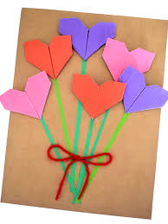
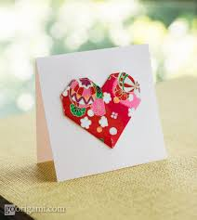
ACTIVITY: ORIGAMI HEARTS
Craft ideas
*Click ‘Notes’ in the lower bar for ‘How to’
Notes:
Step 2 Show Friends You Care (craft) –origami heart
SAY:
There are so many ways we can show our friends that we care. Can you think of a way you've shown a friend that you care?
Have you ever given a friend a gift to show that you care? Have you ever made a friend a gift?
Today, we are going to learn how to make origami hearts. You can use that heart as part of a card or a bookmark or something else to give to your friend to show that you care.
Make sure all the girls have paper. Help them cut the paper into squares.

Slide 57
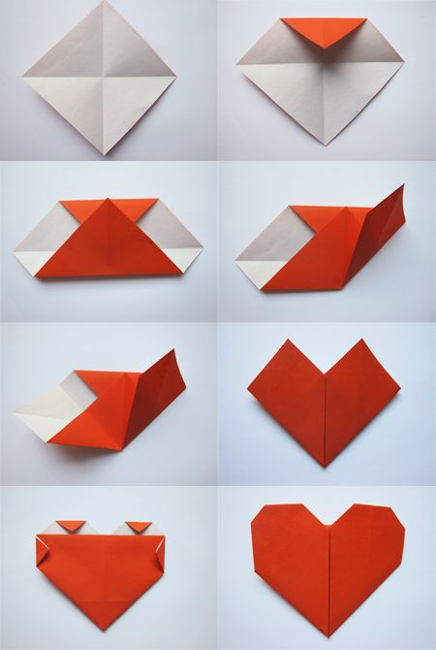
Steps: ORIGAMI HEARTS
*Click ‘Notes’ in the lower bar for ‘How to’
Notes:
Step 2 Show Friends You Care (craft) –origami heart
If the girls haven't cut their paper into squares yet, help them do that.
Instructions:
Fold paper in half diagonally (corner to corner) and then unfold, then fold paper diagonally in the other direction and then unfold, you will have lines showing you where the center is. (picture 1)
Take the square and told it so one of the corners is facing up then fold down that corner so it meets the center (picture 2)
Fold up the bottom corner so it meets the top (picture 3)
Fold in the right side so it meets the middle (picture 4)
Fold in the left side so it meets the middle (pictures 5 & 6)
Flip over the heat and fold down the two corners at the top and fold in the two corners on the sides (picture 7)
Flip over and you have an origami heart! (picture 8)
If you want to watch a video tutorial on this origami: https://www.youtube.com/watch?v=Z-BIL6p1Te8

Slide 58
Brownie Smile Song
YouTube Link
*Click ‘Notes’ in the lower bar for ‘How to’
Notes:
Practice the Brownie Smile Song:
Lyrics: (and hand motions)
I've got something in my pocket (reach in imaginary chest pocket or pants pocket)
That belongs across my face (point to face)
I keep it very close to me (pull both hands into chest like your hugging something close)
In a most convenient place (pull both hands into chest like your hugging something close)
I'm sure you couldn't guess it (wave finger back and forth)
If you guessed a long long while (wave finger back and forth)
So I'll take it out and put it on (take it out of your pocket)
It's a great big... brownie smile. (smile and put fingers on cheeks)
Brownie Smile Song on YouTube: https://www.youtube.com/watch?time_continue=3&v=KQLo5VuKwyE&feature=emb_logo
Girl Scout singing Brownie Smile Song with hand motions: https://www.youtube.com/watch?v=S-E_Og1fPxc
We'll practice this song again next week but you can practice at home if you want.
If Song Leader is Kaper, SAY:
Next week our Song Leader will start us out or help us remember the hand motions. Does that sound good (girl's name)?

Slide 59
Be prepared for next week:
1. Supplies: paper, markers or crayons
2. Remember your Kaper =]
3. Brownie Challenge! Make an origami heart craft for a friend, or write them a card about why their friendship is important to you.

Slide 60
Parent chat!
*Click ‘Notes’ in the lower bar for ‘How to’
Notes:
At the end of every meeting, bring the adults over and clue them in and get them involved:
"I'll send you the follow up email. Who can help me at the next meeting and be present so that we have enough adults?"
Suggestions of what you can ask them to help specifically with an activity:
"Next week, we are working on a mural, can anyone help out with that?"
"Next week, we are going to read a story for a petal. Whose name can I put down for helping with the story?"
"Who can help out when the girls do a craft?"
"Who is good at singing and would like to lead a song?"
Plan out the help you will need for the four meetings. Use Sign-up Genius to get parents to sign up for specific duties.
Suggestions of what you can discuss with parents:
Make sure everyone has your phone and email, knows the troop number, and has all the information about the next troop meting (date, time, location and any supplies the girls will need to bring).
Make Her Experience Memorable (a resource for parents on how they can help): https://my.girlscouts.org/content/dam-resources2/girlscouts-vtkcontent/Parent-Hub/02_MV_VTKMake%20HerExperienceMemorable_flyer_8.5x11.pdf
More Parent Meeting Resources:
See Brownie Intro Meeting in Volunteer Toolkit for more guidance : https://my.girlscouts.org/content/girlscouts-vtk/en/vtk.details.html?elem=190616400000
Another great resource: "Getting Adults to Help" training in our volunteer eLearning portal: https://training.gsnorcal.org/login/index.php To find it, under Troop Leaders, click on Daisy Leader (Grades K-1). Then click "New troop Leader Course (Part 1 & Part 2). Then scroll to Part 1: Troop Basics and select "Getting Adults to Help (Avg. 20 Min.) or scroll down further to "Meeting with Parents (Avg. 5 Min.)"

Slide 61
Friendship Circle and Goodbye
*Click ‘Notes’ in the lower bar for ‘How to’
Notes:
Have girls cross arms right over left. They can hold hands with another person in their house if available. Tell girls to close their eyes and make a wish. Show girls how to "spin out" of the circle.
If Friendship Squeeze starter is a Kaper, let the girl know how she will lead the squeeze next time.
Don't forget to send a follow up email!

Slide 62
Dear Brownies...
*Click ‘Notes’ in the lower bar for ‘How to’
Notes:
Send Follow-up Email within 24 hours of the meeting: (edit underlined text accordingly)
Follow-up Email for 3rd Brownie meeting:
Dear Brownies,
It was wonderful to meet with you! Do you remember what we did at our meeting? We opened with the Girl Scout Promise then played a scavenger hunt game! We all helped out by doing our kapers. After that, we played a game to learn about the Girl Scout Internet Safety Pledge and made origami hearts to show our friends that we care. So far we have completed 2 steps of the Making Friends Badge by:
1. Making a Friendly Introduction (with a game)
2. By Showing Friends we Care (with a craft)
We are only 2 steps away from earning our badge!
Also, do you remember what your Kaper (job) is for our next meeting? Be ready next meeting to do your Kaper! Below is a list of who is doing which Kaper next meeting and what that job means:
(girl's name): (kaper)
(girl's name): (kaper)
(girl's name): (kaper)
(girl's name): (kaper)
(girl's name): (kaper)
(girl's name): (kaper)
Kaper descriptions below.
Now, it is time to get ready for your next meeting. Do you remember what the challenges are?
Make an origami heart craft for a friend, or write them a card about why their friendship is important to you.
Supplies for next week: paper, markers or crayons
We will see you again on (date) at (time). We will send you a reminder again on (Friday morning) with the Zoom link. Until then, have a good rest of the week, read a lot, remember to go out and get some fresh air and exercise.
See you then!
Your Leader,
(leader's name)
Kaper Descriptions: (delete ones you are not using/ modify)
Promise Leader: Leads the group is saying the GS Promise. The girl starts the Promise "On my honor.." and the rest of the girls join in.
Law Leader: Leads the group in saying the GS Law. The girl starts the Law "I will do my best to be..." and the rest of the girls join in.
Reporter: Reports back to the group a summary of what we did at the previous meeting.
Chat Monitor: Reports comments from the Zoom chat, makes sure everyone is being nice in the chat,
Clean up Captain: After snack or craft, leads the group and encourages them to clean up their surroundings. "A Girl Scout always leaves a place cleaner than she found it"
Attendance Taker: Takes the attendance at the beginning of each meeting.
Supply Checker: Reminds other scouts of the supplies needed for that meeting in the beginning. Check to make sure everyone has everything they need and helps to come up with alternatives if missing supplies.
Song Leader: Starts the song for the group or leads the song in repeat after me.
Joke Teller: Brings 1 or 2 jokes to the meeting to share with the troop
Friendship Squeeze Starter: Once girls are crossing their arms, she tells the girls to close their eyes and make a wish and squeeze once.

Slide 63
Brownie Meeting
Meeting 4
Notes:
Meeting 4 summary:
Kaper review, opening, scavenger hunt, badge activity: learn to disagree, closing.
Meeting 4:
Brownie "Making Friends" Meeting 4: about 35 minutes
Welcome: Opening Question / Attendance – 3 minutes
Zoom and Meeting Rules – 2-3 minutes (optional)
Kaper Chart Review: - 5 minutes
Opening: GS Promise, GS Law – 2-5 minutes
Game: Scavenger Hunt (and sharing) - 5 minutes
Badge activity: Learn to Disagree – 5-10 minutes
Closing: Prep for Next Meeting: Kaper switch, Brownie Song, Friendship Circle – 3-5 minutes

Slide 64
Opening Question
How do you help at home?
Today's Supplies:
Paper
Markers or crayons
Notes:
SAY:

Slide 65
Attendance
*Click ‘Notes’ in the lower bar for ‘How to’
Notes:
Take attendance and ask girls about the 2 things they are interested in. Make a note of their interests.
You can use this information to pick some badge options for the girls for later in the year.
Badges and requirements can be found here: Badge Explorer-- https://www.girlscouts.org/en/our-program/badges/badge_explorer.html
Badges and other awards: https://www.girlscouts.org/content/dam/girlscouts-gsusa/forms-and-documents/our-program/Badges/GSUSA_BrownieBadgesAwardsAndPins2019_Guide.pdf

Slide 66
Brownie Zoom Meeting Rules
TURN AUDIO
CAMERA ON & OFF
WRITE A QUESTION OR ADD YOUR IDEAS
Notes:
Show girls how to use Zoom if they don't already know.
Show them how to mute/unmute themselves and where the chat is. You can also show them how to use the hand raise function if you wish to use that feature.

Slide 67
Meeting Rules
Be respectful in the chat
Remember to share with others and allow others to share too
*Click ‘Notes’ in the lower bar for ‘How to’
Notes:
Go over meeting rules with the girls.
Please customize this slide to rules you prefer for your meetings. Some suggestions are:
- Be respectful in Chat and do not type the same thing over and over
- Listen to others when they are talking.
In a later meeting, we will go over the Girl Scout Internet Safety Pledge which will likely reiterate some of these rules.

Slide 68
Notes:
Optional pledge of allegiance

Slide 69
* You may replace 'God' with what you believe in. For e.g. 'family'

Slide 71
Kaper Chart
Sally May Jones
Sally May Jones
Sally May Jones
Sally May Jones
Reporter
Sally May Jones
Sally May Jones
Attendance Taker
Sally May Jones
Supplies Checker
Clean up Captain
Sally May Jones
Chat Monitor
Law Leader
Sally May Jones
Joke Teller
Sally May Jones
Friendship Squeeze Starter
Song Leader
Promise Leader
Sally May Jones
Sally May Jones
Sally May Jones
*Click ‘Notes’ in the lower bar for ‘How to’
Notes:
Learn about Kapers:
SAY:
Kapers are another important part of our meetings. Kaper is another word for job. The jobs when we meet in person might be getting the room ready for the meeting, passing out supplies or snacks, or cleaning the room before leaving. While we are doing virtual meetings, we will have jobs like Promise Leader and Clean up Captain. We use this Kaper Chart to hand out these jobs and make sure we all have something to do. When everyone pitches in to help with chores, the work is lighter for all.
Here is a "Wheel of Names" tool that you can edit and use to assign Kapers or pick a girl at random for any reason—maybe to share first for an activity, or pick a song for the group to sing, etc.
https://wheelofnames.com/?fbclid=IwAR3B_y1iUK-VdEV0EMO6bpU653xTivfnrcvKS1o_y5eb98lqlqib6cwiG4E
Please edit this slide with the girls’ names in your troop. There are extra name boxes beside the slide. You may not want to have all of these roles. To delete a role, click on the box where the job is listed and delete the text. Or you can drag text boxes off the slide and they will not be visible while presenting.
Possible jobs with descriptions:
Promise Leader: Leads the group is saying the GS Promise. The girl starts the Promise "On my honor.." and the rest of the girls join in.
Reporter: Reports back to the group a summary of what we did at the previous meeting.
Clean up Captain: After snack or craft, leads the group and encourages them to clean up their surroundings. "A Girl Scout always leaves a place cleaner than she found it"
Supply Checker: Reminds other scouts of the supplies needed for that meeting in the beginning. Check to make sure everyone has everything they need and helps to come up with alternatives if missing supplies.
Song Leader: Starts the song for the group or leads the song in repeat after me.
Joke Teller: Brings 1 or 2 jokes to the meeting to share with the troop
Friendship Squeeze Starter: Once girls are crossing their arms, she tells the girls to close their eyes and make a wish and squeeze once.
You can set up a Kaper at the end of each meeting + send reminder to girls to be ready.
Once you fill out this slide for next week’s jobs, you can copy the slide and drag it down to near the beginning of next meeting. Right click, select “Duplicate Slide”, then click and hold the new slide to drag it.

Slide 72
Time for a Scavenger Hunt!
something with a funny face
Something made from paper
Something starting with L
A belt or scarf
a game
Something you need on a hike
Notes:
SAY:
It's time to play a game. We are doing a 2 minute scavenger hunt! When I say go, you will have 2 minutes to find (read options on the screen). Can you wear of hold them all at once?
Your two minutes starts in 3...2....1...go!
Give the girls updates on how much time they have left ("1 minute and 10 seconds to go!") and when the return, have them share one of the things they found.

Slide 73
Making Friends Badge
Step 1 Make a Friendly Introduction (game)
Step 2 Show Friends You Care (craft)
Step 3 Share a Favorite Activity
Step 4 Learn How to Disagree
Step 5 Practice Friendship! (pledge)
You are here
The badge you will earn!
Notes:
Badge steps
Step 1 Make a Friendly Introduction (game) ...
Step 2 Show Friends You Care (craft) –origami heart
Step 3 Share a Favorite Activity. ...
Step 4 Learn How to Disagree.
Step 5 Practice Friendship (game)

Slide 74
Role Play: How To Disagree
You do not like what you are eating for dinner
You want to play a different game
A friend says something that hurts your feelings
Notes:
Have two girls volunteer to role play one of these scenarios. Ask them to demonstrate how to work out this disagreement.
Other Scenario examples:
• Your friend wants to play soccer but you want to play something else.
• Your friend beats you in a game you are playing together.
• Your friend says something to you that hurts your feelings.
• Your friend is ignoring you because she is mad at you about something.
• You and your friend both want to use the same jump rope at the same time.
• Your friend forgot to bring a toy to play with at recess today.
• Your friend is sitting all alone with no one to play with.
Additional activity:
If you want, you can break the girls up into pairs in Breakout Rooms and allow them 5 minutes to prepare a skit about a scenario you assign them.
1. Give girls five minutes to quietly prepare the scene they are going to act out, including how to
resolve their scenario. The scenes should be brief—no longer than one minute each.
2. Gather as a large group and allow each pair one minute to act out their scene in front of the rest of
the group. After each skit, allow the group to discuss briefly what was acted out and the
characteristics of good and bad friends.

Slide 75
Be prepared for next week:
1. Supplies: Paper, Markers or crayons
2. Remember your Kaper =]
3. Next meeting is our Talent Show!

Slide 76
Brownie Smile Song
YouTube Link
*Click ‘Notes’ in the lower bar for ‘How to’
Notes:
Practice the Brownie Smile Song:
Lyrics: (and hand motions)
I've got something in my pocket (reach in imaginary chest pocket or pants pocket)
That belongs across my face (point to face)
I keep it very close to me (pull both hands into chest like your hugging something close)
In a most convenient place (pull both hands into chest like your hugging something close)
I'm sure you couldn't guess it (wave finger back and forth)
If you guessed a long long while (wave finger back and forth)
So I'll take it out and put it on (take it out of your pocket)
It's a great big... brownie smile. (smile and put fingers on cheeks)
Brownie Smile Song on YouTube: https://www.youtube.com/watch?time_continue=3&v=KQLo5VuKwyE&feature=emb_logo
Girl Scout singing Brownie Smile Song with hand motions: https://www.youtube.com/watch?v=S-E_Og1fPxc
We'll practice this song again next week but you can practice at home if you want.
If Song Leader is Kaper, SAY:
Next week our Song Leader will start us out or help us remember the hand motions. Does that sound good (girl's name)?

Slide 77
Parent chat!
*Click ‘Notes’ in the lower bar for ‘How to’
Notes:
At the end of every meeting, bring the adults over and clue them in and get them involved:
"I'll send you the follow up email. Who can help me at the next meeting and be present so that we have enough adults?"
Suggestions of what you can ask them to help specifically with an activity:
"Next week, we are working on a mural, can anyone help out with that?"
"Next week, we are going to read a story for a petal. Whose name can I put down for helping with the story?"
"Who can help out when the girls do a craft?"
"Who is good at singing and would like to lead a song?"
Plan out the help you will need for the four meetings. Use Sign-up Genius to get parents to sign up for specific duties.
Suggestions of what you can discuss with parents:
Make sure everyone has your phone and email, knows the troop number, and has all the information about the next troop meting (date, time, location and any supplies the girls will need to bring).
Make Her Experience Memorable (a resource for parents on how they can help): https://my.girlscouts.org/content/dam-resources2/girlscouts-vtkcontent/Parent-Hub/02_MV_VTKMake%20HerExperienceMemorable_flyer_8.5x11.pdf
More Parent Meeting Resources:
See Brownie Intro Meeting in Volunteer Toolkit for more guidance : https://my.girlscouts.org/content/girlscouts-vtk/en/vtk.details.html?elem=190616400000
Another great resource: "Getting Adults to Help" training in our volunteer eLearning portal: https://training.gsnorcal.org/login/index.php To find it, under Troop Leaders, click on Daisy Leader (Grades K-1). Then click "New troop Leader Course (Part 1 & Part 2). Then scroll to Part 1: Troop Basics and select "Getting Adults to Help (Avg. 20 Min.) or scroll down further to "Meeting with Parents (Avg. 5 Min.)"

Slide 78
Friendship Circle and Goodbye
*Click ‘Notes’ in the lower bar for ‘How to’
Notes:
Have girls cross arms right over left. They can hold hands with another person in their house if available. Tell girls to close their eyes and make a wish. Show girls how to "spin out" of the circle.
If Friendship Squeeze starter is a Kaper, let the girl know how she will lead the squeeze next time.
Don't forget to send a follow up email!

Slide 79
Dear Brownies...
*Click ‘Notes’ in the lower bar for ‘How to’
Notes:
Send Follow-up Email within 24 hours of the meeting: (edit underlined text accordingly)
Follow-up Email for 4th Brownie meeting:
Dear Brownies,
It was wonderful to meet with you! Do you remember what we did at our meeting? We opened with the Girl Scout Promise then played a scavenger hunt game! We all helped out by doing our kapers. After that, we played a game to learn about how we can disagree with friends and solve conflicts. This week we completed another step of the Making Friends Badge by:
Learn how to disagree (with a game)
We are only 2 steps away from earning our badge! (3 of 5 steps completed!)
Also, do you remember what your Kaper (job) is for our next meeting? Be ready next meeting to do your Kaper! Below is a list of who is doing which Kaper next meeting and what that job means:
(girl's name): (kaper)
(girl's name): (kaper)
(girl's name): (kaper)
(girl's name): (kaper)
(girl's name): (kaper)
(girl's name): (kaper)
Now, it is time to get ready for your next meeting. Do you remember what the challenges are?
Next meeting is our Talent Show! Prepare 3 minutes to show or teach us about one of your favorite things! Feel free to include your whole family.
Supplies for next week: paper, markers or crayons
We will see you again on (date) at (time). We will send you a reminder again on (Friday morning) with the Zoom link. Until then, have a good rest of the week, read a lot, remember to go out and get some fresh air and exercise. Bring your parents to next meeting so they can see the Talent Show as well!
See you then.
Your Leader,
(leader's name)
Kaper Descriptions: (delete ones you are not using/ modify)
Promise Leader: Leads the group is saying the GS Promise. The girl starts the Promise "On my honor.." and the rest of the girls join in.
Law Leader: Leads the group in saying the GS Law. The girl starts the Law "I will do my best to be..." and the rest of the girls join in.
Reporter: Reports back to the group a summary of what we did at the previous meeting.
Chat Monitor: Reports comments from the Zoom chat, makes sure everyone is being nice in the chat,
Clean up Captain: After snack or craft, leads the group and encourages them to clean up their surroundings. "A Girl Scout always leaves a place cleaner than she found it"
Attendance Taker: Takes the attendance at the beginning of each meeting.
Supply Checker: Reminds other scouts of the supplies needed for that meeting in the beginning. Check to make sure everyone has everything they need and helps to come up with alternatives if missing supplies.
Song Leader: Starts the song for the group or leads the song in repeat after me.
Joke Teller: Brings 1 or 2 jokes to the meeting to share with the troop
Friendship Squeeze Starter: Once girls are crossing their arms, she tells the girls to close their eyes and make a wish and squeeze once.

Slide 80
Brownie Meeting
Meeting 5
Notes:
Meeting 5 summary:
Opening, traffic light game, learn Girl Scout handshake, talent show, closing
Meeting 5:
Brownie "Making Friends" Meeting 5: about 35-45 minutes
Welcome: chatting - 2 minutes
Welcome: Opening Question / Attendance – 3 minutes
Kapers: 5 minutes
Opening: GS Promise, GS Law – 2 minutes
Game: Traffic Light Game – 3-5 minutes
GS Tradition: Girl Scout Handshake – 3 minutes
Badge activity: Talent show! -- 20 minutes
Closing: Prep for Next Meeting, Friendship Circle – 3 minutes

Slide 81
Opening Question
What's the most creative way you can think of to show a friend or family member that you care?

Slide 82
Attendance
*Click ‘Notes’ in the lower bar for ‘How to’
Notes:
Take attendance and ask girls about the 2 things they are interested in. Make a note of their interests.
You can use this information to pick some badge options for the girls for later in the year.
Badges and requirements can be found here: Badge Explorer-- https://www.girlscouts.org/en/our-program/badges/badge_explorer.html
Badges and other awards: https://www.girlscouts.org/content/dam/girlscouts-gsusa/forms-and-documents/our-program/Badges/GSUSA_BrownieBadgesAwardsAndPins2019_Guide.pdf

Slide 83
Brownie Zoom Meeting Rules
TURN AUDIO
CAMERA ON & OFF
WRITE A QUESTION OR ADD YOUR IDEAS
Notes:
Show girls how to use Zoom if they don't already know.
Show them how to mute/unmute themselves and where the chat is. You can also show them how to use the hand raise function if you wish to use that feature.

Slide 84
Meeting Rules
Be respectful in the chat
Remember to share with others and allow others to share too
*Click ‘Notes’ in the lower bar for ‘How to’
Notes:
Go over meeting rules with the girls.
Please customize this slide to rules you prefer for your meetings. Some suggestions are:
- Be respectful in Chat and do not type the same thing over and over
- Listen to others when they are talking.
In a later meeting, we will go over the Girl Scout Internet Safety Pledge which will likely reiterate some of these rules.

Slide 85
Notes:
Optional pledge of allegiance

Slide 86
* You may replace 'God' with what you believe in. For e.g. 'family'

Slide 88
Kaper Chart
Sally May Jones
Sally May Jones
Sally May Jones
Sally May Jones
Reporter
Sally May Jones
Sally May Jones
Attendance Taker
Sally May Jones
Supplies Checker
Clean up Captain
Sally May Jones
Chat Monitor
Law Leader
Sally May Jones
Joke Teller
Sally May Jones
Friendship Squeeze Starter
Song Leader
Promise Leader
Sally May Jones
Sally May Jones
Sally May Jones
*Click ‘Notes’ in the lower bar for ‘How to’
Notes:
Learn about Kapers:
SAY:
Kapers are another important part of our meetings. Kaper is another word for job. The jobs when we meet in person might be getting the room ready for the meeting, passing out supplies or snacks, or cleaning the room before leaving. While we are doing virtual meetings, we will have jobs like Promise Leader and Clean up Captain. We use this Kaper Chart to hand out these jobs and make sure we all have something to do. When everyone pitches in to help with chores, the work is lighter for all.
Here is a "Wheel of Names" tool that you can edit and use to assign Kapers or pick a girl at random for any reason—maybe to share first for an activity, or pick a song for the group to sing, etc.
https://wheelofnames.com/?fbclid=IwAR3B_y1iUK-VdEV0EMO6bpU653xTivfnrcvKS1o_y5eb98lqlqib6cwiG4E
Please edit this slide with the girls’ names in your troop. There are extra name boxes beside the slide. You may not want to have all of these roles. To delete a role, click on the box where the job is listed and delete the text. Or you can drag text boxes off the slide and they will not be visible while presenting.
Possible jobs with descriptions:
Promise Leader: Leads the group is saying the GS Promise. The girl starts the Promise "On my honor.." and the rest of the girls join in.
Reporter: Reports back to the group a summary of what we did at the previous meeting.
Clean up Captain: After snack or craft, leads the group and encourages them to clean up their surroundings. "A Girl Scout always leaves a place cleaner than she found it"
Supply Checker: Reminds other scouts of the supplies needed for that meeting in the beginning. Check to make sure everyone has everything they need and helps to come up with alternatives if missing supplies.
Song Leader: Starts the song for the group or leads the song in repeat after me.
Joke Teller: Brings 1 or 2 jokes to the meeting to share with the troop
Friendship Squeeze Starter: Once girls are crossing their arms, she tells the girls to close their eyes and make a wish and squeeze once.
You can set up a Kaper at the end of each meeting + send reminder to girls to be ready.
Once you fill out this slide for next week’s jobs, you can copy the slide and drag it down to near the beginning of next meeting. Right click, select “Duplicate Slide”, then click and hold the new slide to drag it.

Slide 89
GAME TIME
Traffic Light!
Green: Dance/ Run in place
Yellow: Do what you are doing in slow motion
Red: Freeze

Slide 90
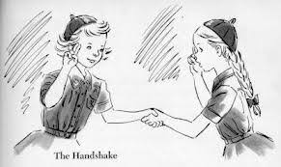
Girl Scout Handshake

Slide 91
Making Friends Badge
Step 1 Make a Friendly Introduction (game)
Step 2 Show Friends You Care (craft)
Step 3 Share a Favorite Activity
Step 4 Learn How to Disagree
Step 5 Practice Friendship! (pledge)
You are here
The badge you will earn!
Notes:
Badge steps
Step 1 Make a Friendly Introduction (game) ...
Step 2 Show Friends You Care (craft) –origami heart
Step 3 Share a Favorite Activity. ...
Step 4 Learn How to Disagree.
Step 5 Practice Friendship (game)

Slide 92
Talent Show / Teach Us Something!
Notes:
Remember in the beginning of the meeting when I said that there would be a chance for one of you to teach us something you love? Well now is that time! If you have an idea of something you want to share, raise your hand.
Ask one girl to spend a few minutes teaching us her favorite activity or teaching us a song.
If there is time and/or another girl really wants to share, maybe allow another to share.
If the girl wants to share something on the computer and share her screen and knows how, you can allow that but will need to make her co-host of the Zoom meeting. You can do this by opening the participants list, clicking the three dots next to her name and selecting "make co-host"

Slide 93
Brownie Smile Song
YouTube Link
*Click ‘Notes’ in the lower bar for ‘How to’
Notes:
Practice the Brownie Smile Song:
Lyrics: (and hand motions)
I've got something in my pocket (reach in imaginary chest pocket or pants pocket)
That belongs across my face (point to face)
I keep it very close to me (pull both hands into chest like your hugging something close)
In a most convenient place (pull both hands into chest like your hugging something close)
I'm sure you couldn't guess it (wave finger back and forth)
If you guessed a long long while (wave finger back and forth)
So I'll take it out and put it on (take it out of your pocket)
It's a great big... brownie smile. (smile and put fingers on cheeks)
Brownie Smile Song on YouTube: https://www.youtube.com/watch?time_continue=3&v=KQLo5VuKwyE&feature=emb_logo
Girl Scout singing Brownie Smile Song with hand motions: https://www.youtube.com/watch?v=S-E_Og1fPxc
We'll practice this song again next week but you can practice at home if you want.
If Song Leader is Kaper, SAY:
Next week our Song Leader will start us out or help us remember the hand motions. Does that sound good (girl's name)?

Slide 94
Be prepared for next week:
1. Supplies: paper and markers or crayons
2. Remember your Kaper =]

Slide 95
Parent chat!
*Click ‘Notes’ in the lower bar for ‘How to’
Notes:
At the end of every meeting, bring the adults over and clue them in and get them involved:
"I'll send you the follow up email. Who can help me at the next meeting and be present so that we have enough adults?"
Suggestions of what you can ask them to help specifically with an activity:
"Next week, we are working on a mural, can anyone help out with that?"
"Next week, we are going to read a story for a petal. Whose name can I put down for helping with the story?"
"Who can help out when the girls do a craft?"
"Who is good at singing and would like to lead a song?"
Plan out the help you will need for the four meetings. Use Sign-up Genius to get parents to sign up for specific duties.
Suggestions of what you can discuss with parents:
Make sure everyone has your phone and email, knows the troop number, and has all the information about the next troop meting (date, time, location and any supplies the girls will need to bring).
Make Her Experience Memorable (a resource for parents on how they can help): https://my.girlscouts.org/content/dam-resources2/girlscouts-vtkcontent/Parent-Hub/02_MV_VTKMake%20HerExperienceMemorable_flyer_8.5x11.pdf
More Parent Meeting Resources:
See Brownie Intro Meeting in Volunteer Toolkit for more guidance : https://my.girlscouts.org/content/girlscouts-vtk/en/vtk.details.html?elem=190616400000
Another great resource: "Getting Adults to Help" training in our volunteer eLearning portal: https://training.gsnorcal.org/login/index.php To find it, under Troop Leaders, click on Daisy Leader (Grades K-1). Then click "New troop Leader Course (Part 1 & Part 2). Then scroll to Part 1: Troop Basics and select "Getting Adults to Help (Avg. 20 Min.) or scroll down further to "Meeting with Parents (Avg. 5 Min.)"

Slide 96
Friendship Circle and Goodbye
*Click ‘Notes’ in the lower bar for ‘How to’
Notes:
Have girls cross arms right over left. They can hold hands with another person in their house if available. Tell girls to close their eyes and make a wish. Show girls how to "spin out" of the circle.
If Friendship Squeeze starter is a Kaper, let the girl know how she will lead the squeeze next time.
Don't forget to send a follow up email!

Slide 97
Dear Brownies...
*Click ‘Notes’ in the lower bar for ‘How to’
Notes:
Send Follow-up Email within 24 hours of the meeting: (edit underlined text accordingly)
Follow-up Email for 5th Brownie meeting:
Dear Brownies,
It was wonderful to meet with you! Do you remember what we did at our meeting? We opened with the Girl Scout Promise then played a traffic light game! We all helped out by doing our kapers. After that, we learned one of the most important Girl Scout greetings, the Girl Scout handshake! The best part of our meeting was seeing everyone's talents at our Talent Show! This week we completed another step of the Making Friends Badge by:
Sharing a Favorite Activity (through the talent show)
We are only 1 step away from earning our badge! (4 of 5 steps completed!)
Also, do you remember what your Kaper (job) is for our next meeting? Be ready next meeting to do your Kaper! Below is a list of who is doing which Kaper next meeting and what that job means:
(girl's name): (kaper)
(girl's name): (kaper)
(girl's name): (kaper)
(girl's name): (kaper)
(girl's name): (kaper)
(girl's name): (kaper)
Now, it is time to get ready for your next meeting. Do you remember what to bring?
paper, markers or crayons
We will see you again on (date) at (time). We will send you a reminder again on (Friday morning) with the Zoom link. Until then, have a good rest of the week, read a lot, remember to go out and get some fresh air and exercise. Bring your parents to next meeting so they can see the Talent Show as well!
See you then.
Your Leader,
(leader's name)

Slide 98
Brownie Meeting
Meeting 6
Notes:
Meeting 6 summary:
Opening, scavenger hunt, making a friendship pledge together, writing an acrostic poem, Brownie song, closing.
Meeting 6:
Brownie "Making Friends" Meeting 6: about 30 minutes
Welcome: Opening Question / Attendance – 3 minutes
Zoom and Meeting Rules – 1 minute (optional)
Kapers: 5 mintues
Opening: GS Promise, GS Law – 2 minutes
Game: Scavenger Hunt (and sharing) - 5 minutes
Badge activity: Friendship Pledge and acrostic poem – 5-10 minutes
Closing: Prep for Next Meeting: Kaper switch, Brownie Song, Friendship Circle – 5 minutes

Slide 99
Opening
What is one special thing you have done to make someone feel special?
Today's Supplies:
Paper
Markers or crayons
*Click ‘Notes’ in the lower bar for ‘How to’
Notes:
SAY:
Give a personal example:
I made a scavenger hunt for a friend's birthday
I planned a surprise party for my parent's anniversary
I sent a letter to my sister's favorite author and asked her to sign my sister's book.

Slide 100
Time for a Scavenger Hunt!
something with a funny face
Something made from paper
Something starting with L
A belt or scarf
a game
Something you need on a hike
Notes:
SAY:
It's time to play a game. We are doing a 2 minute scavenger hunt! When I say go, you will have 2 minutes to find (read options on the screen). Can you wear of hold them all at once?
Your two minutes starts in 3...2....1...go!
Give the girls updates on how much time they have left ("1 minute and 10 seconds to go!") and when the return, have them share one of the things they found.

Slide 101
Making Friends Badge
Step 1 Make a Friendly Introduction (game)
Step 2 Show Friends You Care (craft)
Step 3 Share a Favorite Activity
Step 4 Learn How to Disagree
Step 5 Practice Friendship! (pledge)
The badge you will earn!
You are here
Notes:
Now we will work on our final step, Step 5: Practice Friendship
Badge steps
Step 1 Make a Friendly Introduction (game) ...
Step 2 Show Friends You Care (craft) –origami heart
Step 3 Share a Favorite Activity. ...
Step 4 Learn How to Disagree.
Step 5 Practice Friendship (game)

Slide 102
Friendship Pledge
Notes:
Use this space to make a Friendship Pledge with your Brownies.
An idea:
Have girls trace their hands on paper and write "I will be a good friend!" in the middle and decorate it. Have the girls sign the bottom of their pledge. Encourage girls to display their friendship pledge in a place where they can see it everyday.
Another idea: Discuss the pledge on the slide. Have girls print and sign the pledge.

Slide 103
Let’s try something new: Acrostic/ Name Poem
*Click ‘Notes’ in the lower bar for ‘How to’
Notes:
SAY:
Another great way to practice Friendship is to show friends we care! Now, we are going to make a fun acrostic poem for a friend or sibling. Write the letters of your friend's name in big letters going downwards like this word, "cats". Let me know if you need help spelling your friend's name. Then, we will think of things that start with those letters that reminds us of our friend or why we love them so much!

Slide 104
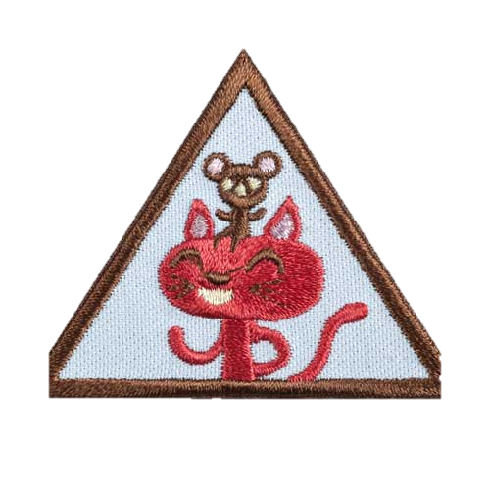
Congratulations!
Purchase your badge at your local shop or online at www.gsnorcal.org/shop

Slide 105
Brownie Smile Song
I've got something in my pocket
That belongs across my face
I keep it very close to me
In a most convenient place
I'm sure you couldn't guess it
If you guessed a long long while
So I'll take it out and put it on
It's a great big... brownie smile.
YouTube Link
Notes:
Practice the Brownie Smile Song:
Lyrics: (and hand motions)
I've got something in my pocket (reach in imaginary chest pocket or pants pocket)
That belongs across my face (point to face)
I keep it very close to me (pull both hands into chest like your hugging something close)
In a most convenient place (pull both hands into chest like your hugging something close)
I'm sure you couldn't guess it (wave finger back and forth)
If you guessed a long long while (wave finger back and forth)
So I'll take it out and put it on (take it out of your pocket)
It's a great big... brownie smile. (smile and put fingers on cheeks)
Brownie Smile Song on YouTube: https://www.youtube.com/watch?time_continue=3&v=KQLo5VuKwyE&feature=emb_logo
Girl Scout singing Brownie Smile Song with hand motions: https://www.youtube.com/watch?v=S-E_Og1fPxc
We'll practice this song again next week but you can practice at home if you want.
If Song Leader is Kaper, SAY:
Next week our Song Leader will start us out or help us remember the hand motions. Does that sound good (girl's name)?

Slide 106
Parent chat!
*Click ‘Notes’ in the lower bar for ‘How to’
Notes:
Share the badge completion news with your parents!

Slide 107
Friendship Circle and Goodbye
*Click ‘Notes’ in the lower bar for ‘How to’
Notes:
End the Sisterhood series with a Friendship circle. Perhaps, your next meeting will be a fun meeting – check out our Resource Packet for a virtual activity you can do together.

Slide 108
Dear Brownies...
*Click ‘Notes’ in the lower bar for ‘How to’
Notes:
Send Follow-up Email within 24 hours of the meeting: (edit underlined text accordingly)
Follow-up Email for 6th Brownie meeting:
Dear Brownies,
It was wonderful to meet with you! Do you remember what we did at our meeting? We opened with the Girl Scout Promise then played a scavenger hunt game! We all helped out by doing our kapers. After that, we made a friendship pledge together and wrote acrostic poems for our friends. This week, we completed the last step of the Making Friends Badge by:
Practicing friendship (through our pledge and acrostic poems)
We have now completed our Making Friends Badge. ongratulations!
Also, do you remember what your Kaper (job) is for our next meeting? Be ready next meeting to do your Kaper! Below is a list of who is doing which Kaper next meeting and what that job means:
(girl's name): (kaper)
(girl's name): (kaper)
(girl's name): (kaper)
(girl's name): (kaper)
(girl's name): (kaper)
(girl's name): (kaper)
Now, it is time to get ready for your next meeting. Do you remember what to bring?
(add supplies here, or anything for them to complete before next meeting)
We will see you again on (date) at (time). We will send you a reminder again on (Friday morning) with the Zoom link. Until then, have a good rest of the week, read a lot, remember to go out and get some fresh air and exercise. Bring your parents to next meeting so they can see the Talent Show as well!
See you then.
Your Leader,
(leader's name)

