Slide 1
GSNorCal Brownie Virtual Meeting Resource Packet

Slide 2
Slides 3-5 Slides 6-16 Slides 17-37 Slides 38-64 Slides 65-76 Slides 77-88 Slides 89-95 Slides 96-112
Table of Content
1. Virtual Troop Meeting FAQ, VTK, Zoom and other virtual resources 2. Girl Scout Traditions 3. Ice breakers 4. Virtual Activities 5. Scavenger Hunt 6. Girl Scout Songs 7. Letters to Brownies
8. Virtual Meeting templates and images
Notes:
(add welcome)

Slide 3
Virtual Troop Meeting FAQ, VTK, Zoom and other virtual resources

Slide 4
- General Virtual Troop Meeting Resources - General Brownie Resources
Click on ‘Notes’ in the lower bar below to learn more about:
*Click ‘Notes’ in the lower bar for ‘How to’
Notes:
These links are listed in the Notes of the slides where they are applicable. They are compiled here if you need to find all of them in one place.
Virtual Troop Leading Resources:
Here is a "Wheel of Names" tool that you can edit and use to assign Kapers or pick a girl at random for any reason—maybe to share first for an activity, or pick a song for the group to sing, etc. https://wheelofnames.com/?fbclid=IwAR3B_y1iUK-VdEV0EMO6bpU653xTivfnrcvKS1o_y5eb98lqlqib6cwiG4E
Link to virtual Ice Breakers: (Pre-made icebreaker slides at end of this presentation) https://www.girlscouts.org/en/girl-scouts-at-home/troop-leaders/digital-icebreakers-games.html
Girl Scout Internet Safety Pledge: https://www.gsnorcal.org/content/dam/girlscouts-gsnorcal/documents/volunteer_resources/risk/internet-safety-pledge.pdf
General Resources:
Badge Explorer (with badge requirements, interactive): https://www.girlscouts.org/en/our-program/badges/badge_explorer.html
Badges and other awards: https://www.girlscouts.org/content/dam/girlscouts-gsusa/forms-and-documents/our-program/Badges/GSUSA_BrownieBadgesAwardsAndPins2019_Guide.pdf
Girl Scout Law Song video made by older Girl Scouts. Challenge the girls to watch the video at home and practice the song.
https://www.youtube.com/watch?v=6dF8dUi37x8&t=1s (start the video 30 seconds in, after they finish singing the song once, stop the video)

Slide 5
Zoom and VTK Tips
Volunteer Toolkit (VTK) includes:
Content to plan any badge!
Video Tutorials on adding badges to year plan and more
Link to Badge Explorer to check requirements for each badge
Zoom How to:
Make sure to disable annotations when you share your screen
Share a video
Create a poll
*Click ‘Notes’ in the lower bar to access Zoom and VTK ‘How to’
Notes:
Volunteer Toolkit (for leaders and parents):
General Volunteer Toolkit Link: https://www.gsnorcal.org/en/for-volunteers/volunteer-toolkit.html
Video tutorials (quick and easy!):
How to Set Up Your Year Plan https://www.youtube.com/watch?v=n0nrh4NJBFk&list=PLZaWZO965rJ2_OmlsOCwnzUe0xkhTBhrG&index=1
Meeting Plan Overview https://www.youtube.com/watch?v=AHw9W6YyOPU&list=PLZaWZO965rJ2_OmlsOCwnzUe0xkhTBhrG&index=2
Setting Meeting Dates and Locations https://www.youtube.com/watch?v=R_nGzg4Ux3w&list=PLZaWZO965rJ2_OmlsOCwnzUe0xkhTBhrG&index=3
Customizing Your Year Plan https://www.youtube.com/watch?v=uTdSFjJcFu0&list=PLZaWZO965rJ2_OmlsOCwnzUe0xkhTBhrG&index=4
Badge Explorer (with badge requirements): https://www.girlscouts.org/en/our-program/badges/badge_explorer.html
Zoom:
General: It can be easier/smoother to use two computer monitors if you have access.
How to disable annotations: This can only be done while the host is sharing their screen. To set it up beforehand, open a zoom meeting and select share screen. Once sharing right click on the three dots/More on the right side of the menu bar. Click "disable participants annotation" When you start the next meeting, this setting should remain saved, but it's good to check when you start sharing your screen during the meeting. If your girls know not to annotate inappropriately, then there is no need to disable this feature and you may choose to use it as part of your meeting—maybe your troop can create a picture together on the screen.
How to share a video: Only a host or co-host can share a screen. Select "Share Screen" and click on the window with the video. Make sure to check the boxes in the bottom left corner that say "Share Computer Sound" and "Optimize for Video Sharing" and then click "share." Make sure there are no "zoom" boxes over the video screen such as the chat, participants list, or control panel. This will appear to participants as a gray box blocking the screen. If you are experienced with Zoom, some of these settings can be changed in Zoom settings: https://zoom.us/
How to see girls' videos while you are screen sharing: While screen sharing, go to the menu bar and click on the three dots/More on the right hand side. Select "View Participant Videos"
How to Poll: When you start the meeting, click Polls on the menu bar. This will take you to a browser window where you can give the Poll a title, question, and possible answers. When you are done you can click the Polls button on the menu again and your poll will show up. You can click Launch Poll to start polling the girls. You can end polling and relaunch at anytime. You can also add additional poll questions. (If you don't see the Polls menu, try making your Zoom window full screen or by clicking the More tab on the menu bar)

Slide 6
Girl Scout Traditions

Slide 7
Kaper Chart
Sally May Jones
Sally May Jones
Sally May Jones
Sally May Jones
Reporter
Sally May Jones
Sally May Jones
Attendance Taker
Sally May Jones
Supplies Checker
Clean up Captain
Sally May Jones
Chat Monitor
Law Leader
Sally May Jones
Joke Teller
Sally May Jones
Friendship Squeeze Starter
Song Leader
Promise Leader
Sally May Jones
Sally May Jones
Sally May Jones
*Click ‘Notes’ in the lower bar for ‘How to’
Notes:
Here is a "Wheel of Names" tool that you can edit and use to assign Kapers or pick a girl at random for any reason—maybe to share first for an activity, or pick a song for the group to sing, etc.
https://wheelofnames.com/?fbclid=IwAR3B_y1iUK-VdEV0EMO6bpU653xTivfnrcvKS1o_y5eb98lqlqib6cwiG4E
Please edit this slide with the girls’ names in your troop. There are extra name boxes beside the slide. You may not want to have all of these roles. To delete a role, click on the box where the job is listed and delete the text. Or you can drag text boxes off the slide and they will not be visible while presenting.
Possible jobs with descriptions:
Promise Leader: Leads the group is saying the GS Promise. The girl starts the Promise "On my honor.." and the rest of the girls join in.
Reporter: Reports back to the group a summary of what we did at the previous meeting.
Clean up Captain: After snack or craft, leads the group and encourages them to clean up their surroundings. "A Girl Scout always leaves a place cleaner than she found it"
Supply Checker: Reminds other scouts of the supplies needed for that meeting in the beginning. Check to make sure everyone has everything they need and helps to come up with alternatives if missing supplies.
Song Leader: Starts the song for the group or leads the song in repeat after me.
Joke Teller: Brings 1 or 2 jokes to the meeting to share with the troop
Friendship Squeeze Starter: Once girls are crossing their arms, she tells the girls to close their eyes and make a wish and squeeze once.
For next week, you can copy this slide and drag it down to near the beginning of next meeting. Right click, select “Duplicate Slide”, then click and hold the new slide to drag it.

Slide 8
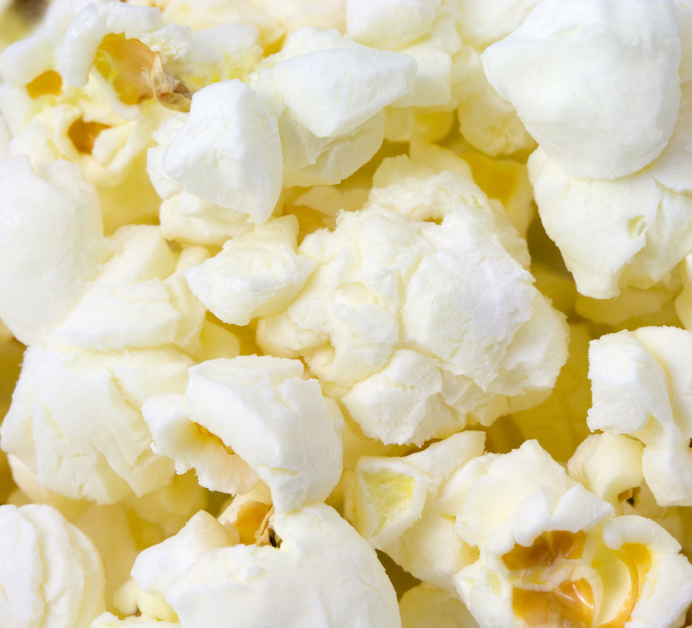
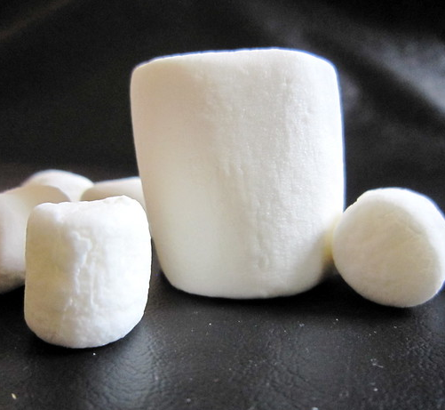
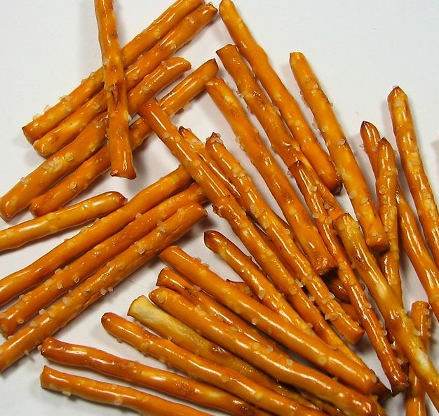
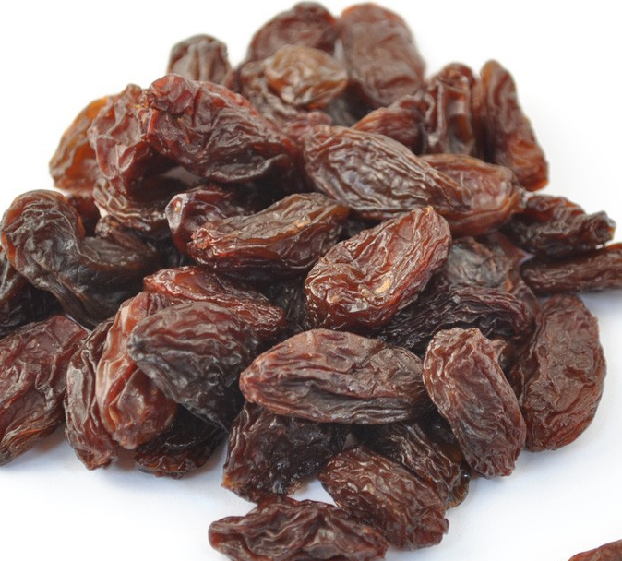
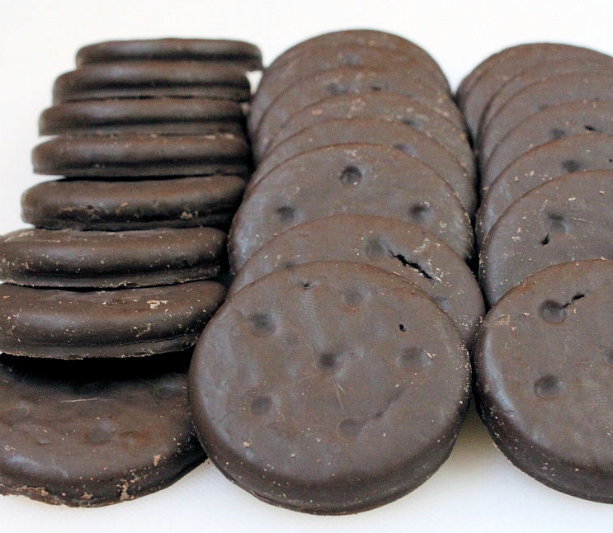
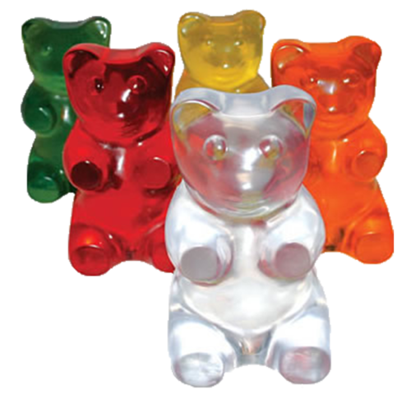
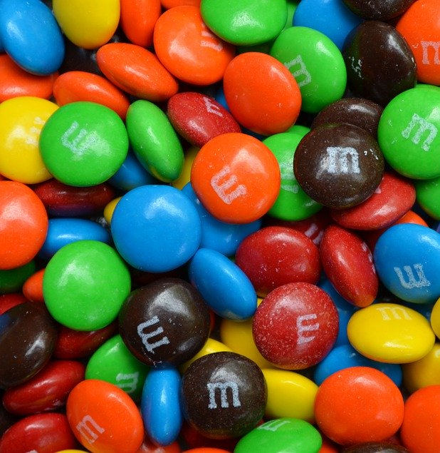
Rededication Scavenger Hunt!!
Get a bowl
And then add as many of these food items as you can find!!
CHEX CEREAL
POPCORN
MARSHMALLOWS
CHEERIOS
PRETZEL STICKS
RAISINS
THIN MINTS
GOLDFISH
GUMMI BEARS
M&M's
*Click ‘Notes’ in the lower bar for ‘How to’
Notes:
Leader: Today we are going to do a Rededication Ceremony.” That is a fancy way of saying we are going to reflect on why we are in Girl Scouts. This ceremony is an important Girl Scout tradition as it is also when we all commit to being a Girl Scout again.
Today, for our ceremony, we will use the items you found during our scavenger hunt to build a snack to nourish our bodies to symbolize how Girl Scouting nourishes our spirits. Each ingredient of our snack represents one of the “ingredients” of the Girl Scout Law. We pledge to uphold this law because we know it will make us better people and help us make the world a better place.
When I read each statement, I want you to hold up that ingredient to the screen so that we can see it. If you don’t have that ingredient, that’s ok because we’re all at our homes and we have different ingredients in our kitchens. If you have the ingredient I call out, put a small bit of it into your bowl.
CHEX MIX SQUARE - “honest and fair” is the first part of the Girl Scout Law. Let’s remember to be fair and square by adding CHEX to our snack.
POPCORN - “friendly and helpful” We “pop” with enthusiasm when we lend a helping hand. So, let’s add POPCORN to show that we are “friendly and helpful.”
MARSHMALLOWS – “considerate and caring” Sometimes, we show that we are “considerate and caring” by giving a squishy-squeezy hug to a friend when they are sad or just to say “hi.” Let’s add MARSHMALLOWS to represent hugs for our friends.
CHEERIOS- “courageous and strong” As a troop, we have a strong circle of friendship that we can count to help all of us be “courageous and strong.” Let’s add CHEERIOS to represent that strong circle.
PRETZELS- “responsible for what I say and do” this pretzel looks like a capital “I”, and represent that “I” am responsible for doing what’s right. Let’s add pretzels to represent “responsible for what I say and do.”
RAISINS - “respect myself and others” I can respect myself be eating foods that are health good for me. RAISINS are a good source of iron, potassium, and other nutrients; so let’s add raisins as a reminder to take care of our bodies.
THIN MINT COOKIES – “respect authority” By selling Girl Scout cookies, we are helping support the Girl Scouts raise money to support girls over the whole nation. By adding THIN MINTS to our mix, we “respect authority” by supporting our organization in raising funds and following Product Sale rules.
GOLDFISH- “use resources wisely” We should always remember to “use resources wisely” in order to take care of our planet and all living things. We will add GOLDFISH to remind us to take care of the earth and use resources wisely.
GUMMI BEARS “make the world a better place” Look at these cute bears!! To represent the community service and conservation projects that we do, let’s add GUMMI BEARS to the mix to represent the endangered animals that we want to help.
M&M’s “be a sister to every Girl Scout” Girl Scouts come from all over the world. No matter what she looks like on the outside or what language she speaks or where she lives, she is our sister, we are all the same on the inside, just like M&M’s.
Now, we have a big mix all these yummy treats, and just like each ingredient on its own is wonderful, mixed together it is AMAZING, just like how your next year in Girl Scouts will be!

Slide 9
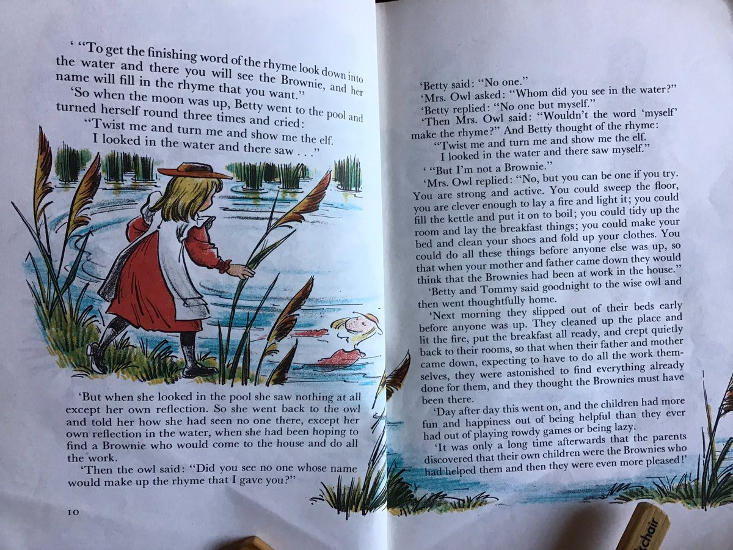
Brownie Rededication Ceremony
Scavenger Hunt!! Go find three items:
1. A mirror or a photo of yourself
2. A stuffed animal or older sibling
3. A cleaning tool (like a duster or broom)
*Click ‘Notes’ in the lower bar for ‘How to’
Notes:
LEADER: Do you all remember the Brownie Girl Scout Elf Story? We, too, will perform a little magic of "let's pretend". Close your eyes and while I read we will magically be transported to the forest with Granny's house and the wise owl."​
"Close your eyes" ​
"Cross your little fingers, stand upon your toes, that's a bit of magic every Brownie knows. Now we all are standing in a forest glade, listen very carefully to hear the magic made. Open your eyes. Here we are in the big woods, before you is a pond, you can almost hear the Wise Old Owl and the friends of whom you're fond." ​
​
Next, I will give you all instructions and a repeat after me poem. ​
​
"Stand Up" (all girls stand up)​
"Look in your mirror or at your photo" (girls look into mirror/photo)​
"Turn in a circle" (girls turn around)​
​
Now repeat after me....​
​
"Twist me and turn me"​
"And show me an elf"​
"I looked in the water"​
"And saw MYSELF" ​
​
"There, the magic is complete! You are again a Brownie and your challenge is to go do a simple helpful cleaning task with the item you grabbed. And now to seal your rededication for another year in Girl Scouts, you will recite the Girl Scout Promise to either your stuffed animal or the adult in the room." ​
Together everyone recite the Girl Scout Promise (advance slide)​

Slide 10
Snack and Brownie Story
In what ways, during snack and mealtime, can we show others that we care?
Make a healthy snack and read the Brownie elf story!
*Click ‘Notes’ in the lower bar for ‘How to’
Notes:
Activity 6: Story and Snack
Materials
Healthy snack such as fruit, granola, veggies with dip, etc.
A Note about this activity:
Girls may need extra small breaks during their hour long meeting to tide them over. Feel free to include some activities involving movement in between.
Steps
Ask girls to get out their snacks.
SAY:
Have you been wondering at all why Girl Scouts in second- and third-grade are called Brownies? While you're eating your snacks, I'll read The Brownie Story. It's a traditional story that has been told to Brownies for years and years - and it tells how Brownies got their name.
READ: The Brownie Story while the girls are eating snack.
Tip: Short on time? Feel free to skip through the story or just tell it in your own words. Use different voices or add sound effects if you want to amp up the fun factor!
SAY:
Who were the Brownies?
What did they do?
How do you think you could be like the Brownies in the story?
That's right! We can clean up after ourselves at all our Girl Scout Brownie activities. Girl Scouts always leave a place cleaner than they found it!
We should start now! Are you ready, Brownies? How could we leave our meeting place cleaner than we found it?
Let girls suggest ways to tidy the room (throw away trash, push in chairs, sweep, put away supplies, etc.). Give them time to clean up and then ask them to come back to the Brownie Ring for the closing ceremony.
OPTIONAL:
Sing the Brownie Clean-up song while girls are tidying up. Cleaning up is much more fun if you sing while you work.
Brownie Clean-up song (tune is London Bridge)
Weave the magic in and out, in and out in and out,
Weave the magic in and out, for we are Brownies.
We have tidied everything, everything, everything,
We have tidied everything, for we are Brownies.

Slide 11
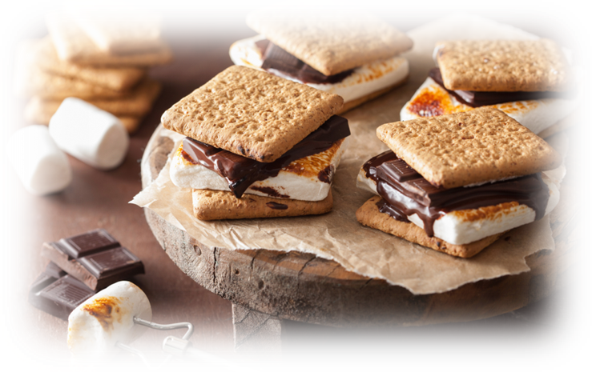
Campfire and Smores
Campfire Video on YouTube
*Click ‘Notes’ in the lower bar for ‘How to’
Notes:
Girl Scouts sing songs, perform skits, and eat s'mores around campfires!
Smores Activity:
Have each girl get the ingredients to make smores and walk them through it (make sure they have adult help if using microwave)
Ingredients: graham cracker, marshmallow, chocolate bar
Campfire Activity 1:
Information on fire safety and how to build a fire:
https://www.gsmw.org/content/dam/girlscouts-gsmw/documents/Fire%20Safety%20%26%20Starting.pdf
Campfire Activity 2:
Edible Campfire: https://browniesmeet.wordpress.com/tag/edible-campfire/
This is also a great opportunity to sing songs together!
You can listen and watch the fire while you sing, tell stories, make smores, etc. With this Campfire Video:
https://www.youtube.com/watch?v=qsOUv9EzKsg&feature=youtu.be

Slide 12
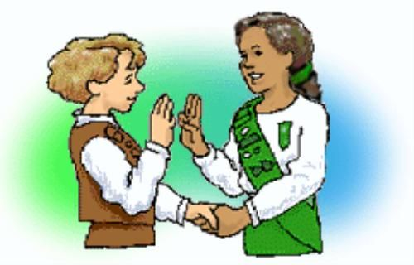
Girl Scout Handshake
Notes:
Greeting: Girl Scouts can greet one another with the Girl Scout handshake, used by Girl Scouts and Girl Guides all over the world. The handshake is made by shaking hands with the left hand and making the Girl Scout sign with the right. The left hand is nearest to the heart and signifies friendship.

Slide 13
Do you know the Girl Scout slogan?
"Do a good turn daily“
The Girl Scout slogan, which has been used since 1912, is "Do a good turn daily." The slogan is a reminder of the many ways girls can contribute positively to the lives of others.
Notes:
Slogan:

Slide 14
Do you know the Girl Scout Motto?
Be prepared
The Girl Scout motto is "Be prepared." In the 1947 Girl Scout Handbook, the motto was explained this way: "A Girl Scout is ready to help out wherever she is needed. Willingness to serve is not enough; you must know how to do the job well, even in an emergency." The same holds true today.
Notes:
Motto:

Slide 15
Juliette Gordon Low's Birthday Party
Juliette Gordon Low's Birthday/Girl Scout Founder's Day - October 31
Ways to Celebrate Juliette Low's birthday:
https://trailhead.gsnorcal.org/ways-to-celebrate-juliette-gordon-lows-birthday/

Slide 16
Girl Scout Traditions: SWAPS
Girl Scouts often make small tokens of friendship to exchange with the Girl Scouts they meet while traveling. These little gifts are called ”SWAPS,” which stands for “Special Whatchamacallits Affectionately Pinned Somewhere.”
More about SWAPS:
https://www.girlscoutsp2p.org/content/dam/girlscouts-girlscoutsp2p/documents/SWAPS.pdf

Slide 17
Ice breakers
The following slides have Ice Breakers you can use with your troop. Duplicate the slide you want and drag it up to where you want to use it.

Slide 18
Action Name Game!
*Click ‘Notes’ in the lower bar for ‘How to’
Notes:
Activity 3: Action Name Introduction Game
Materials
None
Steps
During this meeting, we are going to learn a little about Girl Scouts and spend some time getting to know each other better. Let's do that now.
Each person is going to say their name along with an action-word to go with their name (such as "Swimming Samantha or Jumping Jennifer"), and then you will show the action to the group. So if my name was Samantha, I would say Swimming Samantha and then pretend to swim. Got it?
Let's try! Everyone stand up -we might need some space for this.
Start the game by saying your action name and then, perform the action.
Have girls repeat your action name and do the action.
Now, pick one girl to say her action name and perform her action. Her action name should start with the same letter as her first name.
Great! Now let's all try to remember from the beginning.
Everyone says her action name and performs the action. Keep going until all girls have been introduced.
Keep It Girl-Led Tip
Let girls choose their own action word for their name. Don't decide for them, or let other girls decide for them. If a girl is struggling to come up with a word, ask if she would like the group's help before giving her hints.
After the game, introduce yourself by telling a little about you, including whether you're related to any girls in the troop.
SAY:
I will be guiding you this year as we have our troop meetings, do activities, earn badges and awards, sell cookies, and so much more. The most important thing that I want you to know is that this is YOUR Brownie troop and you get to make the plans and decisions.
How does that sound?
I will help to guide you and make sure we always stay safe.

Slide 19
Ice Breaker: The Wind Blows
For someone whose name starts with letter ‘N’
For someone who has long hair
For someone who had ice-cream for lunch
For someone who went for a walk this week
For someone who is celebrating her birthday this month
For someone who is wearing a blue t-shirt

Slide 20
Ice Breaker
Show and Tell
Ask the girls to share something of theirs with the troop. Consider giving them a theme or a question. For example, “Show us something you’ve had since you were a baby” or “Show us something you can’t go a day without.”

Slide 21
Ice Breaker
Where Are You?
Ask girls to give you a brief virtual tour of their space. What’s one thing they love about the room they are in? What’s one thing they wish they could change?

Slide 22
Ice Breaker
Virtual I-Spy
Ask the girls to pick one spot and stay in that spot for the entire icebreaker. Then, have the girls take turns looking at the screens and seeing what they can find in each other's backgrounds!
Notes:
Virtual ‘I Spy’

Slide 23
Ice Breaker
Two truths and a fib
Give this well-known icebreaker a virtual spin! Ask the girls a specific question (“What are some places you have visited?” Or “What don’t we already know about you?”) and ask them to pick three answers—two that are true and one that’s not. But, when it’s not true, they have to make a subtle gesture or change in their tone of voice. Then, see if the other girls can guess which answers are true.
Notes:
Two Truths and a Fib

Slide 24
Ice Breaker
If I could, then I would
Ask girls to complete each part of the sentence “If only I could____, then I would _____.” Remind them that it can be something true or just something silly. It is completely up to them!
Notes:
If Only I Could… Then I Would...

Slide 25
Ice Breaker
Question of the day
Pick a different question for each meeting and ask the girls to answer it in just one or two sentences. The question can tie into something going on in their lives, badge activities you will complete during the meeting, or just something silly!
Notes:
Question of The Day

Slide 26
Ice Breaker
What’s your emoji today?
Instead of asking the girls how they’re feeling, ask them to take turns making the emoji face that matches how they are feeling. Then, give the rest of the troop a few minutes to guess the emotion before asking the girl to share how she is feeling. This icebreaker is a great way to check in on everyone while turning it into a game for the girls.
Notes:
What's Your Emoji Today?

Slide 27
Ice Breaker
Big questions:
• Do you want to stay the same age forever? If yes, what age would that be?
• What is your favorite possession?
• If you could have one superpower, which one would you choose?
• Are you a morning bird or a night owl?
• Which season is your favorite? Why?
• What item or gadget are you currently dreaming of buying?
• Would you prefer to go to the mountains or the beach?
• If you could live anywhere on this planet, where would you live?
• What is the most memorable vacation you have ever taken?
• What is your favorite food?
• Which historical figure would you want to meet?
• Who has been the most influential person in your life?
• Where do you see yourself in 10 years?
• Juliette Gordon Low left Girl Scouts a wonderful legacy. What do you want your legacy to be?
• What is one of your biggest goals in life?

Slide 28
Ice Breaker
What is unique about me?
This ice-breaker will take a little coordinating with parents of girls before the meeting. Ask each parent to share one unique thing about their daughter. This could be anything from their hobbies to favorite toys. Then, set up a quiz. In the meeting, you can describe one of the girls and everyone has to try to guess who that girl is. This is a great time to talk about how everyone is unique and how important it is to respect each other.

Slide 29
Ice Breaker
What is your favorite song?
This ice-breaker will take a little coordination before the meeting. Have every girl send you their favorite song. Find the music video that goes with each song. During the meeting, play part of the video. Pause it and ask girls to guess whose favorite song it is. Continue this through the year as you go through all the girls in the troop. Or, do this activity, if you can, every time you meet.
Notes:
What is Your Favorite Song?

Slide 30
Ice Breaker
Write a meme (for Brownies+)
Have the girls send you a funny picture of themselves, of their pet, of something in house, etc. before the meeting. At the meeting, bring up one of the pictures. Everyone will write in chat a funny meme that should go with the picture. You can show a few examples of what a Meme is. After everyone comes up with a meme, have them vote for the funniest. Save the winner and if you can, add a title to the meme. You could add captions to the meme and show the girls the finished Memes next time.
Notes:
Write a Meme (for Brownies and up)

Slide 31
Ice Breaker
Would you rather
This is more for laughs and conversation. Don’t waste time coming up with them yourself. This website has 100s to choose from.
Notes:
Would you rather questions

Slide 32
Ice Breaker
Pictionary
If you are meeting with Zoom, use the whiteboard feature:
How to play: Put everyone on call into two teams. To play, divide your group into teams. Choose the team to go first and either have one girl on team come up with a word for her team to guess or use this easy to use Pictionary word generator. Then, give the drawer one minute to draw that word for their team to guess. If the team guesses the card correctly, they get a point. Choose how long you will play or to what point level to find a winner.

Slide 33
Ice Breaker
Freeze dance
Most girls love dancing. Add one of these active YouTube videos to your next virtual meeting. It might be a great way to end the meeting or even break it up in middle of meeting.
The Dance Freeze Song
Tooty Ta

Slide 34
Icebreaker – The wind blows
For someone whose name starts with letter ‘P’
For someone who has short hair
For someone who had cookies for lunch
For someone who went biking this week
For someone who is celebrating her birthday in March
For someone who is wearing a brown t-shirt

Slide 35
Ice Breaker
What did you do this week? Show it in action and let your friends guess.
Notes:
Let the girls take turns sharing answers the these questions.
About 3-4 minutes.

Slide 36
Ice Breaker
Get the wiggles out
Do yoga or have a dance party together.
Notes:
Get the wiggles out:

Slide 37
Ice Breaker
More Ice-breaker links:
https://www.girlscouts.org/en/girl-scouts-at-home/troop-leaders/digital-icebreakers-games.html

Slide 38
Virtual Activities

Slide 39
Virtual Activity
Virtual trip to the zoo
You may not be able to go to the zoo but many zoos offer live footage of their zoo animals. Take your girls on a zoo trip virtually. Here are a few to get you started. If you have a local zoo be sure to check in locally as well.
Baboons at San Diego Zoo
Elephant at Houston Zoo

Slide 40
Talent Show!
*Click ‘Notes’ in the lower bar for ‘How to’
Notes:
SAY:
In a few meetings, each one of you will share something with us that you love to do! You can teach us an activity or a song or share something you know a lot about. I'm telling you now so you can start thinking about what you might want to share. You will have a few minutes only to share. You can share something with your family or by yourself. You can also share a slide show of your talent if you know how. Does anyone have any questions? Does that sound good?
Talent Show requirements:
Groups are allowed to enter. Groups must be from the same household (siblings or family members living together)
Live Virtual Show will be on Date and Time.
Your piece should be under 5 minutes -
You can choose to share your favorite activity: a dance, song, a skit
OR do a show and tell (it could be about your pet, your hobby) - You can create a slide show or do a live presentation.
Practice, practice, practice - we want this to be our best Brownie show!
Invite all your family members (who live in the same household) to watch the show!

Slide 41
*Click ‘Notes’ in the lower bar for ‘How to’
Notes:
Optional activity/discussion:
Ask the girl what they are excited to do in Brownies. If they don't know what Brownies do, ask them which of these pictures looks the most fun and why. You can also talk about what's happening in each picture:
From left to right starting at top:
picture 1—selling Girl Scout cookies at a cookie booth
picture 2—girls creating unique structures, fun crafts
picture 3—making new friends
picture 4—playing field games
picture 5—taking a dance class together
picture 6—cleaning up a beach

Slide 42
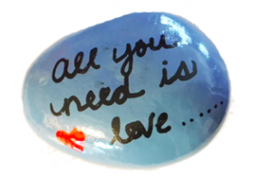
Virtual Activity
Paint a kindness rock
Girls will enjoy painting a rock and leaving somewhere on their next work for someone else to find. I shared my experience with the Kindness Rock Project a few years ago. This is the perfect time to keep these gestures going.

Slide 43
Virtual Activity
Making masks for people in your community.
One thing many people need right now is masks, there are many making them and selling but you could also make them and donate to people in your community. Sew and No Sew Instructions for mask.

Slide 44
Virtual Activity
Make a ‘thinking of you’ card
Make for people in nursing homes, senior residences, and assisted living. The card can be anything the girls want to put on them. Learn how to make a Kite “Thinking of You” card.

Slide 45
Virtual Activity
Kitchen Science
Slides 44-50

Slide 46
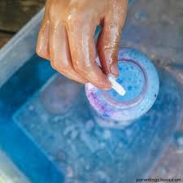
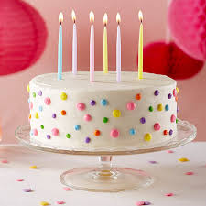
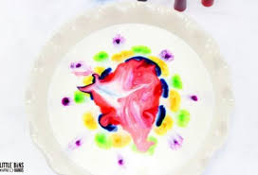
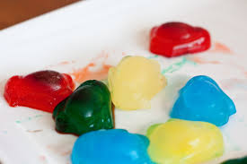
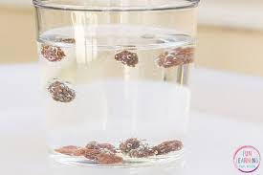
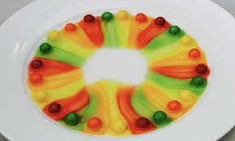
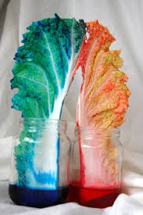
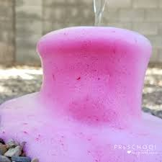
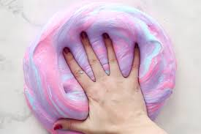
KITCHEN SCIENCE
Program Activity
*Click ‘Notes’ in the lower bar for ‘How to’
Notes:
Did you know that there is a boatload of science right in your own kitchen?
There are so many great science experiments that use simple kitchen ingredients. Most of which you already have in your cupboards. Why not bring your science learning right into the kitchen. Remember Learning happens everywhere!
Please make sure you have an adult nearby to help you with this experiment.

Slide 47
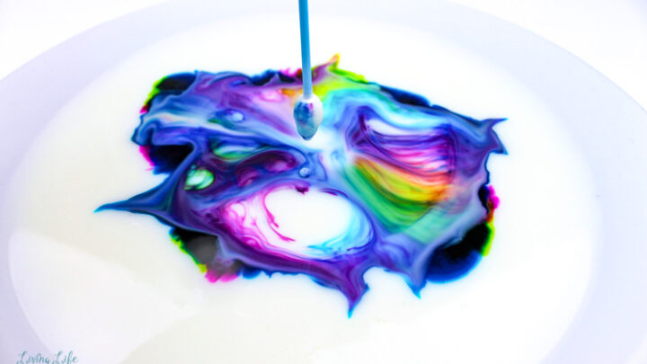
MAGIC MILK
This Photo by Unknown Author is licen
*Click ‘Notes’ in the lower bar for ‘How to’
Notes:
Making a cake is science! All of the different ingredients that you mix into a cake and once it gets heated up they all react to each other and make something new and delicious
Please just watch first, then you will go into a breakout room to do your experiment

Slide 48
What you will need:
a bowl
Whole milk or Nut milk
dish detergent (dawn works best)
food coloring (Not the gel kind)
Q-tip
*Click ‘Notes’ in the lower bar for ‘How to’
Notes:
I'm going to have you watch me first, then you will go into break out rooms to do your experiments

Slide 49
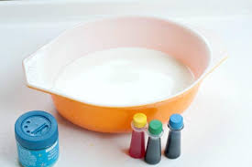
Step 1: Pour milk into bowl Step 2: Choose three colors Step 3: Squeeze 4 to 6 drops of each color, kind of close together, into the milk
Instructions
*Click ‘Notes’ in the lower bar for ‘How to’
Notes:
Just watch for now and then you will do your experiment in a break out room

Slide 50
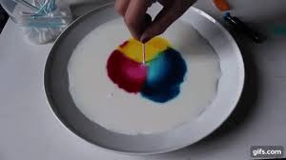
Instructions
Step 4: Dip Q-tip in the dish soap
Step 5: Touch the dipped end of the Q-tip to the center of your colors.
Step 6: Wait for the explosion of color which will be followed with Ooohs and Awwws

Slide 51
If you have Zoom and enough adult support, use breakout rooms for smaller groups to work on the experiment. If not, ask the girls to pay attention to what you do and follow along. Once you add dish detergent to milk, the reaction will happen fast. Ask girls to focus on the milk and the reaction. * More leading questions in ‘Notes’.
Notes:
Did you see what happened?
The secret of the bursting colors is the chemistry of that tiny drop of soap. Milk contains fat and protein which like to be together. Dish Soap sticks to the fat in the milk and pushes away the protein.
This is where the fun begins!
The bits of fat bend, roll, twist, in all directions as the soap races around to join up with the fat.
During all these gymnastics the food coloring is bumped and shoved everywhere which gives you an easy way to see the invisible activity. As the soap becomes evenly mixed with the milk, the action slows down and eventually stops.

Slide 52
Virtual Activity
Paint a sloth
Girls will enjoy painting a rock or paper plate with a picture of a friendly sloth! Check out the video from our Sunday Funday 2020 Renewal Event with instructions on how to paint a sloth in our YouTube channel

Slide 53
Notes:
As a reference for the Leader or can be used for a badge discussion:
Here are all the different kinds of badges we can work on. We won't have time to do them all so we will have to just pick a few that we earn together as a troop. Our badges are in 4 categories, entrepreneurship, life skills, stem, and outdoors. Entrepreneurship means starting your own business.​ Who knows what STEM means?
STEM= Science, Technology, Engineering, an Math
​
​
​
Ask girls what their interests are vs which badges they want to: ​
Hiking, painting, etc.

Slide 54
Virtual Activity: Leaf Man
* Activity information in ‘Notes’.
Notes:
Leaf-man Video:
https://www.youtube.com/watch?v=YvAK2hxNFrY
Breakout Room to do activity:
Assign the girls into breakout room to do the art & craft activity. Each room need to have an adult leader or staff
Girls will create their own Leaf-man using the leaves that they collected and glue
Girls share their art project

Slide 55
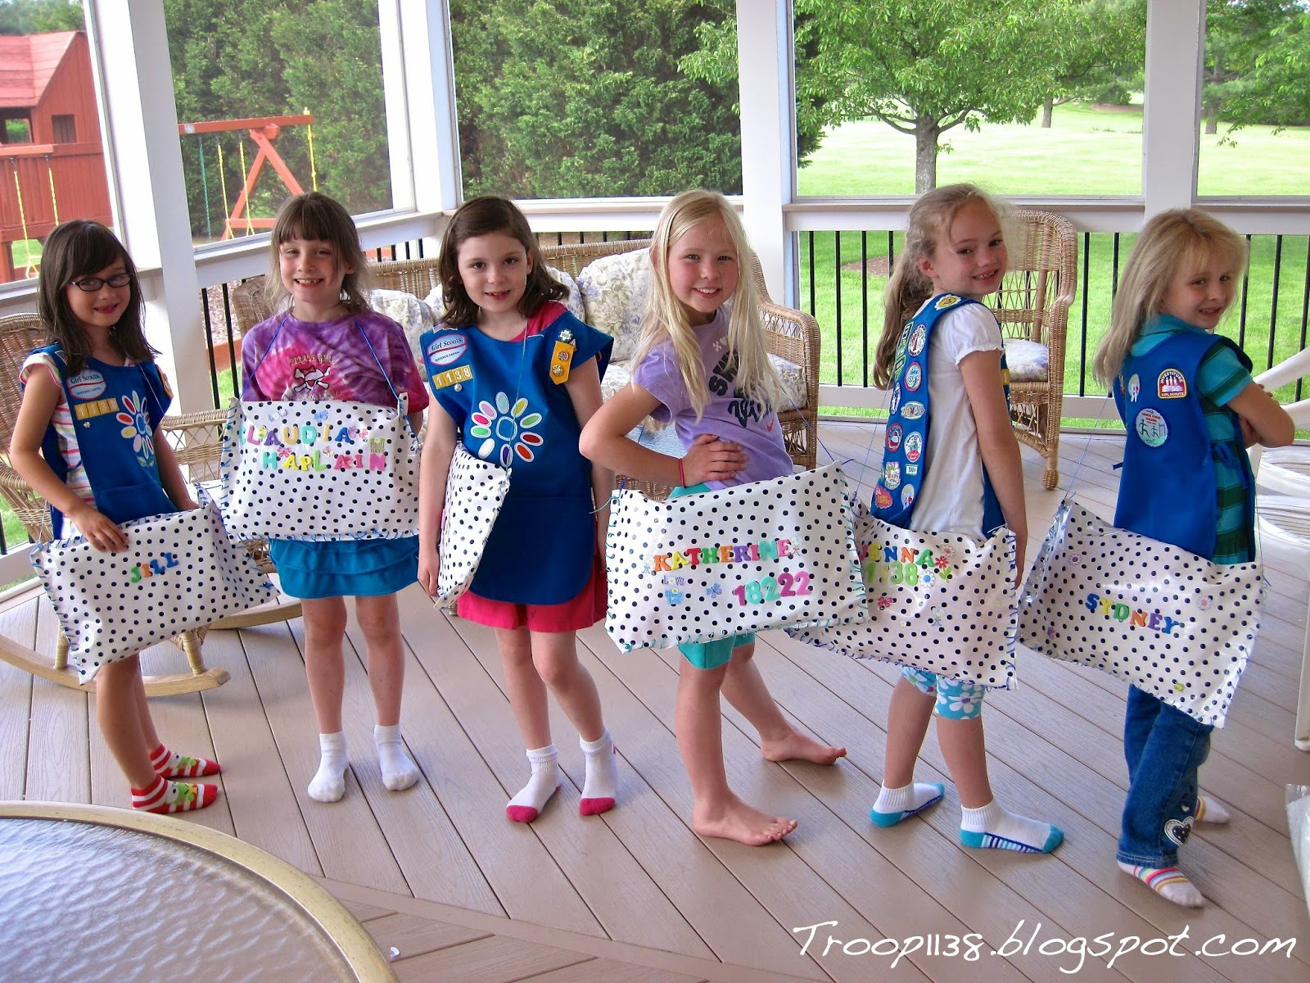
Virtual Activity: Make Sit-upons
Info on Sit-upons from Girl Scouts of Utah:
https://www.gsutah.org/content/dam/girlscouts-gsutah/documents/Sit_Upons_Short_and_Snappy.pdf
Instructions and supplies for Sit-upons:
http://troop1138.blogspot.com/2014/05/sit-upons.html

Slide 56
Great Job!
This Photo by Unknown Author is licensed under CC BY-NC
Notes:
Virtual Activity: Virtual Hike
Ask "what kinds of things do we see on a hike?"
Click through to show them the answers.
*keep muted* Thumbs up and thumbs down , do hiking motions. Explain leave no trace on trash portion.

Slide 57
Virtual Activity
Notes:
Share a little about why we have trail signs and when we would use them, rocks, sticks etc.

Slide 58
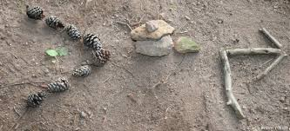
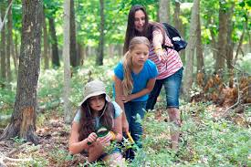
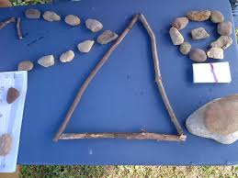
Trail Sign Game
*Click ‘Notes’ in the lower bar for ‘How to’
Notes:
Game options:
Using the trail signs graphic from the previous slide. Call out signs like "turn left" and the girls will build them with the sticks and rocks they collected.
You can also assign a movement or a sound to a trail sign and flash it.
Play a version of red light green light but with trail signs – have the girls stand and flash left then they turn left , turn right etc.

Slide 59
Virtual Activity
Origami
The best way to learn how to do origami is watch someone else walk through the steps of making it. My favorite YouTube Channel that gives great step by step instructions is PPO pick one and have the girls have paper ready you can pause after each step to make sure everyone has that step done.
Notes:
Origami Creation

Slide 60
Virtual Activity
Create a comic
Using Pixton website, girls can make their own avatar and create their very own comic strips.
Notes:
Create comics

Slide 61
Virtual Activity
Digital Escape Room
If you are looking for fun and easy digital escape rooms, but don’t want to pay for one, there are a number of free ones all over the web. Kids Activities website has compiled a pretty extensive list of ones to choose from.
Notes:
Digital Escape Room

Slide 62
Virtual Activity
Yoga party
Here are some ideas for a yoga party, there are ideas for fun patches, how to make the yoga event have a theme. If you don’t want to lead the yoga search YouTube for a short yoga session and play it during meeting.

Slide 63
Virtual Activity
Morse code with flashlights
This could be focus of whole meeting. First share the history of Morse Code how it started this is a great video kid friendly explanation. Give Morse Code a try using flashlights. Maybe do their name or another short word for others to guess. Here is a Morse Code chart for letters and numbers. Here is a morse code translator site so you could watch Morse Code in action when you type words in.

Slide 64
Virtual Activity
How to make slime
This is a great activity you could do together as group. Make sure everyone has the supplies needed to make before hand. Or, ask each girl to find a recipe for slime online and make it before meeting. Then, each girl could take turns sharing how they made it, and the science behind the slime. Here is an article to get you started. There are so many recipes for slime the girls will have a blast learning about a new one.

Slide 65
Scavenger Hunt

Slide 66
Scavenger Hunt!
Find something…
Brown
Blue
Green
Notes:
SAY:
It's time to play a game. We are doing a 2 minute scavenger hunt! When I say go, you will have 2 minutes to find: a hat or headband, something round, something blue, a stuffed animal or pet, and a snack! Any questions?
Your two minutes starts in 3...2....1...go!
Give the girls updates on how much time they have left ("1 minute and 10 seconds to go!") and when the return, have them share one of the things they found.
Explain that Blue is the color of Daisies, Brown is the color of Brownies, and Green is the color of Juniors but also the Girl Scout color!
SAY: (optional)
What are some other things that are green, brown, or blue that relates to Girl Scouts?
Answers could be: green for nature, brown for dirt, earth, and trees, blue for sky. Related to GS because Girl Scouts like to be outside and interacting with nature.
Scavenger hunt: 5 minutes

Slide 67
Time for a Scavenger Hunt!
Spoon
Pair of clean socks on your hands!
Brown crayon or marker
Headband or hat
Towel
Girl Scout vest or sash!
Notes:
SAY:
It's time to play a game. We are doing a 2 minute scavenger hunt! When I say go, you will have 2 minutes to find (read options on the screen). Can you wear of hold them all at once?
Your two minutes starts in 3...2....1...go!
Give the girls updates on how much time they have left ("1 minute and 10 seconds to go!") and when the return, have them share one of the things they found.

Slide 68
Time for a Scavenger Hunt!
Stuffed animal
Something for cleaning
Sunglasses or gloves
a coin
Something that's silly
Something that makes music
Notes:
SAY:
It's time to play a game. We are doing a 2 minute scavenger hunt! When I say go, you will have 2 minutes to find (read options on the screen). Can you wear of hold them all at once?
Your two minutes starts in 3...2....1...go!
Give the girls updates on how much time they have left ("1 minute and 10 seconds to go!") and when the return, have them share one of the things they found.

Slide 69
Time for a Scavenger Hunt!
Something orange
Something soft
Something with spots
Something with eyes
Something that makes you happy
Something that starts with the same letter as your name
Notes:
SAY:
It's time to play a game. We are doing a 2 minute scavenger hunt! When I say go, you will have 2 minutes to find (read options on the screen). Can you wear of hold them all at once?
Your two minutes starts in 3...2....1...go!
Give the girls updates on how much time they have left ("1 minute and 10 seconds to go!") and when the return, have them share one of the things they found.

Slide 70
Time for a Scavenger Hunt!
Something for sports
Something with a zipper
A picture of someone special
Something with ears
Something purple
Something that relates to math or science
Notes:
SAY:
It's time to play a game. We are doing a 2 minute scavenger hunt! When I say go, you will have 2 minutes to find (read options on the screen). Can you wear of hold them all at once?
Your two minutes starts in 3...2....1...go!
Give the girls updates on how much time they have left ("1 minute and 10 seconds to go!") and when the return, have them share one of the things they found.

Slide 71
Time for a Scavenger Hunt!
something with a funny face
Something made from paper
Something starting with L
A belt or scarf
a game
Something you need on a hike
Notes:
SAY:
It's time to play a game. We are doing a 2 minute scavenger hunt! When I say go, you will have 2 minutes to find (read options on the screen). Can you wear of hold them all at once?
Your two minutes starts in 3...2....1...go!
Give the girls updates on how much time they have left ("1 minute and 10 seconds to go!") and when the return, have them share one of the things they found.

Slide 72
Time for a Scavenger Hunt!
You have 2 minutes!
How many can
you find….
Something clear
Something you take to camp
Something you use at night
Something made of plastic
Something square
Something blue

Slide 73
Time for a Scavenger Hunt!
You have 2 minutes!
How many can
you find….
Starting that makes you happy
Something you use during the day
Something you use for class
Something that doesn’t make noise
Something round
Something soft
Notes:
Additional Scavenger Hunt if you have extra time or think the girls need to get some energy out.

Slide 74
Time for a Scavenger Hunt!
You have 2 minutes!
How many can
you find….
Headband or Hat
Something ROUND
Something Yellow
Stuffed Animal
Or Your Pet
A Napkin
Notes:
SAY:
It's time to play a game. We are doing a 2 minute scavenger hunt! When I say go, you will have 2 minutes to find: a hat or headband, something round, something blue, a stuffed animal or pet, and a snack! Any questions?
Your two minutes starts in 3...2....1...go!
Give the girls updates on how much time they have left ("1 minute and 10 seconds to go!") and when the return, have them share one of the things they found.
Scavenger hunt: 5 minutes

Slide 75
Time for a Scavenger Hunt!
Something purple
Something clean
Something found in nature
Something with lots of colors
You have 2 minutes!
How many can
you find….
Something that starts with 'D'
Something that has a letter 'B'

Slide 76
Time for a Scavenger Hunt!
You have 2 minutes!
How many can
you find….
Notes:
Add items to the list for girls to find.

Slide 77
Girl Scout Songs

Slide 78
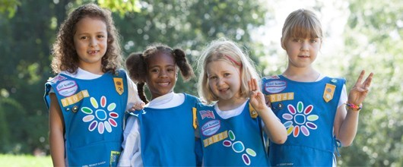
Closing Song
Make new friends
But keep the old
One is silver and the other's gold
A circle is round
It has no end
That's how long I want to be your friend

Slide 79
Closing Song
I'm a little Daisy dressed in blue I am a Girl Scout you are too When I go to meetings I sing and shout I love being a Daisy Girl Scout
*Click ‘Notes’ in the lower bar for ‘How to’
Notes:
Have the girls stand up (and do the hand motions). Go through the lyrics line by line and teach the motions. Have the girls unmute themselves and sing the song in "repeat after me" style once or twice and then all together once.
Song lyrics and motions (tune of "I'm a little teapot")
I'm a little Daisy (fingers spread, at side of face, head tilted) Dressed in blue (hands pick at chest of uniform smock) I am a Girl Scout (make 3 fingered sign) You are too (point to neighbor) When I go to meetings (hands out, palms up) I sing and shout (hands cup around mouth) I love being a Daisy Girl Scout (make a heart with hands or clap hands together)

Slide 80
Super California Surfer
*Click ‘Notes’ in the lower bar for ‘How to’
Because I was afraid to surf When I was just a lass, My father took my board away And told me I was bad. But when I learned the word That every surfer knows, The longest word you ever heard, And this is how it goes... Super California surfer, expert of the ocean. Even though the most of them Do not use suntan lotion. When they hit the waves too hard They always cause a motion.
Super California surfer, expert of the ocean! Um didle iddle iddle um diddle lie, Um didle iddle iddle um diddle lie!
Notes:
Optional song you can add in.
To the tune of super-cali-fragilistic-expialidocious (from Mary Poppins, for reference: https://www.youtube.com/watch?v=rihNRTTcztQ )

Slide 81
Princess Pat
Click The princess pat, (the princess pat) Lived in a tree, (lived in a tree) She sailed across, (she sailed across) The seven Seas, (the seven seas) She sailed across, (she sailed across) The channel two, (the channel two) And she took with her, (and she took with her) A rick-a-bamboo, (a rick-a-bamboo) A rick-a-bamboo, (a rick-a-bamboo) Now what is that? (now what is that?) Its something made, (it's something made) By the princess pat, (by the princess pat) Its red and gold, (its red and gold) And purple too, (and purple too) That's why it's called, (that's why it's called) A rick-a-bamboo, (a rick-a-bamboo) A rick-a-bamboo, (a rick-a-bamboo)
Now Captain Jack, (now captain Jack) Had a mighty fine crew (had a mighty fine crew) He sailed across, (he sailed across) The channel two, (the channel two) But his ship sank, (but his ship sank) And yours will too, (and yours will too) If you don't take, (if you don't take) A rick-a-bamboo (a rick-a-bamboo) A rick-a-bamboo, (a rick-a-bamboo) Now what is that? (now what is that?) Its something made, (it's something made) By the princess pat, (by the princess pat) Its red and gold, (its red and gold) And purple too, (and purple too) That's why it's called, (that's why it's called) A rick-a-bamboo, (a rick-a-bamboo) A rick-a-bamboo, (a rick-a-bamboo)to add text

Slide 82
The Moose Song
There was a great big moose!
He liked to drink a lot of juice.
There was a great big moose!
He liked to drink a lot of juice.
Singin’ oh way oh
Way oh way oh way oh way oh
Way oh way oh
Way oh way oh way oh way oh
The moose’s name was Fred.
He liked to drink his juice in bed.
The moose’s name was Fred.
He liked to drink his juice in bed.
Singin’ oh way oh
Way oh way oh way oh way oh
Way oh way oh
Way oh way oh way oh way oh
He drank his juice with care,
but he spilled some in his hair.
He drank his juice with care,
but he spilled some in his hair.
He drank his juice with care,
but he spilled some in his hair.
Singin’ oh way oh
Way oh way oh way oh way oh
Way oh way oh
Way oh way oh way oh way oh
Now he’s a sticky moose
Because he’s all covered in juice!
Singin’ oh way oh
Way oh way oh way oh way oh
Way oh way oh
Way oh way oh way oh way oh

Slide 83
Kookaburra
Kookaburra sits on the old gum tree, Merry merry king of the bush is he. Laugh, Kookaburra, laugh, Kookaburra, Gay your life must be!
Kookaburra sits in the old gum tree Eating all the gumdrops he can see Stop, Kookaburra, Stop, Kookaburra Leave some there for me.
Kookaburra sits in the old gum tree, Counting all the monkeys he can see Stop, Kookaburra, Stop, Kookaburra, That's no monkey, that's me.

Slide 84
The Little Green Frog
MmmAck went the little green frog one day, MmmAck went the little green frog. Mmmack went the little green frog one day, And his eyes went MmmAck MmmAck MmmAck MmmAckAck All the other frogs go Fo de o de o de o de o Fo de o de o de o, Fo de o de o de o All the other frogs go Fo de o de o de o de o But the little green frog goes Mmmack Mmmack Mmmackack

Slide 85
Boom Chika Boom
I said A Boom Chicka Boom (repeat)
I said A Boom Chicka Boom (repeat)
I said Boom A Chicka Rocka Chicka Rocka Chicka Boom (repeat) Uh Huh! (repeat)
Oh Yeah! (repeat)
One more time (repeat)
1) Baby Style
2) Under water style
3) Really fast

Slide 86
Way Up in the Sky
Way up in the sky, the big birdies fly
While down in the nest, the little ones rest
With a wing on the left *tweet*, and a wing on the right *tweet*
The baby birds sleep all through the night
SHHHH you mustn't wake the baby birdies!
The bright sun comes up, the dew falls away
Good morning! good morning! the little birds say

Slide 87
Other Girl Scout Songs
Notes:
Click link in the slide to access the Song Book PDF.

Slide 88
Closing Song
Notes:
Template for Closing Song for troop meetings, copy lyrics intro purple box if girls can read

Slide 89
Letters to Brownies
Notes:
The following “Dear Brownies..." Slides have prewritten emails that you can alter to send as follow up emails after your meetings.

Slide 90
Dear Brownies...
*Click ‘Notes’ in the lower bar for ‘How to’
Notes:
Send Follow-up Email within 24 hours of the meeting: (edit underlined text accordingly)
Follow-up Email for 1st Brownie Sisterhood meeting
Dear Brownies,
It was wonderful to meet with you and your parents. Do you remember what we did at our meeting? I led you through the Girl Scout Promise. We played a scavenger hunt that you all seemed to enjoy a lot. And even more fun was the ‘get to know you’ game. Wasn’t it cool to come up with an action/ sound/ adjective/ animal that starts with your first name initial?
And without even realizing that you were working on a badge, guess what you were able to earn?
First step of the ‘Making Friends’ badge (Make a friendly introduction with a game)!
Now, it is time to get ready for your next meeting. Do you remember your challenges?
You have to think of two things you like doing the most – with your Troop/ family/ class/ friends/ on your own.
Bring two square pieces of paper to work on Origami – we will make paper craft and work on Step 2 of the badge, Show your friends you care.
I will see you again on (date) at (time). I will send you a reminder again on (Friday morning) with the Zoom link. Until then, have a good rest of the week, read a lot, remember to go out and get some fresh air and exercise.
See you then!
Your Leader,
(leader's name)

Slide 91
Dear Brownies...
*Click ‘Notes’ in the lower bar for ‘How to’
Notes:
Send Follow-up Email within 24 hours of the meeting: (edit underlined text accordingly)
Follow-up Email for 2nd Brownie Sisterhood meeting
Dear Brownies,
It was wonderful to meet with you! Do you remember what we did at our meeting? We opened with the Girl Scout Promise and played a scavenger hunt game! We then learned about kapers (jobs) that we will all do to help our troop! After that, we enjoyed a snack and a story about brownie elves. Wasn’t it cool to learn that new Brownie song? If you want to practice the song at home you can learn it here: https://www.youtube.com/watch?time_continue=3&v=KQLo5VuKwyE&feature=emb_logo
Do you remember what your Kaper (job) is for our next meeting? Be ready next meeting to do your Kaper! Below is a list of who is doing which Kaper next meeting and what that job means:
(girl's name): (kaper)
(girl's name): (kaper)
(girl's name): (kaper)
(girl's name): (kaper)
(girl's name): (kaper)
(girl's name): (kaper)
Now, it is time to get ready for your next meeting. Do you remember what to bring?
Bring two square pieces of paper to work on Origami
I will see you again on (date) at (time) and send you a reminder again on (Friday morning) with the Zoom link. Until then, have a good rest of the week, read a lot, remember to go out and get some fresh air and exercise.
See you then!
Your Leader,
(leader's name)
Kaper Descriptions: (delete ones you are not using/ modify)
Promise Leader: Leads the group is saying the GS Promise. The girl starts the Promise "On my honor.." and the rest of the girls join in.
Law Leader: Leads the group in saying the GS Law. The girl starts the Law "I will do my best to be..." and the rest of the girls join in.
Reporter: Reports back to the group a summary of what we did at the previous meeting.
Chat Monitor: Reports comments from the Zoom chat, makes sure everyone is being nice in the chat,
Clean up Captain: After snack or craft, leads the group and encourages them to clean up their surroundings. "A Girl Scout always leaves a place cleaner than she found it"
Attendance Taker: Takes the attendance at the beginning of each meeting.
Supply Checker: Reminds other scouts of the supplies needed for that meeting in the beginning. Check to make sure everyone has everything they need and helps to come up with alternatives if missing supplies.
Song Leader: Starts the song for the group or leads the song in repeat after me.
Joke Teller: Brings 1 or 2 jokes to the meeting to share with the troop
Friendship Squeeze Starter: Once girls are crossing their arms, she tells the girls to close their eyes and make a wish and squeeze once.

Slide 92
Dear Brownies...
*Click ‘Notes’ in the lower bar for ‘How to’
Notes:
Send Follow-up Email within 24 hours of the meeting: (edit underlined text accordingly)
Follow-up Email for 3rd Brownie meeting:
Dear Brownies,
It was wonderful to meet with you! Do you remember what we did at our meeting? We opened with the Girl Scout Promise then played a scavenger hunt game! We all helped out by doing our kapers. After that, we played a game to learn about the Girl Scout Internet Safety Pledge and made origami hearts to show our friends that we care. So far we have completed 2 steps of the Making Friends Badge by:
1. Making a Friendly Introduction (with a game)
2. By Showing Friends we Care (with a craft)
We are only 2 steps away from earning our badge!
Also, do you remember what your Kaper (job) is for our next meeting? Be ready next meeting to do your Kaper! Below is a list of who is doing which Kaper next meeting and what that job means:
(girl's name): (kaper)
(girl's name): (kaper)
(girl's name): (kaper)
(girl's name): (kaper)
(girl's name): (kaper)
(girl's name): (kaper)
Kaper descriptions below.
Now, it is time to get ready for your next meeting. Do you remember what the challenges are?
Make an origami heart craft for a friend, or write them a card about why their friendship is important to you.
Supplies for next week: paper, markers or crayons
We will see you again on (date) at (time). We will send you a reminder again on (Friday morning) with the Zoom link. Until then, have a good rest of the week, read a lot, remember to go out and get some fresh air and exercise.
See you then!
Your Leader,
(leader's name)
Kaper Descriptions: (delete ones you are not using/ modify)
Promise Leader: Leads the group is saying the GS Promise. The girl starts the Promise "On my honor.." and the rest of the girls join in.
Law Leader: Leads the group in saying the GS Law. The girl starts the Law "I will do my best to be..." and the rest of the girls join in.
Reporter: Reports back to the group a summary of what we did at the previous meeting.
Chat Monitor: Reports comments from the Zoom chat, makes sure everyone is being nice in the chat,
Clean up Captain: After snack or craft, leads the group and encourages them to clean up their surroundings. "A Girl Scout always leaves a place cleaner than she found it"
Attendance Taker: Takes the attendance at the beginning of each meeting.
Supply Checker: Reminds other scouts of the supplies needed for that meeting in the beginning. Check to make sure everyone has everything they need and helps to come up with alternatives if missing supplies.
Song Leader: Starts the song for the group or leads the song in repeat after me.
Joke Teller: Brings 1 or 2 jokes to the meeting to share with the troop
Friendship Squeeze Starter: Once girls are crossing their arms, she tells the girls to close their eyes and make a wish and squeeze once.

Slide 93
Dear Brownies...
*Click ‘Notes’ in the lower bar for ‘How to’
Notes:
Send Follow-up Email within 24 hours of the meeting: (edit underlined text accordingly)
Follow-up Email for 4th Brownie meeting:
Dear Brownies,
It was wonderful to meet with you! Do you remember what we did at our meeting? We opened with the Girl Scout Promise then played a scavenger hunt game! We all helped out by doing our kapers. After that, we played a game to learn about how we can disagree with friends and solve conflicts. This week we completed another step of the Making Friends Badge by:
Learn how to disagree (with a game)
We are only 2 steps away from earning our badge! (3 of 5 steps completed!)
Also, do you remember what your Kaper (job) is for our next meeting? Be ready next meeting to do your Kaper! Below is a list of who is doing which Kaper next meeting and what that job means:
(girl's name): (kaper)
(girl's name): (kaper)
(girl's name): (kaper)
(girl's name): (kaper)
(girl's name): (kaper)
(girl's name): (kaper)
Now, it is time to get ready for your next meeting. Do you remember what the challenges are?
Next meeting is our Talent Show! Prepare 3 minutes to show or teach us about one of your favorite things! Feel free to include your whole family.
Supplies for next week: paper, markers or crayons
We will see you again on (date) at (time). We will send you a reminder again on (Friday morning) with the Zoom link. Until then, have a good rest of the week, read a lot, remember to go out and get some fresh air and exercise. Bring your parents to next meeting so they can see the Talent Show as well!
See you then.
Your Leader,
(leader's name)
Kaper Descriptions: (delete ones you are not using/ modify)
Promise Leader: Leads the group is saying the GS Promise. The girl starts the Promise "On my honor.." and the rest of the girls join in.
Law Leader: Leads the group in saying the GS Law. The girl starts the Law "I will do my best to be..." and the rest of the girls join in.
Reporter: Reports back to the group a summary of what we did at the previous meeting.
Chat Monitor: Reports comments from the Zoom chat, makes sure everyone is being nice in the chat,
Clean up Captain: After snack or craft, leads the group and encourages them to clean up their surroundings. "A Girl Scout always leaves a place cleaner than she found it"
Attendance Taker: Takes the attendance at the beginning of each meeting.
Supply Checker: Reminds other scouts of the supplies needed for that meeting in the beginning. Check to make sure everyone has everything they need and helps to come up with alternatives if missing supplies.
Song Leader: Starts the song for the group or leads the song in repeat after me.
Joke Teller: Brings 1 or 2 jokes to the meeting to share with the troop
Friendship Squeeze Starter: Once girls are crossing their arms, she tells the girls to close their eyes and make a wish and squeeze once.

Slide 94
Dear Brownies...
*Click ‘Notes’ in the lower bar for ‘How to’
Notes:
Send Follow-up Email within 24 hours of the meeting: (edit underlined text accordingly)
Follow-up Email for 5th Brownie meeting:
Dear Brownies,
It was wonderful to meet with you! Do you remember what we did at our meeting? We opened with the Girl Scout Promise then played a traffic light game! We all helped out by doing our kapers. After that, we learned one of the most important Girl Scout greetings, the Girl Scout handshake! The best part of our meeting was seeing everyone's talents at our Talent Show! This week we completed another step of the Making Friends Badge by:
Sharing a Favorite Activity (through the talent show)
We are only 1 step away from earning our badge! (4 of 5 steps completed!)
Also, do you remember what your Kaper (job) is for our next meeting? Be ready next meeting to do your Kaper! Below is a list of who is doing which Kaper next meeting and what that job means:
(girl's name): (kaper)
(girl's name): (kaper)
(girl's name): (kaper)
(girl's name): (kaper)
(girl's name): (kaper)
(girl's name): (kaper)
Now, it is time to get ready for your next meeting. Do you remember what to bring?
paper, markers or crayons
We will see you again on (date) at (time). We will send you a reminder again on (Friday morning) with the Zoom link. Until then, have a good rest of the week, read a lot, remember to go out and get some fresh air and exercise. Bring your parents to next meeting so they can see the Talent Show as well!
See you then.
Your Leader,
(leader's name)

Slide 95
Dear Brownies...
*Click ‘Notes’ in the lower bar for ‘How to’
Notes:
Send Follow-up Email within 24 hours of the meeting: (edit underlined text accordingly)
Follow-up Email for 6th Brownie meeting:
Dear Brownies,
It was wonderful to meet with you! Do you remember what we did at our meeting? We opened with the Girl Scout Promise then played a scavenger hunt game! We all helped out by doing our kapers. After that, we made a friendship pledge together and wrote acrostic poems for our friends. This week, we completed the last step of the Making Friends Badge by:
Practicing friendship (through our pledge and acrostic poems)
We have now completed our Making Friends Badge. ongratulations!
Also, do you remember what your Kaper (job) is for our next meeting? Be ready next meeting to do your Kaper! Below is a list of who is doing which Kaper next meeting and what that job means:
(girl's name): (kaper)
(girl's name): (kaper)
(girl's name): (kaper)
(girl's name): (kaper)
(girl's name): (kaper)
(girl's name): (kaper)
Now, it is time to get ready for your next meeting. Do you remember what to bring?
(add supplies here, or anything for them to complete before next meeting)
We will see you again on (date) at (time). We will send you a reminder again on (Friday morning) with the Zoom link. Until then, have a good rest of the week, read a lot, remember to go out and get some fresh air and exercise. Bring your parents to next meeting so they can see the Talent Show as well!
See you then.
Your Leader,
(leader's name)

Slide 96
Virtual Meeting Templates and Images

Slide 97
Brownie Meeting
*Click ‘Notes’ in the lower bar for ‘How to’
Notes:
Meeting summary:
Opening, icebreaker/scavenger hunt/game, main activity: badge related or craft or other, closing.
Meeting 1:
Brownie Meeting: about 30 minutes
Welcome: Opening Question – 3 minutes
Zoom and Meeting Rules – 2-3 minutes
Opening: Pledge of Allegiance, GS Promise, GS Law – 2 minutes
Game: Scavenger Hunt (and sharing) - 5 minutes
Ice Breaker Game – 5 minutes
Badge activity: – 5-10 minutes
Song, Prep for Next Meeting and Friendship Circle – 5 minutes
Badge Requirements:
Making Friends
Step 1 Make a Friendly Introduction (game)
Step 2 Show Friends You Care (craft)
Step 3 Share a Favorite Activity.
Step 4 Learn How to Disagree.
Step 5 Practice Friendship (pledge)

Slide 98
Opening Question
Supplies:
*Click ‘Notes’ in the lower bar for ‘How to’
Notes:
SAY:
Welcome! Are you looking forward to being Brownies this year? Are you ready to start our Brownie adventures together?
This is our Brownie circle. It's a special place where we will come together to share thoughts and ideas and make decisions and plans for our troop. In the Brownie Ring, everyone gets a chance to talk, and everyone listens to what others have to say.
During this meeting, we are going to learn a little about Girl Scouts and spend some time getting to know each other better.

Slide 99
Ice Breaker

Slide 100
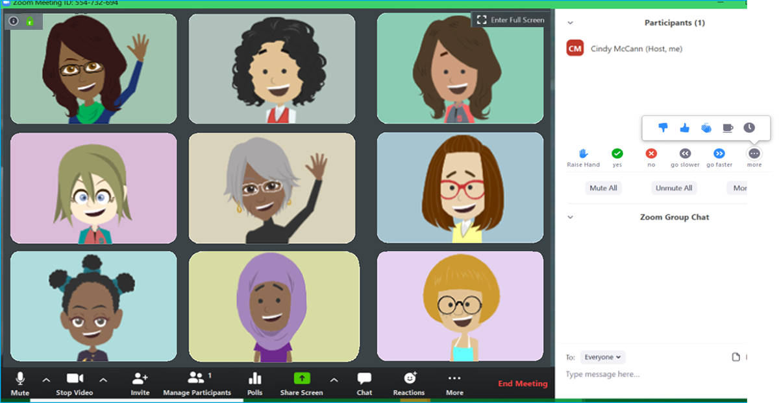
Daisy Zoom Meeting Tips
TURN SOUND &
CAMERA ON & OFF
WRITE A QUESTION OR ADD YOUR IDEAS

Slide 101
Meeting Rules
If we ask a Yes/ No question, answer with a thumbs up or thumbs down
Mute yourself until it is time to talk
Notes:
Please customize this slide to rules you have established for your meetings.

Slide 103
* Members may substitute for the word God in accordance with their own spiritual beliefs.
Notes:
Officially begin the meeting with an Opening Ceremony. This consists of the Girl Scout Promise and the option of adding the pledge of allegiance and/or Girl Scout Law.
Have girls unmute for the Girl Scout Promise. Can do "repeat after me" style if they don't know the Promise yet.
Your troop can have a girl lead the Promise as a job (kaper).
SAY:
Now everyone sit up tall and make the Girl Scout sign. We are going to say the Girl Scout Promise.
Depending how well your girls know the promise you may choose to do "repeat after me" or all together.
Optional: You can take down the slideshow so the girls can all see each other better.
Opening Ceremony: 2 minutes or less.

Slide 105
Time for a Scavenger Hunt!
You have 2 minutes!
How many can
you find….
Notes:
Add items to the list for girls to find.

Slide 106
Time for a Scavenger Hunt!
Spoon
Pair of clean socks on your hands!
Brown crayon or marker
Headband or hat
Towel
Girl Scout vest or sash!
Notes:
SAY:
It's time to play a game. We are doing a 2 minute scavenger hunt! When I say go, you will have 2 minutes to find (read options on the screen). Can you wear of hold them all at once?
Your two minutes starts in 3...2....1...go!
Give the girls updates on how much time they have left ("1 minute and 10 seconds to go!") and when the return, have them share one of the things they found.

Slide 107
Be prepared for next week:
1. Supplies: a healthy snack
2. Brownie Challenge! Think about 2 things you really like to do at home, with friends, or in a club

Slide 108
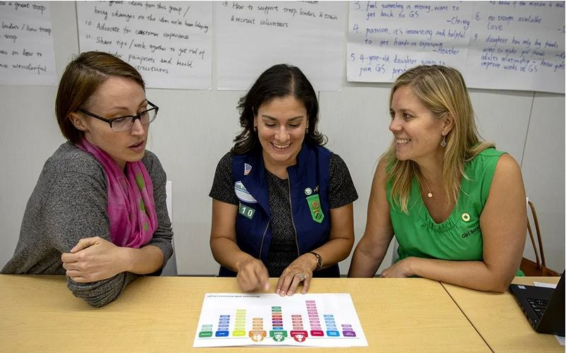
Parent chat!
*Click ‘Notes’ in the lower bar for ‘How to’
Notes:
At the end of every meeting, bring the adults over and clue them in and get them involved:
"I'll send you the follow up email. Who can help me at the next meeting and be present so that we have enough adults?"
Suggestions of what you can ask them to help specifically with an activity:
"Next week, we are working on a mural, can anyone help out with that?"
"Next week, we are going to read a story for a petal. Whose name can I put down for helping with the story?"
"Who can help out when the girls do a craft?"
"Who is good at singing and would like to lead a song?"
Plan out the help you will need for the four meetings. Use Sign-up Genius to get parents to sign up for specific duties.
Suggestions of what you can discuss with parents:
Make sure everyone has your phone and email, knows the troop number, and has all the information about the next troop meting (date, time, location and any supplies the girls will need to bring).
Make Her Experience Memorable (a resource for parents on how they can help): https://my.girlscouts.org/content/dam-resources2/girlscouts-vtkcontent/Parent-Hub/02_MV_VTKMake%20HerExperienceMemorable_flyer_8.5x11.pdf
More Parent Meeting Resources:
See Brownie Intro Meeting in Volunteer Toolkit for more guidance : https://my.girlscouts.org/content/girlscouts-vtk/en/vtk.details.html?elem=190616400000
Another great resource: "Getting Adults to Help" training in our volunteer eLearning portal: https://training.gsnorcal.org/login/index.php To find it, under Troop Leaders, click on Daisy Leader (Grades K-1). Then click "New troop Leader Course (Part 1 & Part 2). Then scroll to Part 1: Troop Basics and select "Getting Adults to Help (Avg. 20 Min.) or scroll down further to "Meeting with Parents (Avg. 5 Min.)"

Slide 109
Main Badge Activity

Slide 110
Closing Song
Lyrics here

Slide 111
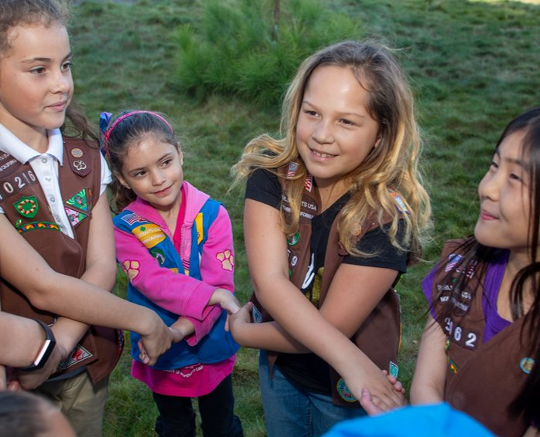
Friendship Circle and Goodbye
Notes:
Don't forget to send a follow up email!

Slide 112
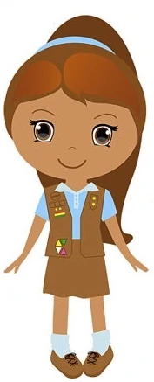
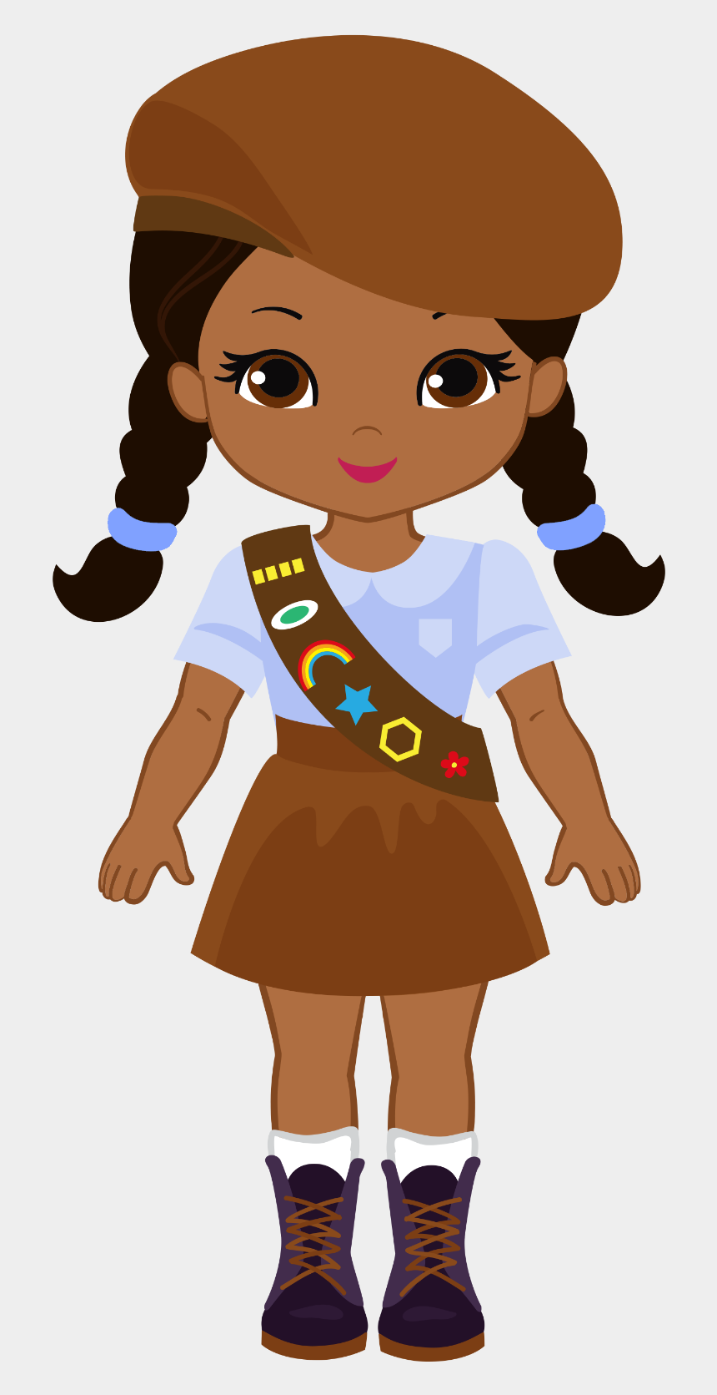
Girl Scout Clipart

