Slide 1
Welcome
Troop #####
Notes:
Enter your Troop #

Slide 2
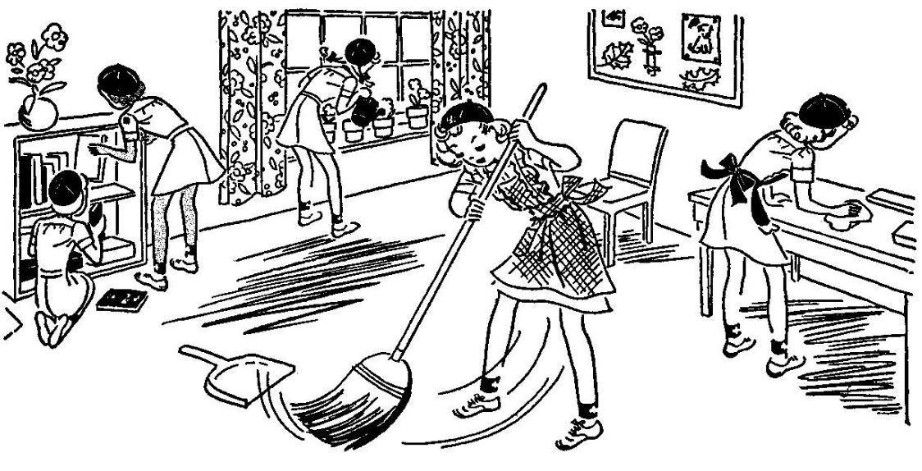
Opening Question
Did you help with a house chore today?
Notes:
Consider having an opening question to get the meeting started or while you wait for all participants to arrive and get settled.
If girls are too young to type in the chat, you can have them discuss openly or take this as an opportunity to practice taking turns sharing
Here are a few other question ideas:
Do you want to stay the same age forever? If yes, what age would that be?
What is your favorite possession?
If you could have one superpower, which one would you choose?
Are you a morning bird or a night owl?
Which season is your favorite? Why?
What item or gadget are you currently dreaming of buying?
Would you prefer to go to the mountains or the beach?
If you could live anywhere on this planet, where would you live?
What is the coolest vacation you have ever taken?
What is your favorite food?
Which historical figure would you want to meet?
Who has been the most influential person in your life thus far?
Where do you see yourself in 10 years?
Juliette Gordon Low left Girl Scouts a wonderful legacy, what do you want your legacy to be?
What is one of your biggest goals within your personal life?

Slide 3
Meeting Rules
If we ask a Yes/ No question, answer with a thumbs up or thumbs down
Girl Scout Quiet Sign
Please DO NOT use the annotate, stamp or write over the screens unless you’re asked to
Mute yourself until it is time to talk
Notes:
Add or remove meeting rules to suit your troop’s needs
More Examples –
Chat Room Etiquette- Be a Girl Scout. Be polite.

Slide 4
Girl Scout Promise and Law
I will do my best to be
Honest and fair,
Friendly and helpful,
Considerate and caring,
Courageous and strong, and
Responsible for what I say and do,
And to
Respect myself and others,
Respect authority,
Use resources wisely,
Make the work a better place, and Be a sister to every Girl Scout
On my honor,
I will try to serve God*
and my country,
to help people at all times,
and to live by
the Girl Scout Law
* Members may substitute for the word God in accordance with their own spiritual beliefs.

Slide 5
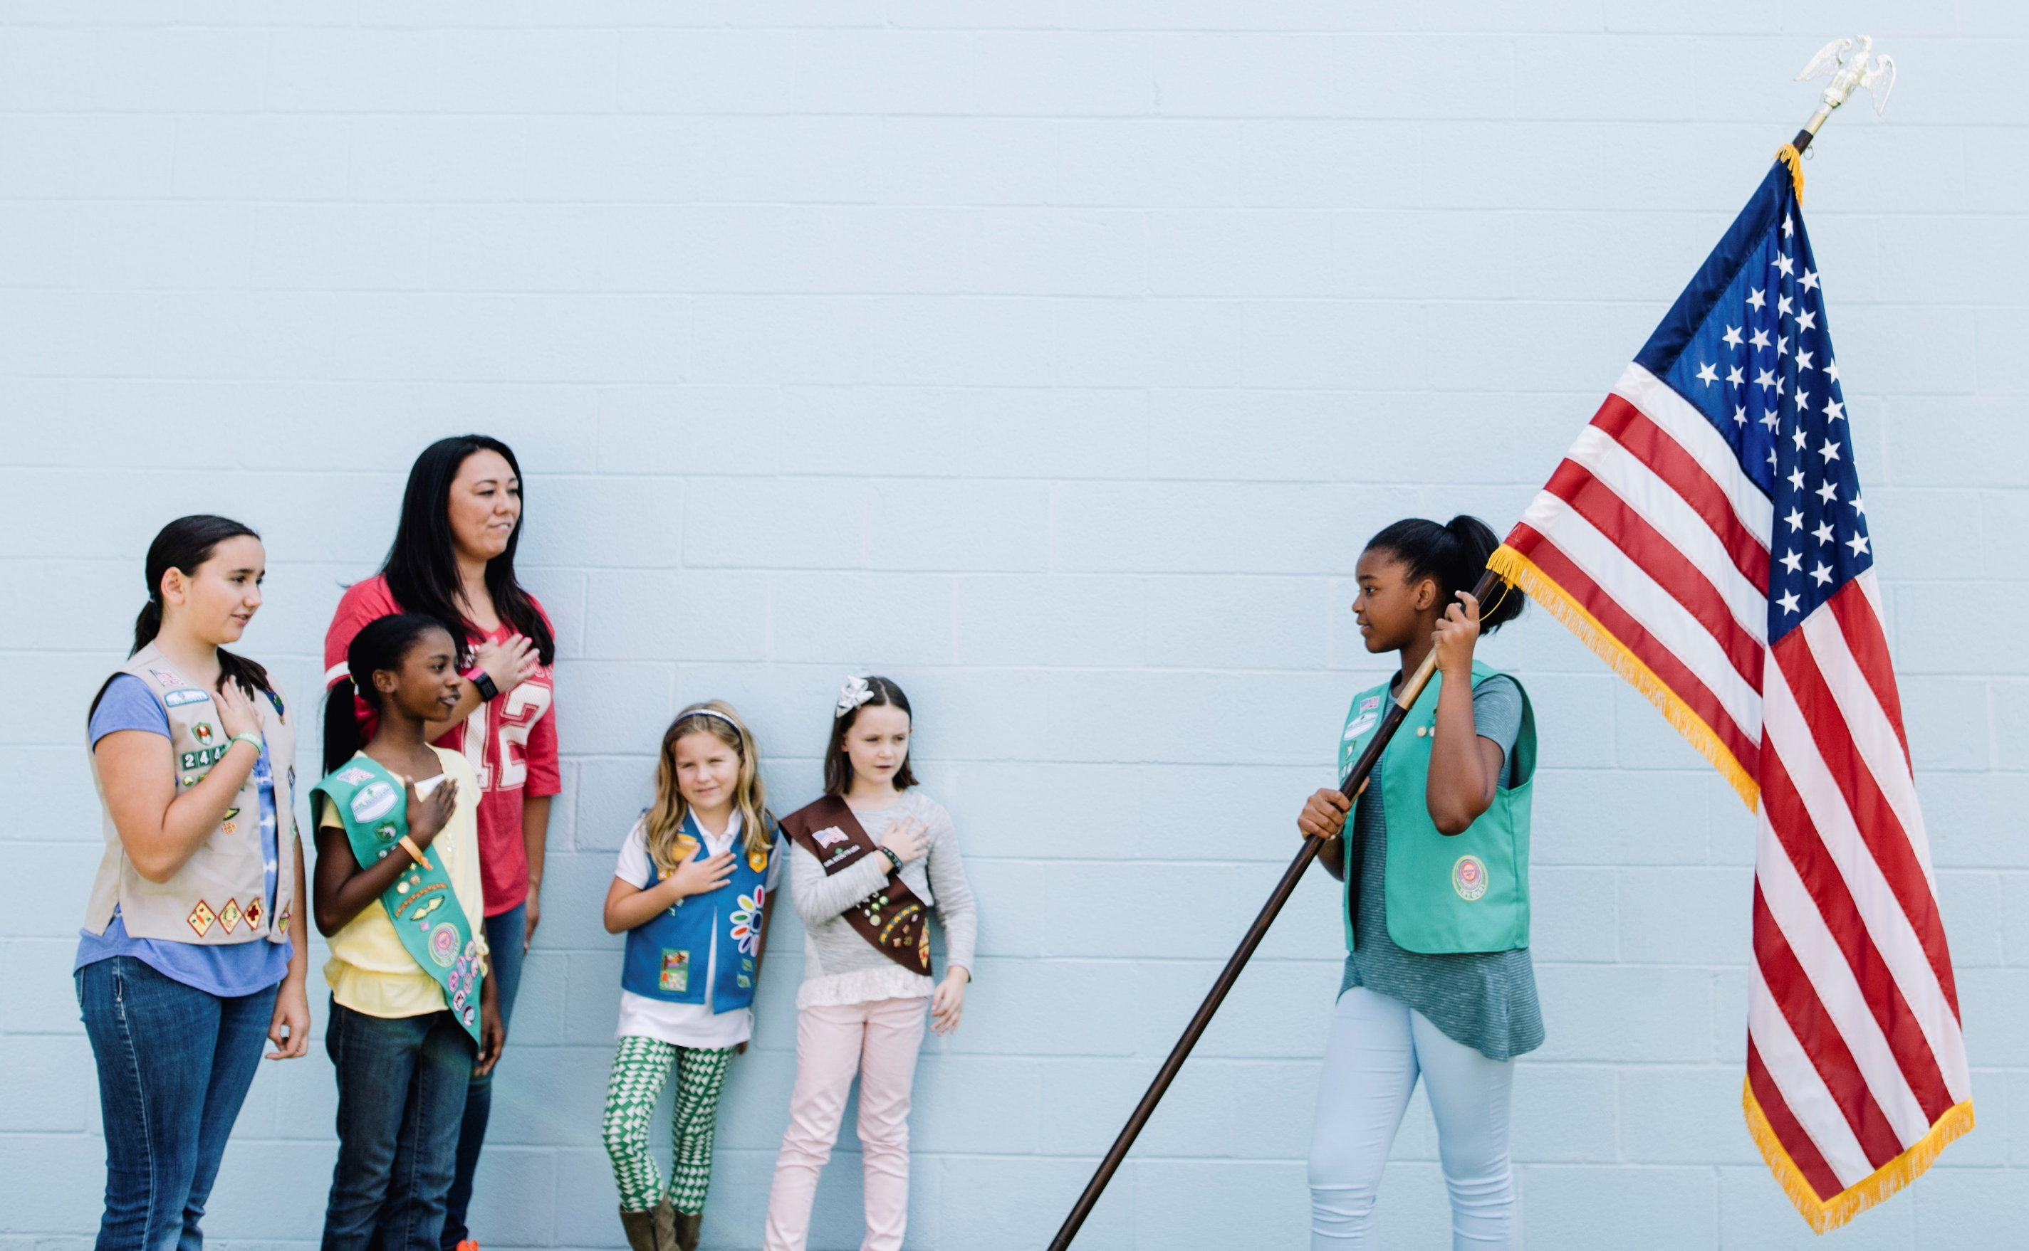
Pledge of Allegiance
* Girls may substitute for the word God in accordance with their own spiritual beliefs.

Slide 6
Agenda
Part of the meeting | What are we doing? | Who is leading?
Opening | Girl Scout Promise and Law Pledge of Allegiance | Sarah Gabby Next week – Jill and Aimee
Business | Agenda Current badge steps Troop Business | Leader Kim Leader Mary Ryan Next Week – Carrie
Game Time! | Scavenger Hunt | Leader Kim
Activity | Share last week’s project New badge work | Leader Mary Leader Mary
Closing | Reminders Closing song | Leader Kim Yolanda Next Week – Ruby
Notes:
If girls are old enough, consider having them lead some parts of the meeting
Using a kaper is a great way to keep track and ensure everyone gets a chance to participate over the course of several virtual meetings
It will be best to let girls know before the meeting what parts they will be in charge of – you can send an email reminder before the meeting

Slide 7
Current Badge Steps (example)
Making Friends Badge
Make Friendly introductions
Show friends you care
Share favorite activities
Learn how to disagree
Practice friendship
Notes:
If doing badge work:
Let the Girls Know what they are step they are on
Visit https://www.girlscoutshop.com/BADGES-PROGRAM/ALL_BADGES_PINS
View all badges, you can right-click on a badge on the site to save the image and place it in this slide
Right click on the image on this slide, choose “change picture”
Visit the Volunteer Toolkit to see all the badge requirements
Check out GSUSA’s Activities for Girls (https://www.girlscouts.org/en/girl-scouts-at-home/activities-for-girls.html). Choose your program level, there are several activity lesson plans with videos covering topics in STEM, Outdoors, Life Skills, and Entrepreneurship.

Slide 8
Troop Business
Enter Troop Business here!
Item 1
Item 2
Notes:
You can share any news and important announcements here.
Remind about upcoming meetings/events, ask questions about planning
Discuss financial decisions
Keep it short and sweet!

Slide 9
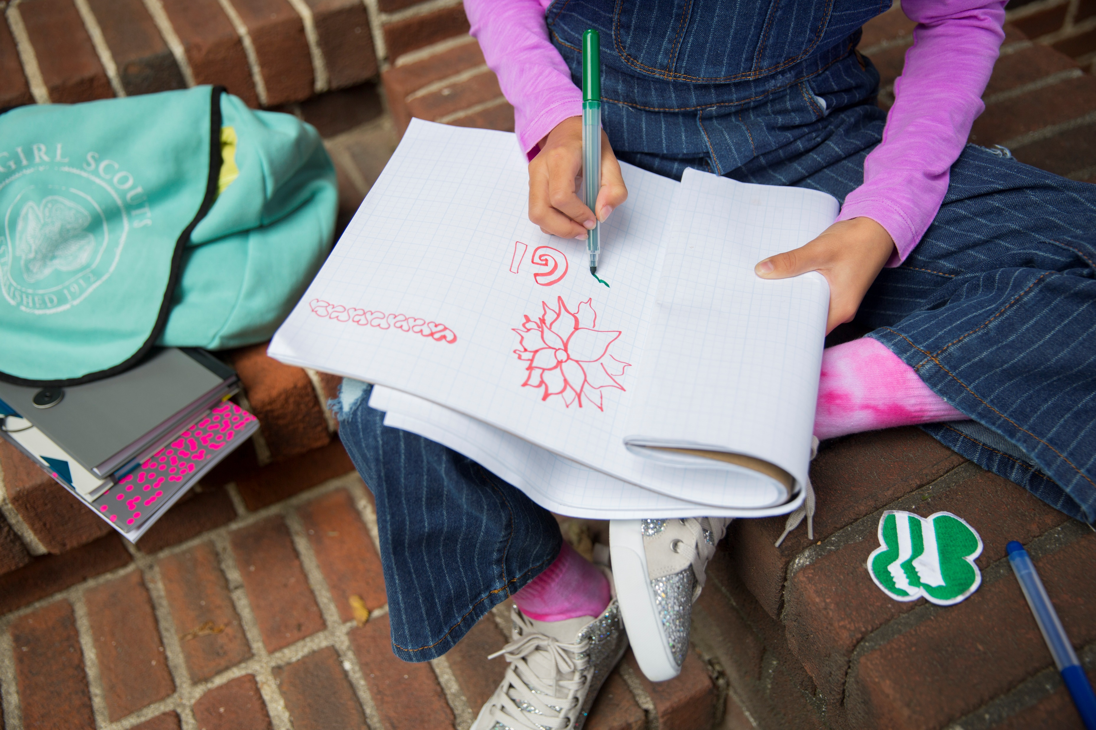
Sharing Time
Share your drawing from last week!
Notes:
Use this slide for your troop to share a project they needed to finish, or other fun sharing activity

Slide 10
Today’s Activity
Notes:
This is a great time to work on badge or Journey activities! – Put down some text or images here
Check out GSUSA’s Activities for Girls (https://www.girlscouts.org/en/girl-scouts-at-home/activities-for-girls.html). Choose your program level, there are several activity lesson plans with videos covering topics in STEM, Outdoors, Life Skills, and Entrepreneurship.
Other Activity Ideas:
Get silly: Play charades, Taboo, or Pictionary. Have a scavenger hunt for silly items that might be around the house.
• Get the wiggles out: Do yoga or have a dance party together.
• Quiet together time: Read stories aloud or do a group add-a-line story. If you have a Daisy troop, read a Petal story!
• Get artistic: Draw portraits of one another and share.
• Explore STEM: Create a racecar from found materials. Share favorite recipes and send them out for others to try. Create a cookbook. Have a Top Chef challenge. Share at-home science experiments.
• Learn more about each other: Share best and worst things that happened today (Rose, bud, thorn).
• Including all Girl Scouts: Learn the Promise (and Law) in American Sign Language or other languages. Check out WAGGGS resources for international ideas.
• For older girls: Watch a TED Talk and discuss. Create your own videos.
• Share: A favorite podcast or online game (give a review for it). Have girls make short video of themselves reciting a poem, teaching a game, teaching a recipe, signing a song, showing some home-made creation, sharing a household chore tip...anything!
• Research: a local issue in their communities and report back on it during the meeting, along with a way they can help from home, such a writing letters to nursing homes.
• Create a playlist: Have a Facebook Watch Party to watch them all together!

Slide 11
Thank you for attending!
Today we did………….for the …………….. Badge
Make sure you join us next week on (day) at (time).
Be Prepared for next weeks meeting:
Finish up…….
Bring……..
Be ready to share…..

Slide 12
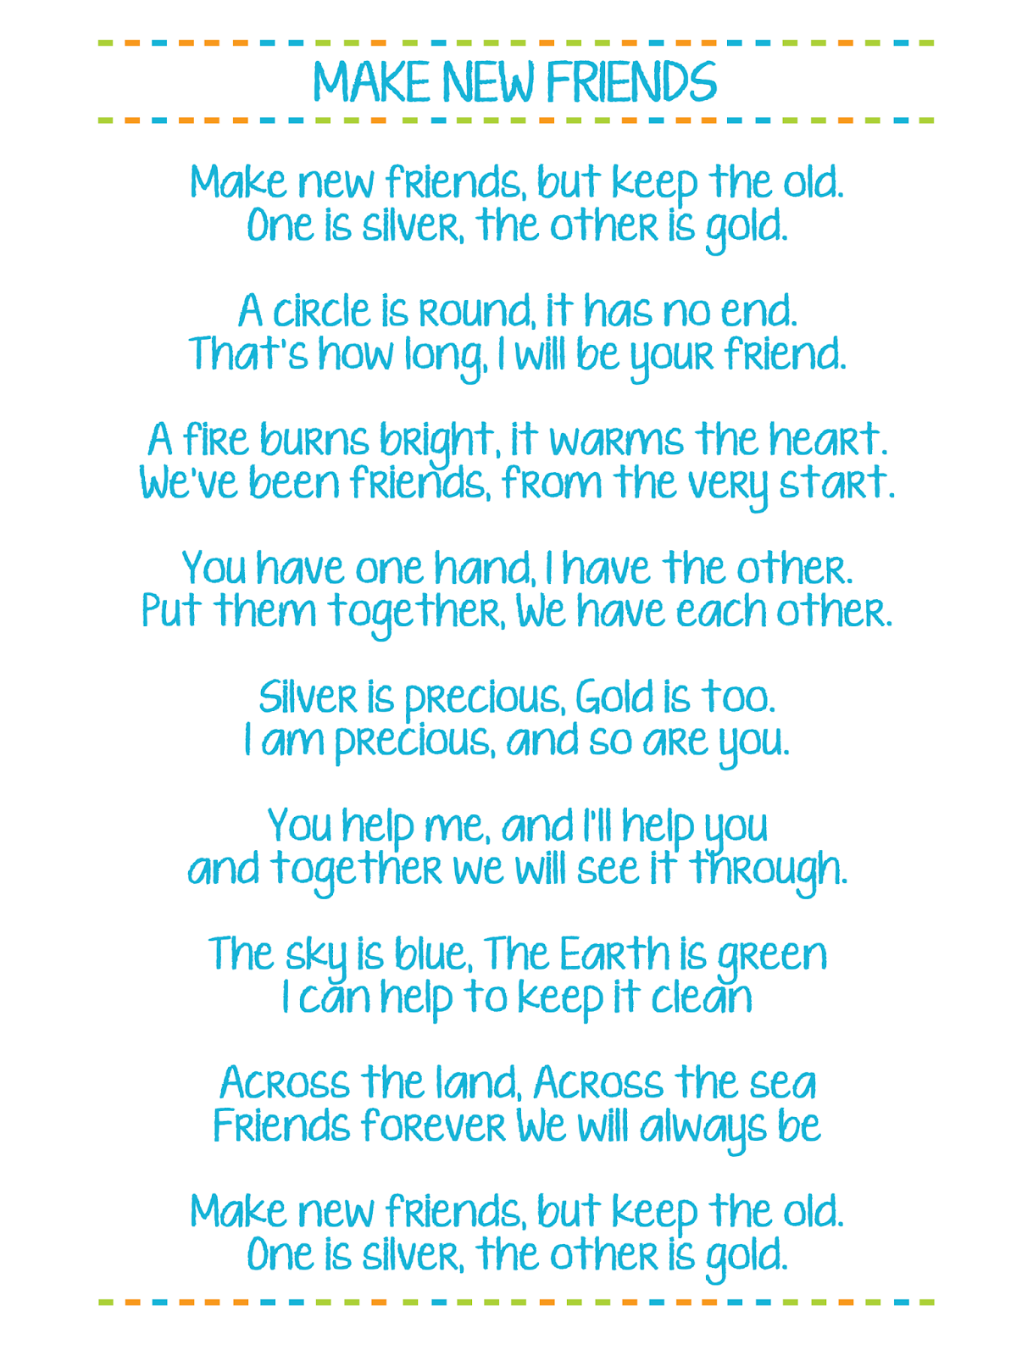
Closing Song
Notes:
Here is one idea on how to end your meeting.
You can continue your troop’s closing tradition or you can also have the girls come up with a new one

Slide 13
Scavenger Hunt!
You have 2 minutes!
How many can
you find….
Item 1
Item 2
Item 3
Item 4
Item 5
Item 6
Notes:
Choose some household items for to girls run and find.
Try to relate it to the badge or topic you are working on!

Slide 14
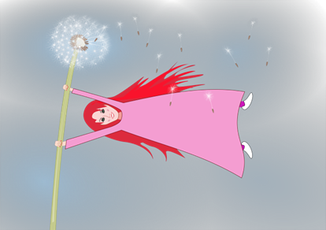
The Wind Blows
The wind blows for someone….
Notes:
This is a icebreaker motion activity
Leader starts (waves hands in the air to look like wind is blowing)
Leader says – “The wind blows for someone….”
whose name starts with letter ‘N’
who has long hair
who had ice-cream for lunch
who went for a walk this week
who is celebrating her birthday in June
who is wearing a Daisy vest/ sash
If the girls fit the description, they too wave their hands to look like the wind.
*Include everyone in the meeting (make sure everyone has at least one “wind” blowing for them)
If girls are old enough, they can lead this activity too!

Slide 15
Traffic Light!
Red Light – Freeze
Yellow Light – Do what you are doing in slow motion
Green Light – Dance/Run in Place
Notes:
Choose someone to be the leader and call out the color light (red, yellow, green).
Others will need to do what the color says.
Give a time limit or # of colors to say, before moving on to another leader

Slide 16
Time for a Poem!
Acrostic/Name Poem
Notes:
An Acrostic poem is where you take a word or name and come up with descriptive word(s) for each letter (see image above)
Give the girls a minute or two to come up with descriptive words for each letter in their name that describe them and share!

Slide 17
Buzzword Bingo!
Don’t say the Buzzword!
Name | Points
Girl 1
Girl 2
Girl 3
Girl 4
Girl 5
Girl 6
Girl 7
Girl 8
Girl 9
Girl 10
“Scout”
Notes:
Choose a few words or phrases that are banned for the duration of the meeting (try to relate it to the theme of the meeting)
When someone uses the word, she gets a point.
Fewest points at the end of the meeting wins.
This can help keep people attentive, while reinforcing the need to speak clearly and simply for best effect.

Slide 18
Two Truths and a Lie
Share 2 truths and a lie about you (personal—not Girl Scout-related).
Let’s all guess which one is the lie!
Notes:
All members should write down two facts and one lie about themselves. These should be personal anecdotes—not Girl Scout-related.
After a team member reads all three, people chime in and guess which fact is actually a fib.

Slide 19
Fortunately/Unfortunately
The leader starts the story with one sentence, then chooses another member to take a turn to add to the story
That player alternates starting their sentence with either “Fortunately…” or “Unfortunately...”
For example:
Leader: Judy raced across the parking lot to her prized red Camaro, she was late to her job interview.
Player 1: Unfortunately, when she reached the car, she realized that she had left the keys inside, and the doors were locked.
Player 2: Fortunately, her car was a convertible, and the top was down. Judy jumped in and turned the key...
Notes:
The leader starts with a simple sentence that sets a scenario.
Then each group member takes a turn to add to the story.
The kicker is that players alternate starting their sentence with either “Fortunately…” or “Unfortunately.”
For example:
Leader: Judy raced across the parking lot to her prized red Camaro, she was late to her job interview.
Player 1: Unfortunately, when she reached the car, she realized that she had left the keys inside, and the doors were locked.
Player 2: Fortunately, her car was a convertible, and the top was down. Judy jumped in and turned the key...

Slide 20
Can you guess the image?
Notes:
Animation triggers on this screen. Use the arrow keys or click on the screen to show the full image
Park!

Slide 21
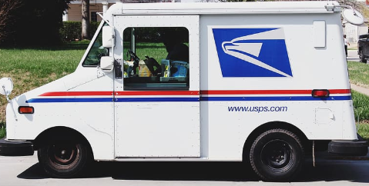
Can you guess the image?
Notes:
Animation triggers on this screen. Use the arrow keys or click on the screen to show the full image
Mail truck!

Slide 22
Can you guess the image?
Notes:
Animation triggers on this screen. Use the arrow keys or click on the screen to show the full image
Butterfly!

Slide 23
Can you guess the image?
Notes:
Animation triggers on this screen. Use the arrow keys or click on the screen to show the full image
iPhone!

Slide 24
Can you guess the image?
Notes:
Animation triggers on this screen. Use the arrow keys or click on the screen to show the full image
Birthday Candles!

Slide 25
Welcome
Troop #####
Notes:
Enter your Troop #
Optional – Add a troop picture

Slide 26
Opening Question
Type in chat your favorite donut flavor or make up your own!
Notes:
Consider having an opening question to get the meeting started, while you wait for all participants to arrive and get settled.
If girls are old enough, you can have them type in the chat.
Here are a few other question ideas:
Do you want to stay the same age forever? If yes, what age would that be?
What is your favorite possession?
If you could have one superpower, which one would you choose?
Are you a morning bird or a night owl?
Which season is your favorite? Why?
What item or gadget are you currently dreaming of buying?
Would you prefer to go to the mountains or the beach?
If you could live anywhere on this planet, where would you live?
What is the coolest vacation you have ever taken?
What is your favorite food?
Which historical figure would you want to meet?
Who has been the most influential person in your life thus far?
Where do you see yourself in 10 years?
Juliette Gordon Low left Girl Scouts a wonderful legacy, what do you want your legacy to be?
What is one of your biggest goals within your personal life?

Slide 27
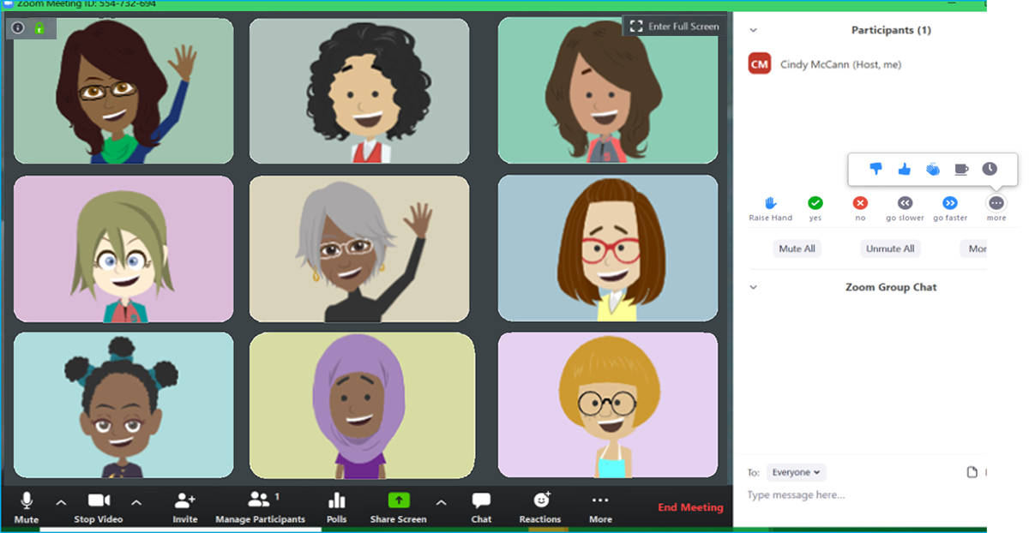
Zoom Meeting Tips
SHARE YOUR NAME AND USE HAND RAISE TO ASK A QUESTION
TURN AUDIO
CAMERA ON & OFF
WRITE A QUESTION OR ADD YOUR IDEAS
Notes:
You can use this slide if you are using Zoom as your meeting platform.

Slide 28
Zoom Meeting Tips
Let’s have fun with annotation
Type Text
Draw Lines and Shapes
Add a Stamp
Change Colors
Notes:
Zoom Meetings, and some other platforms, allow participants to Annotate, or write directly on shared screen.
Tips:
This option may be better for older girls
Be sure to make it clear when annotating is allowed (to avoid distractions)

Slide 29
Blank Slide
Notes:
Right-click on the slide thumbnail to duplicate this slide and use it to create your own content

