Slide 1

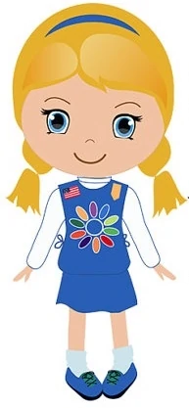
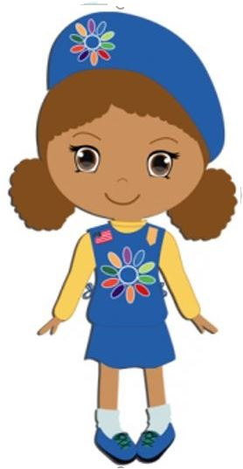
Daisy Virtual
Sisterhood Series
Notes:
Overview:
Daisy Intro Meeting: about 30 minutes + 10 minute parent chat
Welcome: Chatting - 2 minutes
Welcome: Introductions – 3-5 minutes
Zoom and Meeting Rules – 2 minutes
Opening: GS Promise, – 1-2 minutes (optional: Girl Scout Law song video)
Icebreaker: Scavenger Hunt (and sharing) - 5 minutes
Game: I Spy – 5 minutes OR Game: Juliette Low Story with motions – 5 minutes
Badge activity: "Promise Center" Discuss GS Promise - 10 minutes
Prep for Next Meeting and Vote – 2 minutes
Parent Chat – 10 minutes (or longer if you want)
Friendship Circle – 2 minutes
BADGE REQUIREMENTS: Promise Center
1. Make a circle
2. Say the Girl Scout Promise
3. Talk about what the Promise means to you
Supplies Needed:
Paper and something to write with (pencil, markers, crayons, etc.)
Be Prepared to:
Set 2 minute timer for scavenger hunt
Lead I Spy Activity
Lead girls in Juliette Low story with hand motions
Teach the Girl Scout Promise
Lead Friendship Circle

Slide 2
Daisy Sisterhood Series
TOC
Daisy Leader Instructions
Meeting 1
Meeting 2
Meeting 3
Meeting 4
Slides 4-7
Slides 8-32
Slides 33-52
Slides 53-69
Slides 70-85
Notes:
Overview:
Daisy Intro Meeting: about 30 minutes + 10 minute parent chat
Welcome: Chatting - 2 minutes
Welcome: Introductions – 3-5 minutes
Zoom and Meeting Rules – 2 minutes
Opening: GS Promise, – 1-2 minutes (optional: Girl Scout Law song video)
Icebreaker: Scavenger Hunt (and sharing) - 5 minutes
Game: I Spy – 5 minutes OR Game: Juliette Low Story with motions – 5 minutes
Badge activity: "Promise Center" Discuss GS Promise - 10 minutes
Prep for Next Meeting and Vote – 2 minutes
Parent Chat – 10 minutes (or longer if you want)
Friendship Circle – 2 minutes
BADGE REQUIREMENTS: Promise Center
1. Make a circle
2. Say the Girl Scout Promise
3. Talk about what the Promise means to you
Supplies Needed:
Paper and something to write with (pencil, markers, crayons, etc.)
Be Prepared to:
Set 2 minute timer for scavenger hunt
Lead I Spy Activity
Lead girls in Juliette Low story with hand motions
Teach the Girl Scout Promise
Lead Friendship Circle

Slide 3

Daisy Leader Meeting Packet
Notes:
Overview:
Daisy Intro Meeting: about 25 - 30 minutes + 5 minute parent chat
Welcome: Chatting - 2 minutes
Welcome: Introductions – 3-5 minutes
Zoom and Meeting Rules – 2 minutes
Opening: GS Promise, – 1-2 minutes (optional: Girl Scout Law song video)
Icebreaker: Scavenger Hunt (and sharing) - 5 minutes
Game: I Spy – 5 minutes OR Game: Juliette Low Story with motions – 5 minutes
Badge activity: "Promise Center" Discuss GS Promise - 5 minutes
Prep for Next Meeting and Vote – 2 minutes
Parent Chat – 5 minutes (or longer if you want)
Friendship Circle – 2 minutes
BADGE REQUIREMENTS: Promise Center
1. Make a circle
2. Say the Girl Scout Promise
3. Talk about what the Promise means to you
Supplies Needed:
Paper and something to write with (pencil, markers, crayons, etc.)
Be Prepared to:
Set 2 minute timer for scavenger hunt
Lead I Spy Activity
Lead girls in Juliette Low story with hand motions
Teach the Girl Scout Promise
Lead Friendship Circle

Slide 4
Troop Leader Guide
Daisy Virtual Meeting Packet
Promise Center and Sunny Petal

Slide 5
Troop Leader Instructions
This packet includes Daisy Intro Meeting/Promise Center Badge + Friendly and Helpful Petal, in 4 meetings, roughly 25-35 minutes each.
Meetings are designed to be held on Zoom.
"Dear Daisies..." slides contain reminder emails to parents.
For Opening: Pledge of allegiance and GS Law are optional.
Scavenger hunts and other icebreakers can be added or omitted based on timing. See more icebreakers in the “Daisy Resources” packet.
To "hide" slides, right click on slide and select "Hide Slide“. This will make it skip when you are presenting.
You are encouraged to customize the slides to fit your troop meeting needs.
In the slide notes section, there are links to the online Volunteer Toolkit (VTK) has badge requirements and activity plans for your Troop level. The next slide explains how to access and utilize the VTK and Zoom to lead virtual troop meetings.
Click "Notes" below (bottom right corner) to see description of activities, material lists, links, and script.
If you have questions, contact Lauren Fialkow: lfialkow@gsnorcal.org
Notes:
Great! You found the notes section! This is where we have more details on activities, badge requirements, links to resources, a script you can follow, and more!
The first slide for each meeting will have the overview of the whole meeting.
It is very important to remember that girls are looking for a place to connect and share. There is no need to do every tradition (e.g. kaper)/ badge content at the meeting.
Remind each girl to have a dedicated box or folder to keep their work from their Girl Scouts meetings.
Give girls a game to play together in the beginning of the meeting and at closing, give them a theme to share. For e.g., share a wish or something they appreciate about someone in the troop. Ask them to specially interact with each other "Katie, share a wish you have for Sarah."
Tell girls you will call on them to introduce themselves but if they don't feel comfortable, they can say pass/ use the Chat feature.
Instead of saying "here" for attendance, tell them so say their favorite ______.
Please do not feel as though you need to follow the script – it is there if you need some guidance.

Slide 6
VTK & Zoom
Volunteer Toolkit (VTK):
Can be used to plan any badge!
Includes video tutorials on adding badges to year plan and more
Includes link to Badge Explorer to see requirements for each badge
Zoom:
Make sure to disable annotations when you share
Learn how to share a video
Learn how to create a poll
*See ‘Notes’ below for links to more VTK & Zoom resources.
Notes:
Volunteer Toolkit (for leaders and parents):
General Volunteer Toolkit Link: https://www.gsnorcal.org/en/for-volunteers/volunteer-toolkit.html
Video tutorials (quick and easy!):
How to Set Up Your Year Plan https://www.youtube.com/watch?v=n0nrh4NJBFk&list=PLZaWZO965rJ2_OmlsOCwnzUe0xkhTBhrG&index=1
Meeting Plan Overview https://www.youtube.com/watch?v=AHw9W6YyOPU&list=PLZaWZO965rJ2_OmlsOCwnzUe0xkhTBhrG&index=2
Setting Meeting Dates and Locations https://www.youtube.com/watch?v=R_nGzg4Ux3w&list=PLZaWZO965rJ2_OmlsOCwnzUe0xkhTBhrG&index=3
Customizing Your Year Plan https://www.youtube.com/watch?v=uTdSFjJcFu0&list=PLZaWZO965rJ2_OmlsOCwnzUe0xkhTBhrG&index=4
Badge Explorer (with badge requirements): https://www.girlscouts.org/en/our-program/badges/badge_explorer.html
Zoom:
General: It can be easier/smoother to use two computer monitors if you have access.
How to disable annotations: This can only be done while the host is sharing their screen. To set it up beforehand, open a zoom meeting and select share screen. Once sharing right click on the three dots/More on the right side of the menu bar. Click "disable participants annotation" When you start the next meeting, this setting should remain saved, but it's good to check when you start sharing your screen during the meeting. If your girls know not to annotate inappropriately, then there is no need to disable this feature and you may choose to use it as part of your meeting—maybe your troop can create a picture together on the screen.
How to share a video: Only a host or co-host can share a screen. Select "Share Screen" and click on the window with the video. Make sure to check the boxes in the bottom left corner that say "Share Computer Sound" and "Optimize for Video Sharing" and then click "share." Make sure there are no "zoom" boxes over the video screen such as the chat, participants list, or control panel. This will appear to participants as a gray box blocking the screen. If you are experienced with Zoom, some of these settings can be changed in Zoom settings: https://zoom.us/
How to see girls' videos while you are screen sharing: While screen sharing, go to the menu bar and click on the three dots/More on the right hand side. Select "View Participant Videos"
How to Poll: When you start the meeting, click Polls on the menu bar. This will take you to a browser window where you can give the Poll a title, question, and possible answers. When you are done you can click the Polls button on the menu again and your poll will show up. You can click Launch Poll to start polling the girls. You can end polling and relaunch at anytime. You can also add additional poll questions. (If you don't see the Polls menu, try making your Zoom window full screen or by clicking the More tab on the menu bar)

Slide 7
Extra interactive tools, videos, and links in ‘Notes’
Notes:
These links are listed in the Notes of the slides where they are applicable. They are compiled here if you need to find any of them more easily.
Virtual Troop Leading Resources:
GSNorCal At Home resources--SO MANY RESOURCES including: Virtual Programs and Events, GSNorCal Patch Programs, Virtual Badges, Journeys, and Awards, Family Days at Camp info, Community Service ideas, and Outdoors activities! https://www.gsnorcal.org/en/families/at-home.html
Here is a "Wheel of Names" tool that you can edit and use to assign Kapers or pick a girl at random for any reason—maybe to share first for an activity, or pick a song for the group to sing, etc. https://wheelofnames.com/?fbclid=IwAR3B_y1iUK-VdEV0EMO6bpU653xTivfnrcvKS1o_y5eb98lqlqib6cwiG4E
Link to virtual Ice Breakers: (Pre-made icebreaker slides at end of this presentation) https://www.girlscouts.org/en/girl-scouts-at-home/troop-leaders/digital-icebreakers-games.html
Girl Scout Internet Safety Pledge: https://www.gsnorcal.org/content/dam/girlscouts-gsnorcal/documents/volunteer_resources/risk/internet-safety-pledge.pdf
General Daisy Resources:
Link to Your Daisy Petals and Leaves (Badges) in GS Volunteer Toolkit PDF:
http://vtkdemo.girlscouts.org/content/dam/girlscouts-vtk/meeting-aids/Daisy-Petals.pdf
All Daisy Badges and Journeys (except brand new ones) PDF:
https://www.girlscouts.org/content/dam/girlscouts-gsusa/forms-and-documents/our-program/Badges/GSUSA_DaisyBadgesAwardsAndPins2019_Guide.pdf
Badge Explorer (with badge requirements, interactive): https://www.girlscouts.org/en/our-program/badges/badge_explorer.html
Link to Daisy Promise and Law worksheet in GS Volunteer Toolkit PDF:
http://vtkdemo.girlscouts.org/content/dam/girlscouts-vtk/meeting-aids/Daisy-Promise-and-Law.pdf
Girl Scout Law Song video made by older Girl Scouts. Challenge the girls to watch the video at home and practice the song.
https://www.youtube.com/watch?v=6dF8dUi37x8&t=1s (start the video 30 seconds in, after they finish singing the song once, stop the video)
Daisy Intro Meeting in Volunteer Toolkit: http://vtkdemo.girlscouts.org/content/girlscouts-vtk/en/vtk.details.html?elem=189320400000
Friendly and Helpful Petal (Sunny) Resources:
Sunny's Story in PDF form:
https://my.girlscouts.org/content/dam/girlscouts-vtk/local/aid/meetings/D14DP04/Sunnys-Story.pdf
(You can make the PDF full screen and then "share screen" over zoom so girls can see the pages as you read the story to them)
Sunny’s Story (read aloud) YouTube link:
https://www.youtube.com/watch?v=Y2uopZwglBw&feature=youtu.be
GSUSA Sunny story and petal activities (mural and discussing) 8 minutes:
https://www.girlscouts.org/en/girl-scouts-at-home/activities-for-girls/daisies/daisy-sunny-petal-badge-activity.html
Video made by GS Virgina Skyline on making a mural for Sunny’s story—can use as part of your meeting or for inspiration (17 minutes):
https://www.youtube.com/watch?v=Ls5InHewAoQ&list=PLPrEwDw9DOl-mS2AI7pawC4EsL7eaEQeF&index=2

Slide 8
Daisy Meeting:
Welcome to Girl Scouts!
Meeting 1
Notes:
Overview:
Daisy Intro Meeting: about 30 minutes + 10 minute parent chat
Welcome: Chatting - 2 minutes
Welcome: Introductions – 3-5 minutes
Zoom and Meeting Rules – 2 minutes
Opening: GS Promise, – 1-2 minutes (optional: Girl Scout Law song video)
Icebreaker: Scavenger Hunt (and sharing) - 5 minutes
Game: I Spy – 5 minutes OR Game: Juliette Low Story with motions – 5 minutes
Badge activity: "Promise Center" Discuss GS Promise - 10 minutes
Prep for Next Meeting and Vote – 2 minutes
Parent Chat – 10 minutes (or longer if you want)
Friendship Circle – 2 minutes
BADGE REQUIREMENTS: Promise Center
1. Make a circle
2. Say the Girl Scout Promise
3. Talk about what the Promise means to you
Supplies Needed:
Paper and something to write with (pencil, markers, crayons, etc.)
Be Prepared to:
Set 2 minute timer for scavenger hunt
Lead I Spy Activity
Lead girls in Juliette Low story with hand motions
Teach the Girl Scout Promise
Lead Friendship Circle

Slide 9
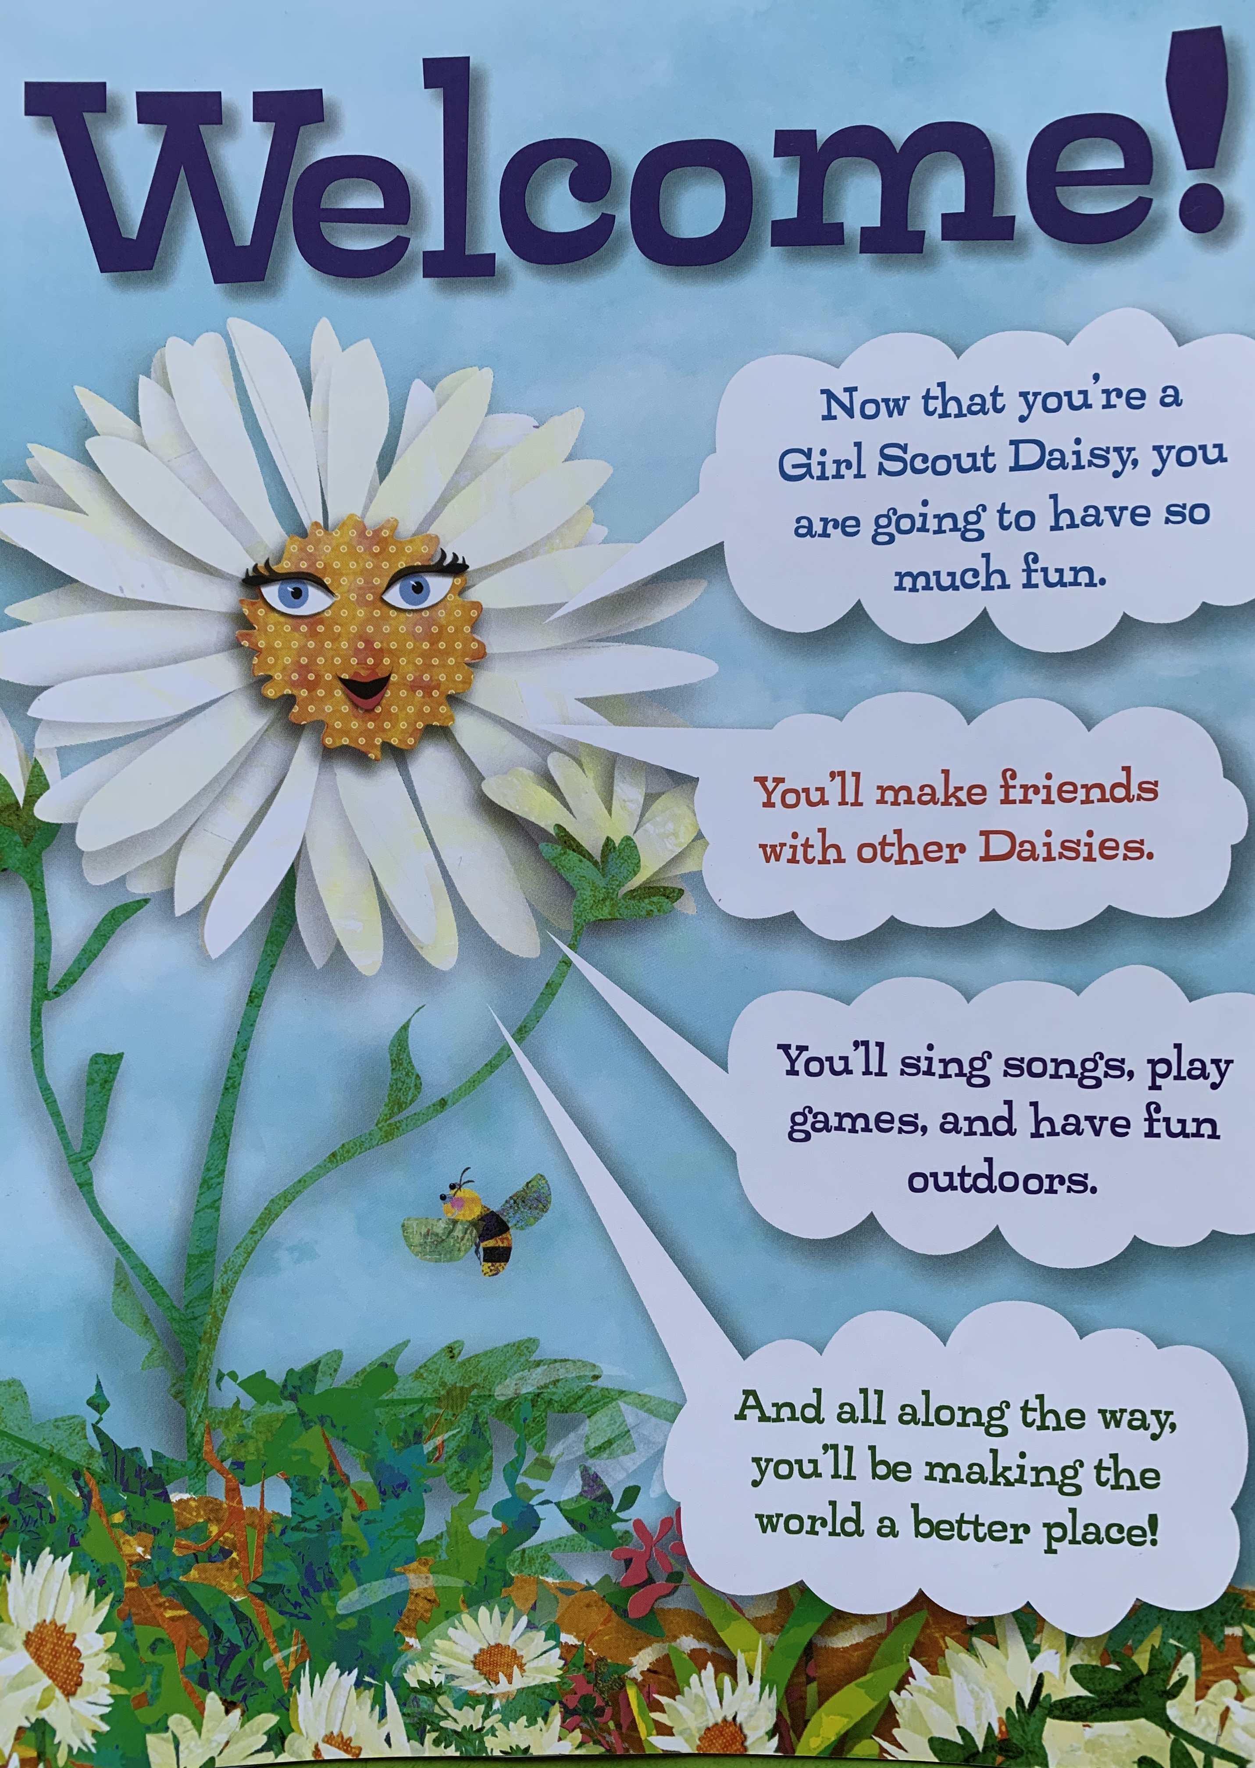
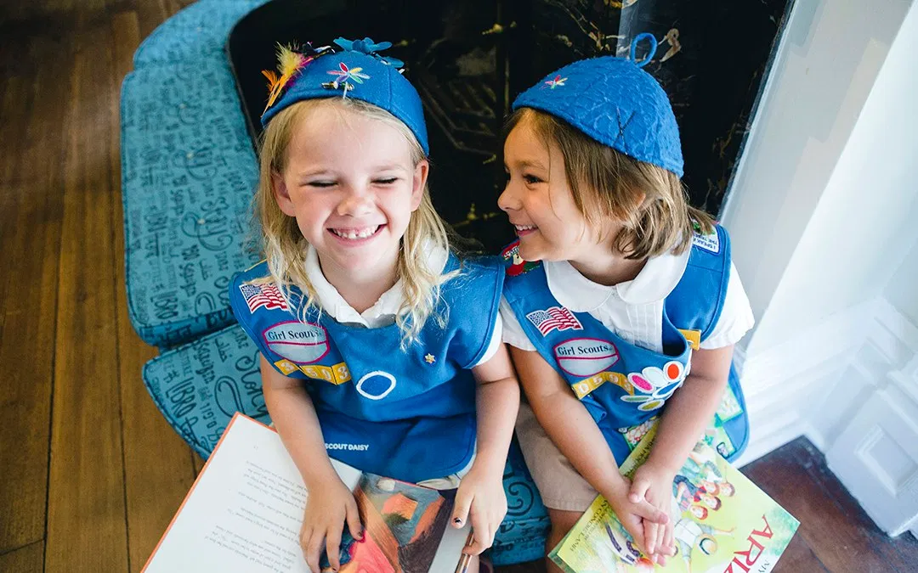
Today's Supplies:
Paper
Pencil, markers, or crayons
Notes:
While girls are arriving, ask them to share about things they did this week. Ask girls to gather supplies if they haven't.
Once all have arrived:
Ask girls and adults to introduce themselves by saying their name and one thing about themselves that they want everyone to know.
After each girl introduces herself, direct the group to respond by saying "Welcome To Daisy Girl Scouts (name)" (can unmute themselves to do this but they must mute after or leader can "Mute all")

Slide 10
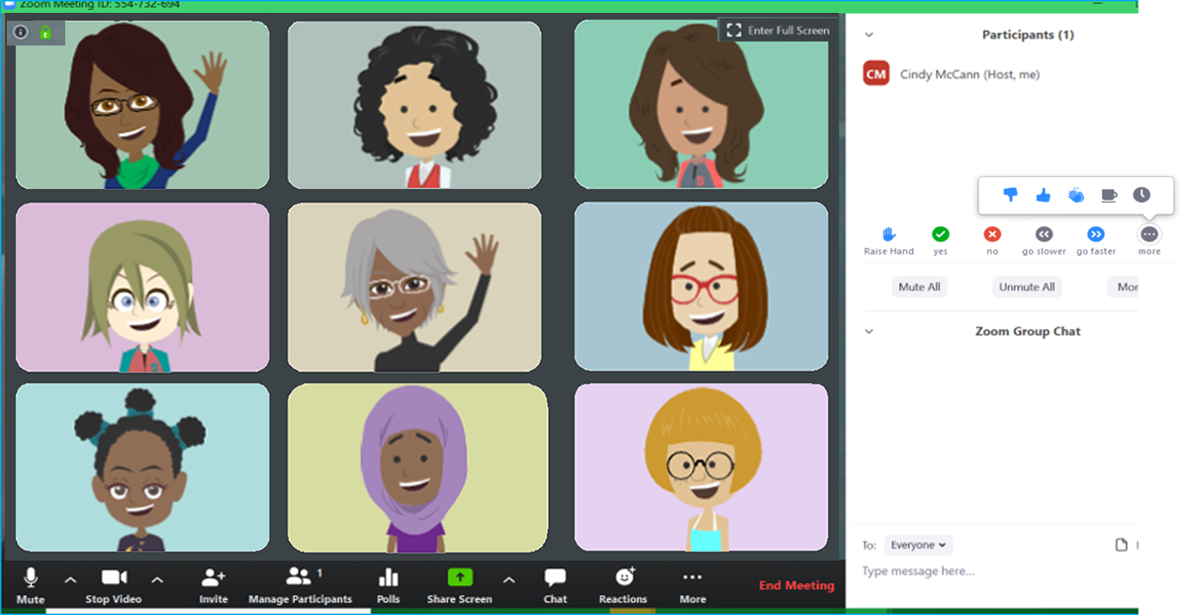
Daisy Zoom Meeting Tips
TURN SOUND &
CAMERA ON & OFF
WRITE A QUESTION OR ADD YOUR IDEAS
Notes:
Show girls how to use Zoom if they don't already know.
Show them how to mute/unmute themselves and where the chat is. You can also show them how to use the hand raise function if you wish to use that feature.
Zoom Tips and Meeting Rules: 2 minutes

Slide 11


Meeting Rules
If we ask a Yes/ No question, answer with a thumbs up or thumbs down
Mute yourself until it is time to talk
Can we think of any other good rules for our meetings?
Notes:
Go over meeting rules with the girls.
Please customize this slide to rules you have establish for your meetings. Some other suggestions are:
- Only use the chat nicely and do not type the same thing over and over
- Listen to the person who is talking
Zoom Tips and Meeting Rules: 2 minutes
If you can incorporate Daisy level aspects of the GD Internet Safety pledge, feel free to do so. The pledge can be found here:
https://www.gsnorcal.org/content/dam/girlscouts-gsnorcal/documents/volunteer_resources/risk/internet-safety-pledge.pdf

Slide 12


Notes:
Pledge is optional.
Opening Ceremony: 2 minutes or less.

Slide 13


* You may replace 'God' with anything else you believe in. For e.g. Family
Notes:
Officially begin the meeting with an Opening Ceremony. This consists of the Girl Scout Promise and the option of adding the pledge of allegiance and/or Girl Scout Law.
Have girls unmute for the Girl Scout Promise. Can do "repeat after me" style if they don't know the Promise yet.
Your troop can have a girl lead the Promise as a job (kaper).
SAY:
Now everyone sit up tall and make the Girl Scout sign, we are going to say the Girl Scout Promise.
Depending how well your girls know the promise you may choose to do "repeat after me" or all together.
Optional: You can take down the slideshow so the girls can all see each other better.
Link to Daisy Promise and Law worksheet in GS Volunteer Toolkit:
http://vtkdemo.girlscouts.org/content/dam/girlscouts-vtk/meeting-aids/Daisy-Promise-and-Law.pdf
Opening Ceremony: 2 minutes or less.

Slide 14

Notes:
SAY:
Now I will say the Girl Scout Law. Listen closely and see if you can find a part of the Law that is you really like or is your favorite part.
After Law:
Each of these flower friends have a cool story about their part of the Girl Scout Law. (point to Sunny) Sunny here has a story about being Friendly and Helpful which we will read at our next meeting when we work on earning our first petal badge for our uniforms!
Optional: Show girls the Girl Scout Law Song video made by older Girl Scouts. Challenge the girls to watch the video at home and practice the song.
https://www.youtube.com/watch?v=6dF8dUi37x8&t=1s (start the video 30 seconds in, after they finish singing the song once, stop the video) See tips on Slide #2 for sharing videos on Zoom.
Link to Daisy Promise and Law worksheet in GS Volunteer Toolkit:
http://vtkdemo.girlscouts.org/content/dam/girlscouts-vtk/meeting-aids/Daisy-Promise-and-Law.pdf
Opening ceremony: 2 minutes (if including Girl Scout Law Song video it will be a few minutes longer)

Slide 15


Scavenger Hunt!
Find something…
Brown
Blue
Green
Notes:
SAY:
It's time to play a game. We are doing a 2 minute scavenger hunt! When I say go, you will have 2 minutes to find: something brown, something blue, and something green. If you can, try and find 2 things for each color! Any questions?
Your two minutes starts in 3...2....1...go!
Give the girls updates on how much time they have left ("1 minute and 10 seconds to go!") and when the return, have them share one of the things they found.
Explain that Blue is the color of Daisies, Brown is the color of Brownies, and Green is the color of Juniors but also the Girl Scout color!
SAY: (optional)
What are some other things that are green, brown, or blue that relates to Girl Scouts?
Answers could be: green for nature, brown for dirt, earth, and trees, blue for sky. Related to GS because Girl Scouts like to be outside and interacting with nature.
Scavenger hunt: 5 minutes

Slide 16
Let’s Vote!
Which activity would you like to do?
1
Play the I-Spy game
2
Hear the story about Juliette Gordon Low and do the actions
Notes:
SAY:
Juliette Gordon Low start the Girl Scouts in 1912. She is our Founder! Next we will play a game to get to know her better. Which would you like to do? We can play an I-Spy game or we can hear a story and do fun actions along with the story.
Raise your hand if you want to play I-spy. (count votes) Now raise your hand if you want to hear the story and do the actions. (count votes)
If you think your girls are able to use Zoom polling, set up a poll and let them click option 1: I Spy or 2: Story
You can do a practice poll to try it out but still take the actual vote from girls raising hands.

Slide 17
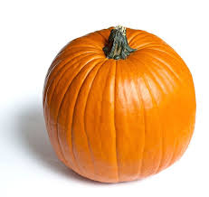
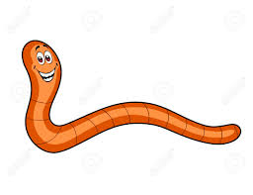

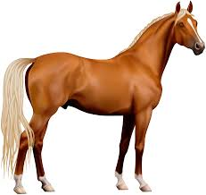

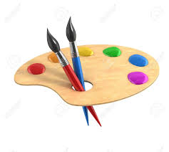
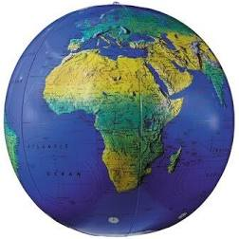

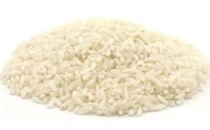
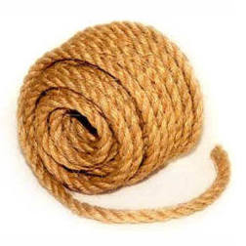
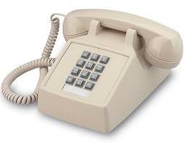
Juliette Gordon Low I-Spy
Notes:
Game – I Spy, JGL items
The person who started Girl Scouts in America was called Juliette Gordon Low. You’ll learn more about her throughout your time in Girl Scouts. I’m going to show you some pictures that will tell you a little bit about Juliette and what kind of person she was. We’re going to play a game of I-Spy so if you know the answer, raise your hand and we’ll call on someone to share with us.
*Display collage*
I spy something that you carve
I spy something that has 4 legs
I spy something that you wear
I spy something that lives underneath the ground
I spy something that you eat
I spy something that grows in my lawn
Pumpkin – Juliette Gordon Low’s birthday is on Halloween (October 31)
Pearls – she sold her pearls to fund the first Girl Scout troop
Daisy – her nickname is Daisy
Rice – she got rice lodged in her ear from a wedding, which caused her to be deaf in one ear
Horse – she loves to ride horses
Book – she loved reading
Paintbrush – she loved painting
Telephone – called Lord Baden Powell to talk about idea to start Girl Scouts
Rope/twine
Worm
Globe

Slide 18
Juliette Gordon Low Story
Once upon a time there was a little girl named Juliette Low who lived in Georgia and loved to ride horses. After she grew up she went to London where she met Lord Baden-Powell who founded the Boy Scouts.
She was fascinated by the work he was doing. She studied with him awhile and decided to found a troop of Girl Scouts for her friends who liked to ride horses in Georgia. So Juliette Low said good-bye to the Boy Scouts in London and came home with the idea that Lord Baden-Powell gave her.
Notes:
You can choose either of the Juliette Gordon Low stories to share with your girls. One version of the story is in BLUE and one is in GREEN. Please review this slide and the next two and remove the version of the story that you will not be using.
Option 1:
Story of Juliette Gordon Low:
SAY:
Girl Scouts was started in 1912 by a woman named Juliette Gordon Low. Listen closely while I tell you her story, because you’re going to make sound effects and do the actions for the story!
Whenever I say “Juliette Low” - you wave and say, “Daisy” (lets practice)
When I say “Little Girl” – you flex and say, “Girl Power”
When I say “Georgia” – you wave and say “hi, y’all”
When I say “Horses” – you glamp and say “Neighhhh”
When I say “London” – you sing “ London Bridge is Falling Down”
When I say “Girl Scouts” - you make the Girl Scout sign (demonstrate) and say, “Be prepared”
STORY: Once upon a time there was a little girl named Juliette Low who lived in Georgia and loved to ride horses. After she grew up she went to London where she met Lord Baden-Powell who founded the Boy Scouts.
She was fascinated by the work he was doing. She studied with him awhile and decided to found a troop of Girl Scouts for her friends who liked to ride horses in Georgia. So Juliette Low said good-bye to the Boy Scouts in London and came home with the idea that Lord Baden-Powell gave her.
She formed a group of little girls, who liked to ride horses and be together, into a troop of Girl Scouts. And they loved it so much that the idea spread and now there are troops all over the world
Aren‛t we glad that a Little Girl named Juliette Low from Georgia who liked Horses went to London and met Lord Baden-Powell, founder of the Boy Scouts, and came home to start the wonderful world of Girl Scouts!
SOUND EFFECTS: As the story is read, each group upon hearing its name, stands up making the sound effect listed below. Practice the sounds and actions first so each group understands what to do.
Little Girls..................................Flex and and say "Girl Power"
Juliette Low...............................Girl Scout sign and say "On my Honor"
Georgia (state of)................... Wave and say “Hey, y' all!”
Horses..........................................Gallop in place and Say “Neighhhhh”
London..........................................Sing “London Bridge is Falling Down”
Girl Scouts.................................Make Girl Scout sign and sing "Make New Friends”

Slide 19
Juliette Gordon Low Story
She formed a group of little girls, who liked to ride horses and be together, into a troop of Girl Scouts. And they loved it so much that the idea spread and now there are troops all over the world.
Aren‛t we glad that a Little Girl named Juliette Low from Georgia who liked Horses went to London and met
the founder of the Boy Scouts, and came home to start the wonderful world of Girl Scouts!
Notes:
SOUND EFFECTS: As the story is read, each group upon hearing its name, stands up making the sound effect listed below. Practice the sounds and actions first so each group understands what to do.
Little Girls..................................Flex and say "Girl Power"
Juliette Low...............................Girl Scout sign and say "On my Honor"
Georgia (state of)................... Way and say “Hey, y' all!”
Horses..........................................Gallop in place and Say “Neighhhhh”
London..........................................Sing “London Bridge is Falling Down”
Girl Scouts.................................Make Girl Scout sign and sing "Make New Friends”

Slide 20
Juliette Gordon Low Story
GIRL SCOUTING was started by a woman named Juliette Gordon Low. When she was a BABY, her uncle said she was going to be a DAISY. That was his way of saying she was special! Her family started calling her DAISY, and that became her nickname.
Years later, GIRL SCOUT DAISIES were named after her. When DAISY was a girl, she liked to CLIMB trees and SWING on vines. She loved all kinds of animals. She even had a pet RABBIT! And she always had a lot of FUN and when she grew up, she wanted other girls to have FUN so she started the GIRL SCOUTS.
Now there are GIRL SCOUTS all over the world!
Notes:
Juliette Gordon Low Story – Option 2:
SAY:
Now I will read the story and you will do the actions when you hear those words.
I'll read a story and when I say certain words, you do an action.
Let us review the words and actions:
GIRL SCOUTING or GIRL SCOUTS The Girl Scout sign (GGGS page 12)
DAISY Touch the floor, jump up, and say Daisy!
BABY Fold arms and rock like you are holding a baby
CLIMB Pretend to climb
SWING Sway side-to-side
RABBIT Hop
FUN Spin in a circle while waving arms in the air

Slide 21
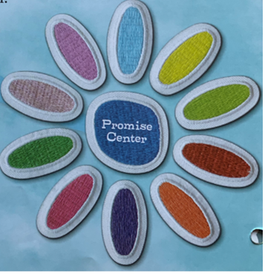

Your first badge!
Earn the Promise Center
1
Make a circle
2
Say the Girl Scout Promise
3
Talk about what the Girl Scout Promise means to you
Notes:
SAY:
This is what the Daisy uniform looks like. Throughout the year we will learn new skills and earn patches to put on our Daisy uniforms! I can't wait to see all you girls in your uniforms! Today is very exciting because we are going to earn our first Daisy patch! It is called the Promise Center, do you see it here? This badge will be the center of the Daisy flower we will be working on this year. For every Daisy patch we earn, we will need to complete 3 steps. For this patch, the three steps are: make a circle, say the Girl Scout Promise, and talk about what the Promise means to us.

Slide 22
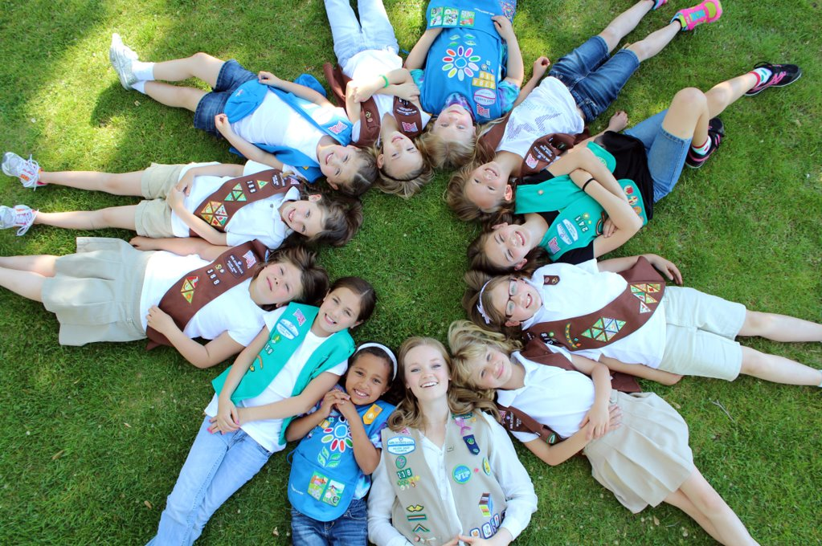
Notes:
SAY:
This is a circle of Girl Scouts, do you see any Daisies? How many?
Normally, we would all sit in a circle together, but today we will imagine we are in a circle together. We can draw our Daisy circle to help us imagine. Does everyone have a piece of paper and something write with?

Slide 23
Make a Circle
L
Daisy Circle
Notes:
Steps:
Draw a big circle on a piece of paper
Draw a smaller circle on the edge and write the first letter of your name
Now we will draw circles for our daisy friends around the circle.
Optional: have the girls write the first initial of each of the other girls in the small circles to represent their Daisy friends.

Slide 24
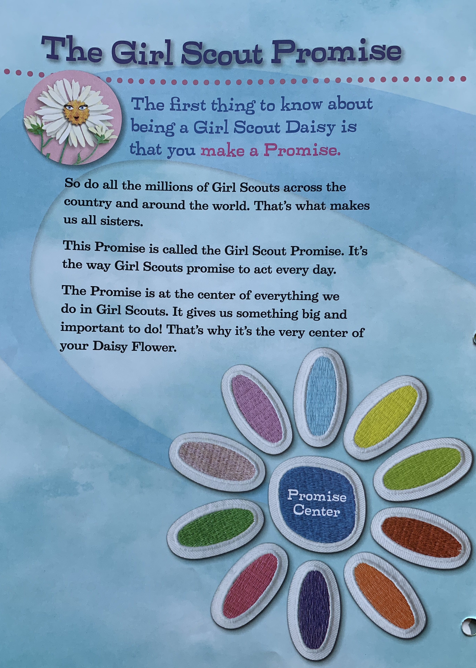
Notes:
Read about the Girl Scout Promise (above) and explain to the girls that you will start every meeting by saying the Girl Scout Promise.
Say the Promise using a slide displaying the words, pointing to the words as you read them. Read it again, line by line, and ask the girls to repeat each line after you. Ask the girls to share what the Promise means to them.
Prompts may be used if girls are shy. "Sally, what do you think honor means?" "Susie, what ways can we help people?"

Slide 25

Notes:
Explain how these flowers are talking about the very beginning and the very end of the Girl Scout Promise. You can read the quotes from the flowers. Show the girls that all these flowers are all our flower friends and we will hear stories about all of them to learn more about the Girl Scout Law.

Slide 26
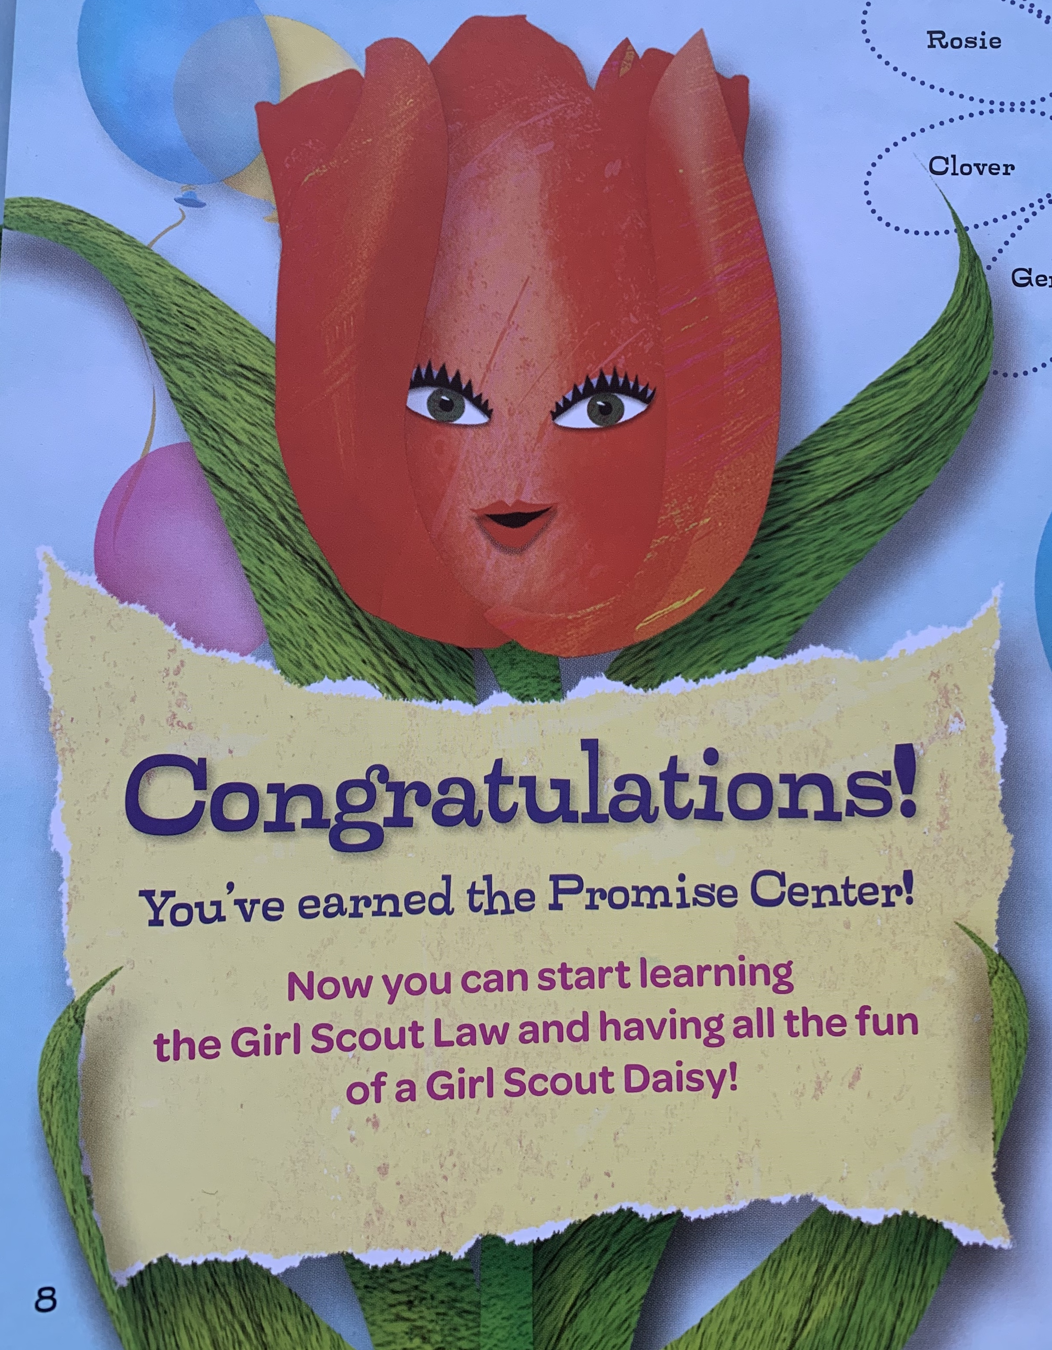
Notes:
SAY:
Now that we have completed all three steps, we have earned the Amazing Daisy Promise Center. Congratulations! Who can remember what one of the steps we did was?
1. Make a circle
2. Say the Girl Scout Promise
3. Talk about what the Girl Scout Promise means to us.
Great job! Congratulations to everyone for earning the Promise Center!

Slide 27
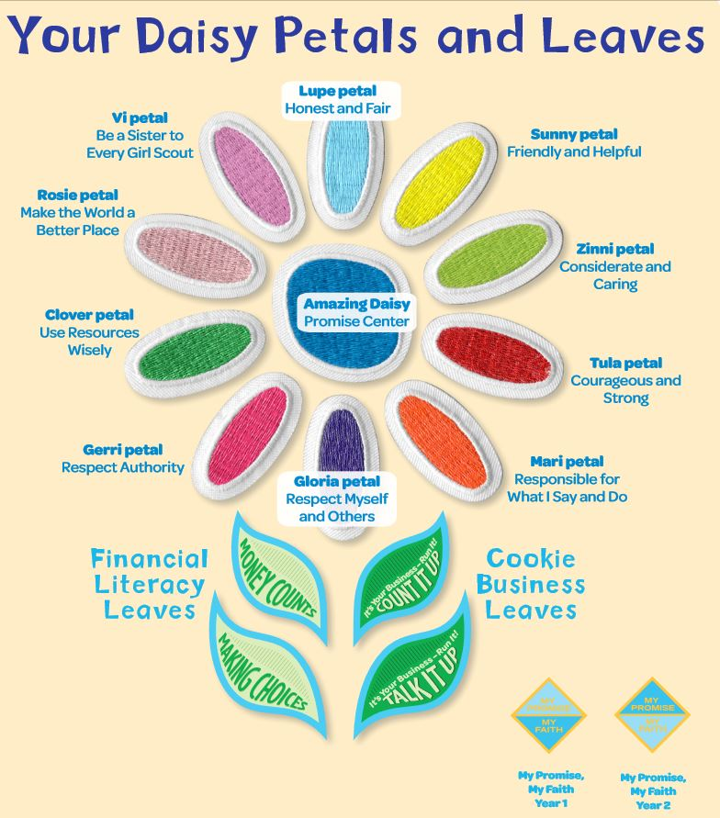
Notes:
SAY:
These are all the Daisy Petals and leaves that we can work on earning this year. Here is the Amazing Daisy Promise Center that you just earned. In the opening ceremony today, after we said the Girl Scout Promise we said the Girl Scout Law. Each of these leaves is about a different part of the Girl Scout Law. Each petal has a fun flower friend that will help us learn. Next time we will earn the Sunny Petal which is all about being Friendly and Helpful.
You might be wondering, when will I get my badge to put on my uniform? Well, we might have an online award ceremony with our troop, or you might get your patch in the mail or from your grown-ups.
(If you troop has already decided how patches will be given to the girls, share that with them now.)
Link to Your Daisy Petals and Leaves:
http://vtkdemo.girlscouts.org/content/dam/girlscouts-vtk/meeting-aids/Daisy-Petals.pdf

Slide 28
Let’s Vote!
Which game would you like to start our next meeting with?
1
A Scavenger Hunt
2
Show and Tell
Notes:
The scavenger hunt will be like the one they did today. A 'Show and Tell’ would mean each girl would bring something to the next meeting to show to her fellow Daisies and tell them why it's important to her.
You can use the polling feature on Zoom or you can have the girls raise their hands for each option.

Slide 29
Be prepared for Next Meeting:
Think about ways you are friendly and helpful.
2. Bring supplies:
  Colored markers or crayons or colored pencils
  Colored or white paper
  Scissors
  Glue or tape
Notes:
Read them this slide and see if anyone has any questions about supplies or what to do for their Kaper.

Slide 30
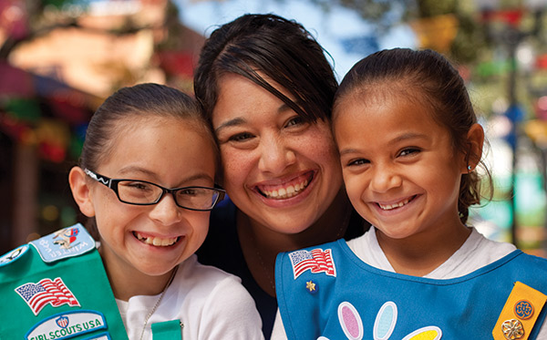
Parent chat!
Notes:
At the end of every meeting, bring the adults over and clue them in and get them involved:
"I'll send you the follow up email. Who can help me at the next meeting and be present so that we have enough adults?"
Suggestions of what you can ask them to help specifically with an activity:
"Next week we are working on a mural, can anyone help out with that?"
"Next week we are going to read a story for a petal, whose name can I put down for helping with the story?"
"Who can help out when the girls do a craft?"
"Who is good at singing and would like to lead a song?"
Plan out the help you will need for the four meetings. Use a sign-up genius to get parents to sign up for specific duties.
Suggestions of what you can discuss with parents:
Make sure everyone has your phone and email, knows the troop number, and has all the information about the next troop meting (date, time, location and any supplies the girls will need to bring).
Make Her Experience Memorable (a resource for parents on how they can help): https://my.girlscouts.org/content/dam-resources2/girlscouts-vtkcontent/Parent-Hub/02_MV_VTKMake%20HerExperienceMemorable_flyer_8.5x11.pdf
More Parent Meeting Resources:
See Daisy Intro Meeting in Volunteer Toolkit for more guidance : http://vtkdemo.girlscouts.org/content/girlscouts-vtk/en/vtk.details.html?elem=189320400000
Another great resource: "Getting Adults to Help" training in our volunteer eLearning portal: https://training.gsnorcal.org/login/index.php To find it, under Troop Leaders, click on Daisy Leader (Grades K-1). Then click "New troop Leader Course (Part 1 & Part 2). Then scroll to Part 1: Troop Basics and select "Getting Adults to Help (Avg. 20 Min.) or scroll down further to "Meeting with Parents (Avg. 5 Min.)"

Slide 31
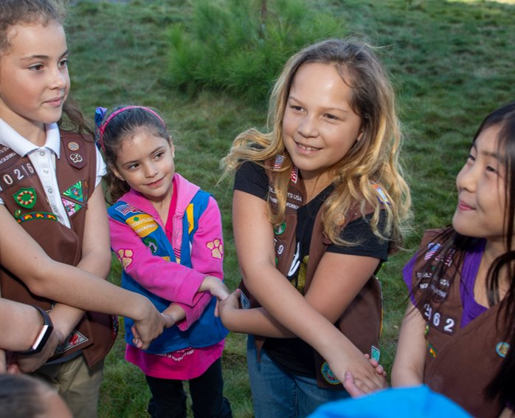
Friendship Circle and Goodbye
Notes:
Have girls cross arms right over left. They can hold hands with another person in their house if available. Tell girls to close their eyes and make a wish. Show girls how to "spin out" of the circle.
SAY:
Good job! Bye Daisies see you next week!

Slide 32
Dear Daisies...
Notes:
(hide this slide)
Send Follow-up Email within 24 hours of the meeting: (edit underlined text accordingly)
Dear Daisies,
You did a great job at your first Daisy Meeting! We earned our Promise Center (our very first badge!) and played some fun games to learn more about Girl Scouts and our founder, Juliette Gordon Low. We voted for a fun activity for next meeting to be (a Scavenger Hunt or Show and Tell). (if Show and Tell: So remember to bring something to the next meeting to show all our Daisy friends and tell us why it's special to you!) Remember, until next meeting, your challenge is to think about ways you are friendly and helpful to those around you.
Supplies to bring to next meeting are:
Colored markers or crayons or colored pencils
Colored or white paper
Scissors
Glue or tape
I can't wait to see you again, Daisies! We will meet again at (Date and Time) and use this link: (Zoom link).
Send a reminder email the day before the meeting—send the same email but add this at the beginning:
Hi Daisies! This is a reminder that we are meeting with our Troop friends tomorrow at (time). Please let me know if you can't come to the meeting.
See you soon!

Slide 33
Daisy Meeting
Friendly and Helpful
Meeting 2
Notes:
Overview:
Friendly and Helpful – Part 1: 35 minutes
Welcome question - 5 minutes
Kaper Introduction- 5 minutes
Opening: GS Promise, GS Law – 5 minutes (optional: Girl Scout Law song video)
Game: Scavenger Hunt (and sharing) - 5 minutes
Main badge activity: Sunny's story and Mural making - 10 minutes
(Optional: Make New Friends Song – 5 minutes)
Prep for Next Meeting, Friendship Circle – 5 minutes
BADGE REQUIREMENTS:
Friendly and Helpful Petal:
Talk about "Sunny's Story"
Make a mural based on "Sunny's Story" with your Daisy friends
Practice being friendly and helpful
When you’ve earned your Sunny petal, you'll know how to be friendly and helpful, just like Sunny the Sunflower.
**YOU CAN REPLACE THE STORY WITH ANOTHER PROJECT OR ACTIVITY THAT REINFORCES 'FRIENDLY AND HELPFUL'**

Slide 34
Welcome!
Was there a time this week when you were friendly? Do you do anything this week to help a friend or family member?
Supplies for today:
Colored markers or crayons or colored pencils
Colored or white paper
Scissors
Glue or tape
Notes:
Welcome your Daisies to the meeting. Remind them of the supplies for the meeting and help them come up with any needed substitutions.
SAY:
Today we're going to

Slide 35
Daisy Zoom Meeting Tips
TURN SOUND &
CAMERA ON & OFF
WRITE A QUESTION OR ADD YOUR IDEAS
Notes:
Show girls how to use Zoom if they don't already know.
Show them how to mute/unmute themselves and where the chat is. You can also show them how to use the hand raise function if you wish to use that feature.
Zoom Tips and Meeting Rules: 2 minutes

Slide 36
Meeting Rules
If we ask a Yes/ No question, answer with a thumbs up or thumbs down
Mute yourself until it is time to talk
Notes:
Go over meeting rules with the girls. Add to this slide any rules the girls suggested from last week.
Please customize this slide to rules you have established for your meetings. Some other suggestions are:
- Only use the chat nicely and do not type the same thing over and over
- Listen when someone else is talking
Zoom Tips and Meeting Rules: 2 minutes

Slide 37

Kaper Chart
Katara Waterbender
Supply
Checker
Junie B. Jones
Hermione Granger
Promise Leader
Song Leader
Kaper
Chart
Lucy Pevensie
Ramona Quimby
Clean up Captain
Matilda Wormwood
Katniss Everdeen
Friendship
Squeeze Starter
Joke
Teller
Dora Explora
Reporter
Dorothy Gale
Annie Warbucks
Notes:
Kaper Chart 1:
SAY:
Kapers are another important part of our meetings. Kaper is another word for job. The jobs when we meet in person might be getting the room ready for the meeting, passing out supplies or snacks, or cleaning the room before leaving. While we are doing virtual meetings, we will have jobs like Promise Leader and Clean up Captain. We use this Kaper Chart to hand out these jobs and make sure we all have something to do. When everyone pitches in to help with chores, the work is lighter for all.
Here is a "Wheel of Names" tool that you can edit and use to assign Kapers or pick a girl at random for any reason—maybe to share first for an activity, or pick a song for the group to sing, etc.
https://wheelofnames.com/?fbclid=IwAR3B_y1iUK-VdEV0EMO6bpU653xTivfnrcvKS1o_y5eb98lqlqib6cwiG4E
Please edit this slide with the girls’ names in your troop. There are extra name boxes beside the slide. You may not want to have all of these roles. To delete a role, click on the box where the job is listed and delete the text. Or you can drag text boxes off the slide and they will not be visible while presenting.
Possible jobs with descriptions:
Promise Leader: Leads the group is saying the GS Promise. The girl starts the Promise "On my honor.." and the rest of the girls join in.
Reporter: Reports back to the group a summary of what we did at the previous meeting.
Clean up Captain: After snack or craft, leads the group and encourages them to clean up their surroundings. "A Girl Scout always leaves a place cleaner than she found it"
Supply Checker: Reminds other scouts of the supplies needed for that meeting in the beginning. Check to make sure everyone has everything they need and helps to come up with alternatives if missing supplies.
Song Leader: Starts the song for the group or leads the song in repeat after me.
Joke Teller: Brings 1 or 2 jokes to the meeting to share with the troop
Friendship Squeeze Starter: Once girls are crossing their arms, she tells the girls to close their eyes and make a wish and squeeze once.
For next week, you can copy this slide and drag it down to near the beginning of next meeting. Right click, select “Duplicate Slide”, then click and hold the new slide to drag it.

Slide 38
Notes:
OPTIONAL PLEDGE OF ALLEGIANCE
Opening Ceremony: 2 minutes or less.

Slide 39
* You may replace 'God' with anything else you believe in. For e.g. Family
Notes:
Officially begin the meeting with an Opening Ceremony. This consists of the Girl Scout Promise and the option of adding the pledge of allegiance and/or Girl Scout Law.
Have girls unmute for the Girl Scout Promise. Can do "repeat after me" style for Girl Scout Law.
Your troop can have a girl lead the Opening Ceremony as a job (or kaper).
SAY:
Now everyone stand/sit up tall and make the Girl Scout sign, we are going to say the Girl Scout Promise.
Depending how well your girls know the promise you may choose to do "repeat after me" or all together.
Optional: You can take down the slideshow so the girls can all see each other better.
Link to Daisy Promise and Law worksheet in GS Volunteer Toolkit:
http://vtkdemo.girlscouts.org/content/dam/girlscouts-vtk/meeting-aids/Daisy-Promise-and-Law.pdf
Opening Ceremony: 2 minutes or less.

Slide 40
Notes:
SAY:
Now we will say the Girl Scout Law. Repeat after me.
Optional: Show girls the Girl Scout Law Song video made by older Girl Scouts. Challenge the girls to watch the video at home and practice the song.
https://www.youtube.com/watch?v=6dF8dUi37x8&t=1s (start the video 30 seconds in, after they finish singing the song once, stop the video) See tips on Slide #2 for sharing videos on Zoom.
Link to Daisy Promise and Law worksheet in GS Volunteer Toolkit:
http://vtkdemo.girlscouts.org/content/dam/girlscouts-vtk/meeting-aids/Daisy-Promise-and-Law.pdf
Opening ceremony: 2 minutes (if including Girl Scout Law Song video it will be a few minutes longer)

Slide 41



Time for a Scavenger Hunt!
You have 2 minutes!
How many can
you find….
Headband or Hat
Something Round
Something Yellow
Stuffed Animal
Or Your Pet
A Napkin
Notes:
If the girls voted last meeting for Show and Tell, then take down the slideshow and allow girls to share what they brought. You may need more than 5 minutes.
If they voted for scavenger hunt:
SAY:
It's time to play a game. We are doing a 2 minute scavenger hunt! When I say go, you will have 2 minutes to find: a hat or headband, something round, something blue, a stuffed animal or pet, and a snack! Any questions?
Your two minutes starts in 3...2....1...go!
Give the girls updates on how much time they have left ("1 minute and 10 seconds to go!") and when the return, have them share one of the things they found.
Scavenger hunt: 5 minutes

Slide 42
Notes:
SAY:
Do you remember which badge we earned last week? That's right! It was the Amazing Daisy Promise Center. Today, we are going to earn our first petal! It's the Friendly and Helpful Petal. Do you remember hearing the words "friendly and helpful" while we said the Girl Scout Law? Each petal we earn will teach us about a different part of the Girl Scout Law.
Can you guess which color the Friendly and Helpful Petal is? That's right! It's yellow! (Point to petal) Can you see it right here? To earn this petal, we are going to hear a story about our special flower friend, Sunny. Let's see what else we need to do to earn our Friendly and Helpful Petal...
Link to Your Daisy Petals and Leaves:
http://vtkdemo.girlscouts.org/content/dam/girlscouts-vtk/meeting-aids/Daisy-Petals.pdf

Slide 43


Learn to be Friendly and Helpful
Badge Steps:
Talk about Sunny’s Story
Make a mural based on Sunny’s Story with your Daisy friends
Practice being friendly and helpful
Notes:
SAY:
Here are the steps for earning the Friendly and Helpful Petal. (Read the steps above). We will start with reading Sunny's story. When you’ve earned your Sunny petal, you'll know how to be friendly and helpful, just like Sunny the Sunflower.
BADGE REQUIREMENTS:
Friendly and Helpful Petal:
Talk about "Sunny's Story"
Make a mural based on "Sunny's Story" with your Daisy friends
Practice being friendly and helpful
When you’ve earned your Sunny petal, you'll know how to be friendly and helpful, just like Sunny the Sunflower.

Slide 44

YouTube Link
Notes:
You can read Sunny’s story to your troop or play the following video.
After story:
SAY:
Wow, that was a great story! Sunny was so friendly and helpful. She made breakfast for her friends and showed Suzy around the garden to make her feel at home.
Discuss the questions below.
SAY:
How did Sunny show that she was friendly and helpful?
How do you think Robin felt when Sunny offered to give Suzy a tour of the garden?
How do you think Suzy felt after Sunny gave her a tour of the garden and Buckley invited her to the party?
Allow girls to discuss and share.
Story in PDF form:
https://my.girlscouts.org/content/dam/girlscouts-vtk/local/aid/meetings/D14DP04/Sunnys-Story.pdf
(You can make the PDF full screen and then "share screen" over zoom so girls can see the pages as you read the story to them). Ask girls to pay attention to any 'action' words/ verbs and enact as you read the story.
Sunny’s story YouTube link: (link on the slide)
https://www.youtube.com/watch?v=Y2uopZwglBw&feature=youtu.be
GSUSA Sunny story and petal activities (mural and discussing) 8 minutes:
https://www.girlscouts.org/en/girl-scouts-at-home/activities-for-girls/daisies/daisy-sunny-petal-badge-activity.html
17 minute video maybe by GS Virgina Skyline on making a mural for Sunny’s story—can use as part of your meeting or for inspiration:
https://www.youtube.com/watch?v=Ls5InHewAoQ&list=PLPrEwDw9DOl-mS2AI7pawC4EsL7eaEQeF&index=2

Slide 45
Learn to be Friendly and Helpful
Badge Steps:
Talk about Sunny’s Story
Make a mural based on Sunny’s Story with your Daisy friends
Practice being friendly and helpful
Notes:
SAY:
The next step towards earning our Friendly and Helpful Petal is to make a mural based on Sunny's story with our Daisy friends. Does anyone know what a mural is? (Next slide)

Slide 46
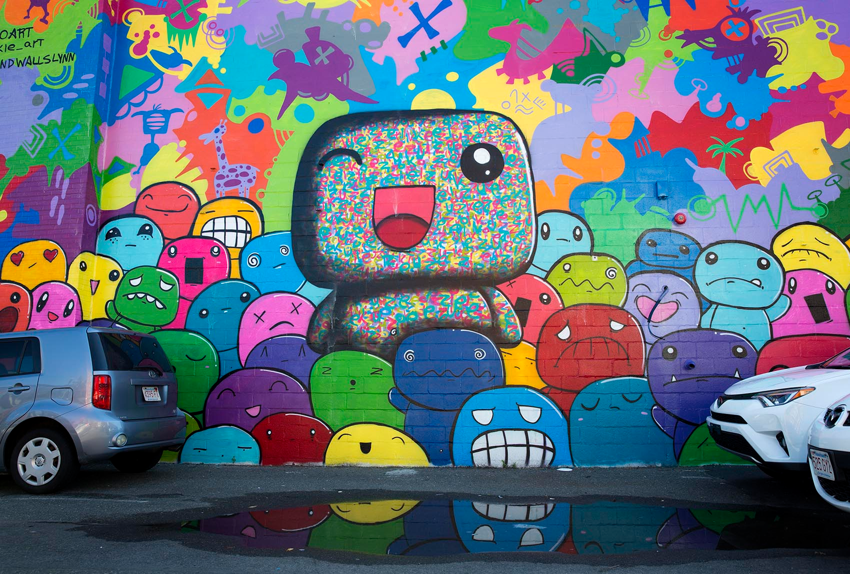
Let’s Make A Mural Together!
Notes:
SAY:
That's right! A mural is a painting on a wall or a ceiling. Murals are usually big. They may be in public places, such as the outside of a building, or indoors.
(Optional, if time permits:) Have you ever seen a mural somewhere? Where? … Do you think a picture can tell a story? How?
A mural is a picture that tells a story. We are now going to each make our own murals about Sunny's Story. Maybe someday, when we get together in person as a Daisy troop, we can combine all our murals together to make one big mural! To make your mural, you can use all the craft supplies you brought: crayons, colored pencils, markers, paper, or glue. Did anyone bring any other craft supplies? Great, you can use those too!
Take your time and remember that if you don't finish now, you can finish after our meeting. We will be sharing our murals with each other next time we meet. Try and think hard about how you can create a picture about Sunny's story and also about what it means to be Friendly and Helpful to others.
Badge Step 2:
Make a mural based on “Sunny’s Story” with your Daisy friends
Earn this step by creating your own mural based on the story. You can use crayons, markers, colored pencils, or even paint! BONUS! Next time you connect with your Daisy friends, share your mural and talk with them about Sunny’s story.
GSUSA Sunny story and petal activities (mural and discussing) 8 minutes:
https://www.girlscouts.org/en/girl-scouts-at-home/activities-for-girls/daisies/daisy-sunny-petal-badge-activity.html
17 minute video maybe by GS Virgina Skyline on making a mural for Sunny’s story—can use as part of your meeting or for inspiration:
https://www.youtube.com/watch?v=Ls5InHewAoQ&list=PLPrEwDw9DOl-mS2AI7pawC4EsL7eaEQeF&index=2

Slide 47

Make New Friends
Make new friends,
But keep the old.
One is silver,
And the other, gold
Notes:
SAY:
Girl Scouts like to sing and we also like to have a special way to close our meetings when we get together. That changes depending on what each troop chooses to do, but today we’re going to close our meeting with a traditional song that has been sung by Girl Scouts for many years. It has lots of verses, but we’re only going to learn the first verse today. You might even have heard this song before! It represents one of the best parts about being a Girl Scout - making lots of new friends and belonging to a big sisterhood of girls around the country and around the world. Everyone can unmute so that we can all hear each other sing together!
Sing song. If time permits, ask them to raise their hands if they’d like to sing it again and/or learn the second verse.

Slide 48
Make New Friends: Verse 2
A circle is round,
It has no end.
That's how long,
I want to be your friend

Slide 49
Be Prepared for Next Meeting:
Bring your mural!
2. Bring supplies:
  Paper
  Markers, crayons, or colored pencils
3. Don't forget your Kaper!

Slide 50
Parent chat!
Notes:
At the end of every meeting, bring the adults over and clue them in and get them involved:
"I'll send you the follow up email. Who can help me at the next meeting and be present so that we have enough adults?"
Suggestions of what you can ask them to help specifically with an activity:
"Next week, we are working on a mural. Can anyone help out with that?"
"Next week, we are going to read a story for a petal. Whose name can I put down for helping with the story?"
"Who can help out when the girls do a craft?"
"Who is good at singing and would like to lead a song?"
Plan out the help you will need for the four meetings. Use Sign-up genius to get parents to sign up for specific tasks.
Suggestions of what you can discuss with parents:
Make sure everyone has your phone and email, knows the troop number, and has all the information about the next troop meting (date, time, location and any supplies the girls will need to bring).
Make Her Experience Memorable (a resource for parents on how they can help): https://my.girlscouts.org/content/dam-resources2/girlscouts-vtkcontent/Parent-Hub/02_MV_VTKMake%20HerExperienceMemorable_flyer_8.5x11.pdf
More Parent Meeting Resources:
See Daisy Intro Meeting in Volunteer Toolkit for more guidance : http://vtkdemo.girlscouts.org/content/girlscouts-vtk/en/vtk.details.html?elem=189320400000
Another great resource: "Getting Adults to Help" training in our volunteer eLearning portal: https://training.gsnorcal.org/login/index.php To find it, under Troop Leaders, click on Daisy Leader (Grades K-1). Then click "New troop Leader Course (Part 1 & Part 2). Then scroll to Part 1: Troop Basics and select "Getting Adults to Help (Avg. 20 Min.) or scroll down further to "Meeting with Parents (Avg. 5 Min.)"

Slide 51
Friendship Circle and Goodbye
Notes:
Have girls cross arms right over left. They can hold hands with another person in their house if available. Tell girls to close their eyes and make a wish. Show girls how to "spin out" of the circle.
Have the Friendship Squeeze Starter lead the squeeze.
SAY:
Good job! Bye Daisies see you next week!

Slide 52
Dear Daisies...
Notes:
(hide this slide)
Send Follow-up Email within 24 hours of the meeting: (edit underlined text accordingly)
Dear Daisies,
You did a great job at our Daisy Meeting! Today, we worked on earning our Friendly and Helpful Petal by listening to Sunny's story and creating a mural. We also learned a fun song to sing called Make New Friends.
Supplies to bring to next meeting are:
Colored markers or crayons or colored pencils
Paper
Also, do you remember what your Kaper (job) is for our next meeting? Be ready at the next meeting to do your Kaper! Below is a list of who is doing which Kaper at the next meeting and what that job means:
(girl's name): (kaper)
(girl's name): (kaper)
(girl's name): (kaper)
(girl's name): (kaper)
(girl's name): (kaper)
(girl's name): (kaper)
Kaper Descriptions: (delete ones you are not using)
Promise Leader: Leads the group in saying the GS Promise. The girl starts the Promise "On my honor.." and the rest of the girls join in.
Reporter: Reports back to the group a summary of what we did at the previous meeting.
Clean up Captain: After snack or craft, leads the group and encourages them to clean up their surroundings. "A Girl Scout always leaves a place cleaner than she found it."
Supply Checker: Reminds other Girl Scouts of the supplies needed for that meeting in the beginning. Check to make sure everyone has everything they need and helps to come up with alternatives if missing supplies.
Song Leader: Starts the song for the group or leads the song in repeat after me.
Joke Teller: Brings 1 or 2 jokes to the meeting to share with the troop
Friendship Squeeze Starter: When girls are crossing their arms, she tells the girls to close their eyes and make a wish and squeeze once.
I can't wait to see you again, Daisies! We will meet again at (Date and Time) and use this link: (Zoom link).
Send a reminder email the day before the meeting—send the same email but add this at the beginning:
Hi Daisies! This is a reminder that we are meeting with our Troop friends tomorrow at (time). Please let me know if you can't come to the meeting.
See you soon!

Slide 53
Daisy Meeting
Friendly and Helpful
Meeting 3
Notes:
Overview:
Friendly and Helpful – Part 2: 40 minutes
Welcome: Sharing - 5 minutes
Kapers review – 5 minutes
Opening: Pledge of Allegiance, GS Promise, GS Law – 5 minutes (optional: Girl Scout Law song video)
Icebreaker: "is this a friendly action?" : - 5 minutes
Main badge activity: Girl Pledge and write a card - 10 minutes
Prep for Next Meeting, Friendship Circle – 10 minutes
BADGE REQUIREMENTS:
Friendly and Helpful Petal:
Talk about "Sunny's Story"
Make a mural based on "Sunny's Story" with your Daisy friends
Practice being friendly and helpful
When you’ve earned your Sunny petal, you'll know how to be friendly and helpful, just like Sunny the Sunflower.

Slide 54
Who's ready to share their mural?
Supplies for today:
Markers, crayons or colored pencils
Colored or white paper
Notes:
Let each girl share if she wants to. If you have a lot of girls and enough adults, you can split girls into Zoom breakout rooms.
SAY:
If you aren't done, you can keep working on your mural and share in the next meeting!

Slide 55
Daisy Zoom Meeting Tips
TURN SOUND &
CAMERA ON & OFF
WRITE A QUESTION OR ADD YOUR IDEAS
Notes:
Show girls how to use Zoom if they don't already know.
Show them how to mute/unmute themselves and where the chat is. You can also show them how to use the hand raise function if you wish to use that feature.
Zoom Tips and Meeting Rules: 2 minutes

Slide 56
Meeting Rules
If we ask a Yes/ No question, answer with a thumbs up or thumbs down
Mute yourself until it is time to talk
Notes:
Go over meeting rules with the girls. Add to this slide any rules the girls suggested from last week.
Please customize this slide to rules you have established for your meetings. Some other suggestions are:
Only use the chat nicely and do not type the same thing over and over
Listen to each other when we talk
Zoom Tips and Meeting Rules: 2 minutes

Slide 57
Kaper Chart
Katara Waterbender
Supply
Checker
Junie B. Jones
Hermione Granger
Promise Leader
Song Leader
Kaper
Chart
Lucy Pevensie
Ramona Quimby
Clean up Captain
Matilda Wormwood
Katniss Everdeen
Friendship
Squeeze Starter
Joke
Teller
Dora Explora
Reporter
Dorothy Gale
Annie Warbucks
Notes:
Kaper Chart for Meeting 2:
(You can retype your troops' names into this slide or copy the text below to the notes of the Kaper Chart slide you have already edited.)
SAY:
Remember our Kaper Chart from last week? Today, we will start our Kapers. Who remembers what Kaper means? That's right, it means job. When everyone helps out, all big tasks are made easier. Girl Scouts is all about being girl-led. So, by the time you are older, you will be leading this troop and these meetings all by yourselves! These are your roles for today's meeting but we will rotate the roles at each meeting so you will get a chance to do each Kaper.
Ask each of the girls if they are ready for their role today (tell them each what they will do and when). Ask the Supply Checker if anyone had all their supplies for today (and help her check with the other girls), and have the Reporter share from last meeting.
After this, have the Promise Leader start the Promise.
Possible jobs with descriptions:
Promise Leader: Leads the group is saying the GS Promise. The girl starts the Promise "On my honor.." and the rest of the girls join in.
Reporter: Reports back to the group a summary of what we did at the previous meeting.
Clean up Captain: After snack or craft, leads the group and encourages them to clean up their surroundings. "A Girl Scout always leaves a place clean than she found it"
Supply Checker: Reminds other scouts of the supplies needed for that meeting in the beginning. Check to make sure everyone has everything they need and helps to come up with alternatives if missing supplies.
Song Leader: Starts the song for the group or leads the song in repeat after me.
Joke Teller: Brings 1 or 2 jokes to the meeting to share with the troop
Friendship Squeeze Starter: Once girls are crossing their arms, she tells the girls to close their eyes and make a wish and squeeze once.
For next week, you can copy this slide and drag it down to near the beginning of next meeting. (Right click, select “Duplicate Slide”, then click and hold the new slide to drag it)

Slide 58
Notes:
OPTIONAL PLEDGE OF ALLEGIANCE
Opening Ceremony: 2 minutes or less.

Slide 59
* You may replace 'God' with anything else you believe in. For e.g. Family
Notes:
Officially begin the meeting with an Opening Ceremony. This consists of the Girl Scout Promise and the option of adding the pledge of allegiance and/or Girl Scout Law.
Have girls unmute for the Girl Scout Promise. Can do "repeat after me" style for Girl Scout Law.
Your troop can have a girl lead the Opening Ceremony as a job (or kaper).
SAY:
Now everyone stand/sit up tall and make the Girl Scout sign. We are going to say the Girl Scout Promise.
Depending how well your girls know the promise, you may choose to do "repeat after me" or all together.
Optional: You can take down the slideshow so the girls can all see each other better.
Link to Daisy Promise and Law worksheet in GS Volunteer Toolkit:
http://vtkdemo.girlscouts.org/content/dam/girlscouts-vtk/meeting-aids/Daisy-Promise-and-Law.pdf
Opening Ceremony: 2 minutes or less.

Slide 60
Notes:
SAY:
Now, we will say the Girl Scout Law. Repeat after me.
Optional: Show girls the Girl Scout Law Song video made by older Girl Scouts. Challenge the girls to watch the video at home and practice the song.
https://www.youtube.com/watch?v=6dF8dUi37x8&t=1s (start the video 30 seconds in, after they finish singing the song once, stop the video) See tips on Slide #2 for sharing videos on Zoom.
Link to Daisy Promise and Law worksheet in GS Volunteer Toolkit:
http://vtkdemo.girlscouts.org/content/dam/girlscouts-vtk/meeting-aids/Daisy-Promise-and-Law.pdf
Opening ceremony: 2 minutes (if including Girl Scout Law Song video it will be a few minutes longer)

Slide 61
Learn to be Friendly and Helpful
Badge Steps:
Talk about Sunny’s Story
Make a mural based on Sunny’s Story with your Daisy friends
Practice being friendly and helpful
Notes:
BADGE REQUIREMENTS:
Friendly and Helpful Petal:
Talk about "Sunny's Story"
Make a mural based on "Sunny's Story" with your Daisy friends
Practice being friendly and helpful
When you’ve earned your Sunny petal, you'll know how to be friendly and helpful, just like Sunny the Sunflower.

Slide 62
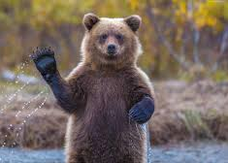
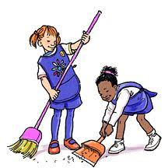
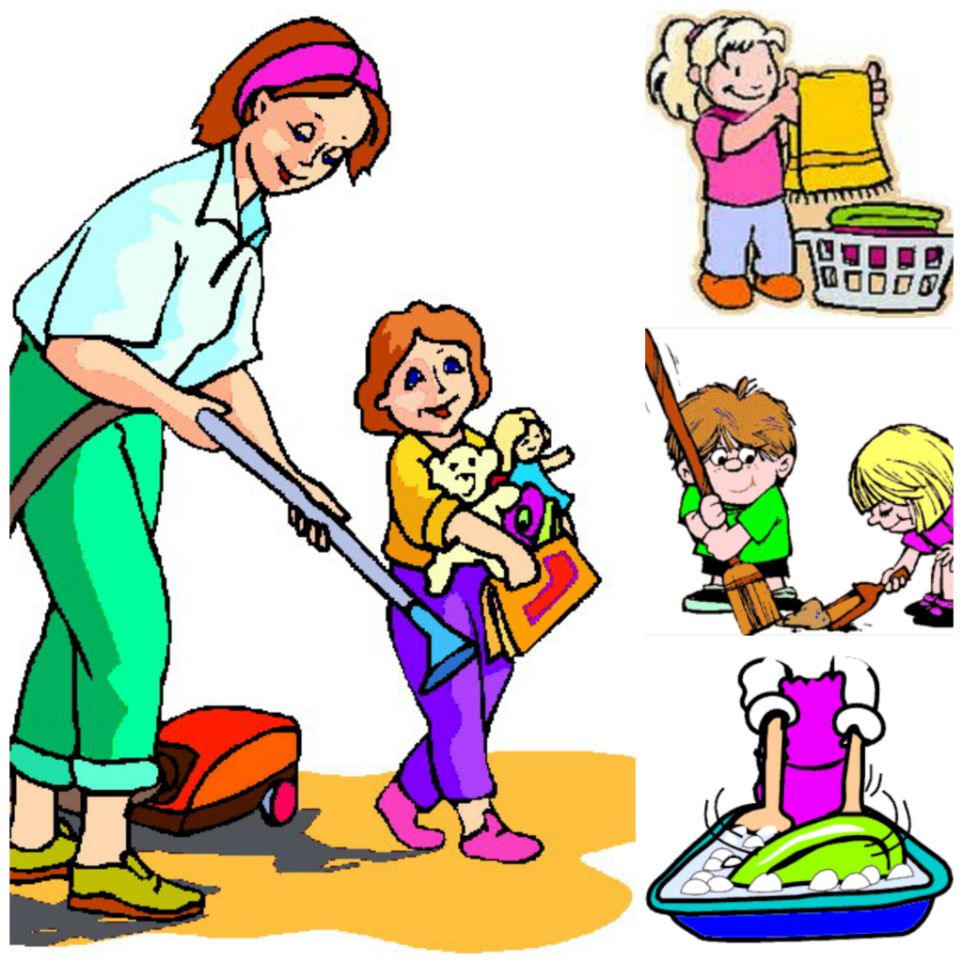
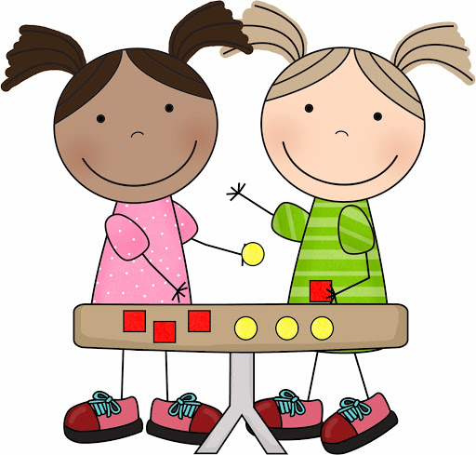

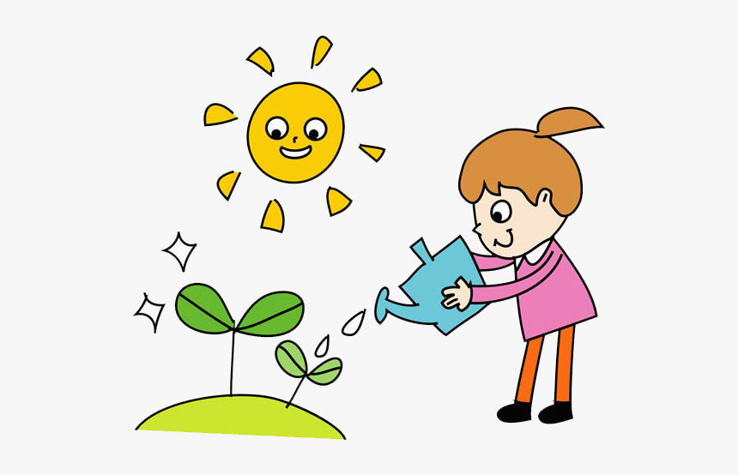
Helpful or Friendly?
Hello!
Go Team!
Notes:
SAY:
If you are able to stand up, we are going to play a game to figure out if a picture is helpful or friendly
helpful = wiggle. Can we try that right now? Show me your best wiggle! Great job!
friendly = wave your hands in in the air, lets try that too
Ready? First picture..
After the pictures run out, ask the girls if they want to give an example and we'll all act out if it's friendly or helpful

Slide 63
Girl Pledge
Capture ideas as girls unmute and share:
Notes:
SAY:
Think of some ways you can be friendly or helpful like Sunny or in your own way this week. We will be making a pledge to do something this week that is friendly and helpful.
(Give a personal example if you can.) Here is an example: "If it were me, the way I could be friendly and helpful would be by helping my family with dishes this week and always saying good morning"
What are some things that we could pledge to do as a group to be friendly or helpful this week?
These are great! Let's vote on our favorite way we can help as a group!
This could be a great opportunity to stop "presenting" the slideshow and type the girls' suggestions straight onto this slide (while still "screen sharing" so girls can see their ideas listed)
Write down some of the girls' suggestions so they can vote at the end of the meeting. You could do this via a Zoom poll or just asking girls to raise their hands for each option.

Slide 64
Let’s Vote!
1
Example: Pick Up Toys
What should we all pledge to do as a troop this week to be Friendly and Helpful?
2
Example: Give 5 compliments
3
Enter idea here
Notes:
Either type the options the girls came up with in the text boxes and drag them onto the slide, or make a Zoom poll and type in the question and the choices and then select "Launch Poll" See Slide with Zoom instructions for more details.
If the girls can't all read yet, we recommend doing the vote verbally.

Slide 65
Practice being friendly and helpful
write a card
for your:
mail carrier
UPS/FedEx/Amazon driver
grocery delivery person
Neighbor
Grandparent, Aunt, Uncle, Cousin
Who else helps you who is not your Mom, Dad, brother, or sister?
Notes:
SAY:
Sometimes, it can be hard to be friendly and helpful when we aren't allowed to see lots of other people like we normally would. Who are some people who come to your house to help you?
Ask them if any of the people on the slide come to their house and help them.
SAY:
What could we do (while social distancing) to be friendly to the helpful people in our lives? Would it be nice to make them a card or draw them a picture to thank them? Do you like it when someone makes you a card or a picture? I know, I do! Lets all get our papers and coloring supplies and start making a card or a picture for someone who helps you. Who already knows who they will make a card for?
Allow for girls to start working on their cards during the meeting and remind them to complete the card and give it to who it was intended for.

Slide 66
Be Prepared for Next Meeting:
Daisy Challenge! Girl Pledge
Send thank you card
3. Bring supplies:
  Print and bring Daisy Uniform Coloring Sheet
  Paper
  Markers, crayons, or colored pencils
4. Don't forget your Kaper!
Notes:
Remind them of the Girl Pledge and to finish and send their thank you cards. Answer any questions about kapers.

Slide 67
Parent chat!
Notes:
At the end of every meeting, bring the adults over and clue them in and get them involved:
"I'll send you the follow up email. Who can help me at the next meeting and be present so that we have enough adults?"
Suggestions of what you can ask them to help specifically with an activity:
"Next week we are working on a mural, can anyone help out with that?"
"Next week we are going to read a story for a petal, whose name can I put down for helping with the story?"
"Who can help out when the girls do a craft?"
"Who is good at singing and would like to lead a song?"
Plan out the help you will need for the four meetings. Use a sign-up genius to get parents to sign up for specific duties.
Suggestions of what you can discuss with parents:
Make sure everyone has your phone and email, knows the troop number, and has all the information about the next troop meting (date, time, location and any supplies the girls will need to bring).
Make Her Experience Memorable (a resource for parents on how they can help): https://my.girlscouts.org/content/dam-resources2/girlscouts-vtkcontent/Parent-Hub/02_MV_VTKMake%20HerExperienceMemorable_flyer_8.5x11.pdf
More Parent Meeting Resources:
See Daisy Intro Meeting in Volunteer Toolkit for more guidance : http://vtkdemo.girlscouts.org/content/girlscouts-vtk/en/vtk.details.html?elem=189320400000
Another great resource: "Getting Adults to Help" training in our volunteer eLearning portal: https://training.gsnorcal.org/login/index.php To find it, under Troop Leaders, click on Daisy Leader (Grades K-1). Then click "New troop Leader Course (Part 1 & Part 2). Then scroll to Part 1: Troop Basics and select "Getting Adults to Help (Avg. 20 Min.) or scroll down further to "Meeting with Parents (Avg. 5 Min.)"

Slide 68
Friendship Circle and Goodbye
Notes:
Have girls cross arms right over left. They can hold hands with another person in their house if available. Tell girls to close their eyes and make a wish. Show girls how to "spin out" of the circle.
SAY:
Good job! Bye Daisies see you next week!

Slide 69
Dear Daisies...
Notes:
(hide this slide)
Send Follow-up Email within 24 hours of the meeting: (edit underlined text accordingly)
Dear Daisies,
You did a great job at our Daisy Meeting! Today, we worked on earning our Friendly and Helpful Petal by playing a fun game with body motions. We also voted this week to do a Daisy Pledge together to practice being friendly and helpful by (write what the girls voted on for their pledge). Remember, before next meeting, your challenge is to write a card or draw a picture to thank someone who helps you!
Supplies to bring to next meeting are:
Colored markers or crayons or colored pencils
Paper
Daisy Uniform Coloring Sheet (attached to email or link here)
Also, do you remember what your Kaper (job) is for our next meeting? Be ready at the next meeting to do your Kaper! Below is a list of who is doing which Kaper at the next meeting and what that job means:
(girl's name): (kaper)
(girl's name): (kaper)
(girl's name): (kaper)
(girl's name): (kaper)
(girl's name): (kaper)
(girl's name): (kaper)
Kaper Descriptions: (delete ones you are not using)
Promise Leader: Leads the group is saying the GS Promise. The girl starts the Promise "On my honor.." and the rest of the girls join in.
Reporter: Reports back to the group a summary of what we did at the previous meeting.
Clean up Captain: After snack or craft, leads the group and encourages them to clean up their surroundings. "A Girl Scout always leaves a place cleaner than she found it."
Supply Checker: Reminds other scouts of the supplies needed for that meeting in the beginning. Check to make sure everyone has everything they need and helps to come up with alternatives if missing supplies.
Song Leader: Starts the song for the group or leads the song in repeat after me.
Joke Teller: Brings 1 or 2 jokes to the meeting to share with the troop
Friendship Squeeze Starter: Once girls cross their arms, she tells the girls to close their eyes and make a wish and squeeze once.
I can't wait to see you again, Daisies! We will meet again at (Date and Time) and use this link: (Zoom link).
Send a reminder email the day before the meeting—send the same email but add this at the beginning:
Hi Daisies! This is a reminder that we are meeting with our Troop friends tomorrow at (time). Please let me know if you can't come to the meeting.
See you soon!

Slide 70
Daisy Meeting
Friendly and Helpful
Meeting 4
Notes:
Overview:
Friendly and Helpful -- Part 3: 35 minutes Celebration of badges earned!
Welcome: Sharing - 5 minutes
Kapers: 3 minutes (Reporter, Supply Checker, Joke Teller)
Opening: GS Promise, GS Law – 5 minutes (optional: Girl Scout Law song video)
Icebreaker: Wind Blows - 5 minutes
Discussion on badges earned - 5 minutes
Activity: Paper Daisy uniform – 5-10 minutes
Reflection on Badges – 3 minutes
Daisy Song – 2 minutes
Prep for Next Meeting, Friendship Circle – 5 minutes
Friendly and Helpful Petal:
Talk about "Sunny's Story"
Make a mural based on "Sunny's Story" with your Daisy friends
Practice being friendly and helpful
When you’ve earned your Sunny petal, you'll know how to be friendly and helpful, just like Sunny the Sunflower.
If you don’t’ have the Flower stories, you can learn about being friendly and helpful in other ways.

Slide 71
Sharing
Supplies:
  Print and bring Daisy Uniform Coloring Sheet
  Paper
  Markers, crayons, or colored pencils
Notes:
Let each girl share if she wants to. If you have a lot of girls and enough adults, you can split girls into Zoom breakout rooms
SAY:
If you aren't done, you can keep working on your mural and share in the next meeting!

Slide 72
Kaper Chart
Katara Waterbender
Supply
Checker
Junie B. Jones
Hermione Granger
Promise Leader
Song Leader
Kaper
Chart
Lucy Pevensie
Ramona Quimby
Clean up Captain
Matilda Wormwood
Katniss Everdeen
Friendship
Squeeze Starter
Joke
Teller
Dora Explora
Reporter
Dorothy Gale
Annie Warbucks
Notes:
Kaper Chart for Meeting 2:
(You can retype your troops' names into this slide or copy the text below to the notes of the Kaper Chart slide you have already edited.)
SAY:
Remember our Kaper Chart from last week? Today we will start our Kapers. Who remembers what Kaper means? That's right, it means job. When everyone helps out, all big tasks are made easier. Girl Scouts is all about being girl-led so by the time you are older, you will be leading this troop and these meetings all by yourselves! These are your roles for today's meeting, but we will rotate the roles each meeting so you will get a chance to do each Kaper.
Ask each of the girls if they are ready for their role today (tell them each what they will do and when). Ask the Supply Checker if anyone had all their supplies for today (and help her check with the other girls), and have the Reporter share from last meeting.
After this, have the Promise Leader start the Promise.
Possible jobs with descriptions:
Promise Leader: Leads the group is saying the GS Promise. The girl starts the Promise "On my honor.." and the rest of the girls join in.
Reporter: Reports back to the group a summary of what we did at the previous meeting.
Clean up Captain: After snack or craft, leads the group and encourages them to clean up their surroundings. "A Girl Scout always leaves a place clean than she found it"
Supply Checker: Reminds other scouts of the supplies needed for that meeting in the beginning. Check to make sure everyone has everything they need and helps to come up with alternatives if missing supplies.
Song Leader: Starts the song for the group or leads the song in repeat after me.
Joke Teller: Brings 1 or 2 jokes to the meeting to share with the troop
Friendship Squeeze Starter: Once girls are crossing their arms, she tells the girls to close their eyes and make a wish and squeeze once.
For next week, you can copy this slide and drag it down to near the beginning of next meeting. (Right click, select “Duplicate Slide”, then click and hold the new slide to drag it)

Slide 73
* You may replace 'God' with anything else you believe in. For e.g. Family
Notes:
Officially begin the meeting with an Opening Ceremony. This consists of the Girl Scout Promise and the option of adding the pledge of allegiance and/or Girl Scout Law.
Have girls unmute for the Girl Scout Promise. Can do "repeat after me" style for Girl Scout Law.
Your troop can have a girl lead the Opening Ceremony as a job (or kaper).
SAY:
Now everyone stand/sit up tall and make the Girl Scout sign, we are going to say the Girl Scout Promise.
Depending how well your girls know the promise you may choose to do "repeat after me" or all together.
Optional: You can take down the slideshow so the girls can all see each other better.
Link to Daisy Promise and Law worksheet in GS Volunteer Toolkit:
http://vtkdemo.girlscouts.org/content/dam/girlscouts-vtk/meeting-aids/Daisy-Promise-and-Law.pdf
Opening Ceremony: 2 minutes or less.

Slide 74
Ice Breaker: The Wind Blows
For someone whose name starts with letter ‘N’
For someone who has long hair
For someone who had ice-cream for lunch
For someone who went for a walk this week
For someone who is celebrating her birthday in June
For someone who is wearing a Daisy vest/ sash

Slide 75
Promise Center and Sunny Petal
- Learnt the Girl Scout Promise
- Worked on your mural
- Drew a card for a friend/ family/ neighbor/ first responder
- Decided on a 'Friendly' pledge

Slide 76

Steps we have finished so far….
Promise Center
Make a circle
Say the Promise
Talk about what the Promise means
Sunny Petal
Read Sunny's Story
Make a mural about Sunny story
Practice being friendly and helpful

Slide 77
Congratulations!
You earned your first petal! Friendly and Helpful!

Slide 78
Notes:
Show them the petal they earned and mention some of the others if you have time/ if girls ask.
Link to Your Daisy Petals and Leaves:
http://vtkdemo.girlscouts.org/content/dam/girlscouts-vtk/meeting-aids/Daisy-Petals.pdf

Slide 79
I know the Girl Scout Promise!
I'm friendly and helpful!

Slide 80
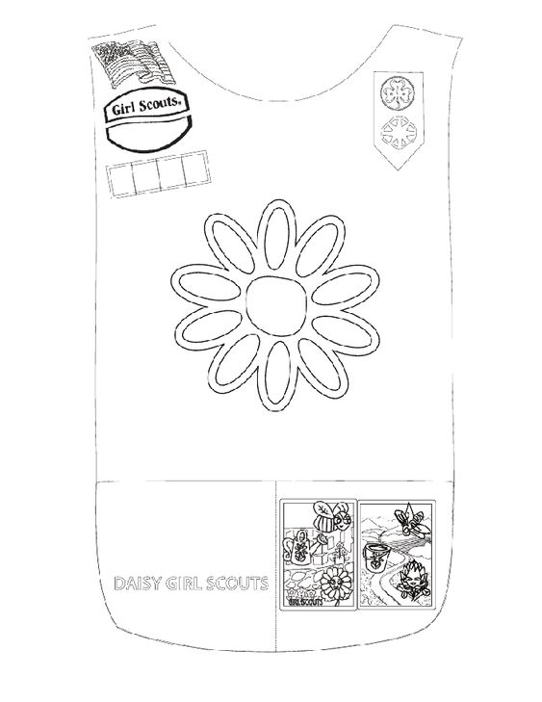
Daisy Uniforms! DIY
DIY means Do-It-Yourself.
We are making our own paper Girl Scout uniforms!
Notes:
Explain DIY.
Do-it-Yourself: Method of building or creating without help from experts. Lots of people do DIY projects at home by following tutorials on the internet or by following written instructions.
Explain that we might not all have our uniforms right away but we can find other ways to display our badges.
See if everyone printed out the Daisy uniform page (if not, ask for parent help to draw their own).
Ask them to color the background blue and color in ONLY the badges they have earned so far: Promise Center and Friendly and Helpful Petal (yellow)

Slide 81
What did you like most about the Friendly and Helpful Petal or the Promise Center?
Notes:
Have the girls each say something they liked doing to earn one of the badges.

Slide 82

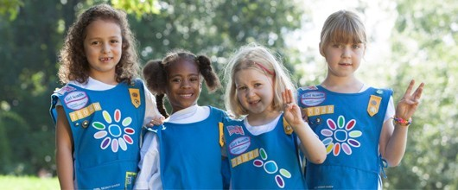
Closing Song
Make new friends
But keep the old
One is silver and the other's gold
A circle is round
It has no end
That's how long I want to be your friend
Notes:
If you have Song Leader as a Kaper, she can help start the song.

Slide 83
Parent chat!
Notes:
At the end of every meeting, bring the adults over and clue them in and get them involved:
"I'll send you the follow up email. Who can help me at the next meeting and be present so that we have enough adults?"
Suggestions of what you can ask them to help specifically with an activity:
"Next week we are working on a mural, can anyone help out with that?"
"Next week we are going to read a story for a petal, whose name can I put down for helping with the story?"
"Who can help out when the girls do a craft?"
"Who is good at singing and would like to lead a song?"
Plan out the help you will need for the four meetings. Use a sign-up genius to get parents to sign up for specific duties.
Suggestions of what you can discuss with parents:
Make sure everyone has your phone and email, knows the troop number, and has all the information about the next troop meting (date, time, location and any supplies the girls will need to bring).
Make Her Experience Memorable (a resource for parents on how they can help): https://my.girlscouts.org/content/dam-resources2/girlscouts-vtkcontent/Parent-Hub/02_MV_VTKMake%20HerExperienceMemorable_flyer_8.5x11.pdf
More Parent Meeting Resources:
See Daisy Intro Meeting in Volunteer Toolkit for more guidance : http://vtkdemo.girlscouts.org/content/girlscouts-vtk/en/vtk.details.html?elem=189320400000
Another great resource: "Getting Adults to Help" training in our volunteer eLearning portal: https://training.gsnorcal.org/login/index.php To find it, under Troop Leaders, click on Daisy Leader (Grades K-1). Then click "New troop Leader Course (Part 1 & Part 2). Then scroll to Part 1: Troop Basics and select "Getting Adults to Help (Avg. 20 Min.) or scroll down further to "Meeting with Parents (Avg. 5 Min.)"

Slide 84
Friendship Circle and Goodbye
Notes:
Have girls cross arms right over left. They can hold hands with another person in their house if available. Tell girls to close their eyes and make a wish. Show girls how to "spin out" of the circle.
Have the Friendship Squeeze Starter lead the squeeze.
SAY:
Good job! Bye, Daisies. See you next week!

Slide 85
Dear Daisies...
Notes:
(hide this slide)
Send Follow-up Email within 24 hours of the meeting: (edit underlined text accordingly)
Dear Daisies,
You did a great job at our Daisy Meeting! Today, we finished our Friendly and Helpful Petal. We also made a paper uniform to see what badges we've earned so far! To earn the Promise Center and the Friendly and Helpful Petal, you:
- learned the Girl Scout Promise
- worked on your mural about Sunny's story
- drew a card for a friend/ family/ neighbor/first responder
- decided on a 'Friendly' pledge
You girls should be so proud. You did such an amazing job!
Also, do you remember what your Kaper (job) is for our next meeting? Be ready next meeting to do your Kaper! Below is a list of who is doing which Kaper next meeting and what that job means:
(girl's name): (kaper)
(girl's name): (kaper)
(girl's name): (kaper)
(girl's name): (kaper)
(girl's name): (kaper)
(girl's name): (kaper)
Kaper Descriptions: (delete ones you are not using)
Promise Leader: Leads the group is saying the GS Promise. The girl starts the Promise "On my honor.." and the rest of the girls join in.
Reporter: Reports back to the group a summary of what we did at the previous meeting.
Clean up Captain: After snack or craft, leads the group and encourages them to clean up their surroundings. "A Girl Scout always leaves a place cleaner than she found it."
Supply Checker: Reminds other scouts of the supplies needed for that meeting in the beginning. Check to make sure everyone has everything they need and helps to come up with alternatives if missing supplies.
Song Leader: Starts the song for the group or leads the song in repeat after me.
Joke Teller: Brings 1 or 2 jokes to the meeting to share with the troop
Friendship Squeeze Starter: Once girls are crossing their arms, she tells the girls to close their eyes and make a wish and squeeze once.
I can't wait to see you again Daisies! We will meet again at (Date and Time) and use this link: (Zoom link).
Send a reminder email the day before the meeting—send the same email but add this at the beginning:
Hi Daisies! This is a reminder that we are meeting with our Daisy friends tomorrow at (time). Please let me know if you can't come to the meeting.
See you soon!

